Slide 1
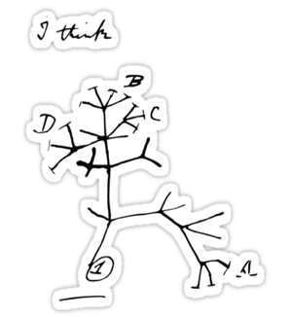
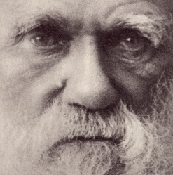
Seminar(i)
Deceit and self-deception
Robert Trivers
http://roberttrivers.com
Deception is everywhere in nature. And nowhere more so than in our own species. We humans are especially good at telling others less - or more - than the truth. Why, however, would organisms both seek out information and then act to destroy it? In short, why practice self-deception? We deceive ourselves the better to deceive others, and thereby reap the advantages. But can we correct our own biases? Are we doomed to indulge in fantasies, inflate our egos, and show off? Is it even a good idea to battle self-deception?
WHERE?
WHEN?
Conference room Parc Científic
(first floor, Institutes building)
Friday 1/12/2017 - 12:30 h
Col·laboren:

