Slide 1
Institut für Soziologie
Do ‘birds of a feather’ stay together? Intracouple similarity of lifestyles and marital stability
Oliver Arránz Becker & Daniel Lois
Chemnitz University of Technology, Germany

Slide 2
I. Theoretical background

Slide 3
The Attainment of Homogamy
Considerable degree of couple similarity concerning a variety of characteristics
e.g., education, intelligence, BMI, attitudes
Three origins of homogamy:
Mating process
Selection: „weeding out“ of incompatible couples
Alignment/convergence: Process of becoming more similar over time

Slide 4
Consequences of Homogamy: Selection Processes
theoretical arguments from various approaches support the notion of a stabilizing impact of homogamy and alignment:
Exchange theory: Rewards from similarity increase relationship satisfaction which has a stabilizing impact
Interactionism: shared worldview facilitates interaction and reinstates one‘s own worldview (fulfilling needs of social approval)
New home economics: alignment as an investment

Slide 5
Theoretical Rationale for the Study of Lifestyles
differentiation of social classes within modern societies
potentially increasing importance of lifestyles as an action-theoretical complement to vertical stratification criteria (Schulze 1992)
leisure-related lifestyles:
leisure time subject to deliberate choice → significant changes across time expected
high potential for producing affect within close relationships

Slide 6
Hypotheses
Lifestyle homogamy lowers the risk of marital dissolution (selection hypothesis).
Convergence of lifestyles, beyond initial similarity, contributes to lowering the risk of marital separation (resilience hypothesis).
Alignment of lifestyles varies over the life course, according to time restrictions and demands in competing life domains (life course hypothesis).

Slide 7
II. Method
Sample, analytical approach

Slide 8
Data Base
SOEP, waves O (1998) – Y (2008)
household sample → fully longitudinal dyadic design
sample: married and unmarried cohabitors without previous marriage
analytical approach: discrete-time event history analysis (Willett & Singer 1993)
time-varying and time-independent covariates
controls: basic sociodemographic variables, including age and educational homogamy

Slide 9
Two Leisure-related Lifestyles
factor analyses yield two distinct clusters of leisure behaviors (frequency assessments):
Highbrow scheme: Preference for contemplative activities such as attending museums, theater, listening to classical music (5 items covering 7 activities)
dependent upon education
Action scheme: Preference for physically arousing and exciting activities such as going to discotheques, cinema, going out for food and drinks, working out (4 items covering 12 activities)
negative association with age
Satisfactory loadings and internal consistency

Slide 10
Data Structure
Convergence: change of intracouple discrepancy (t1-t2)
Homogamy (t1): Absolute intracouple discrepancy
Homogamy (t2): Absolute intracouple discrepancy
Period of observation for n=88 union dissolutions (convergence analyses)
lifestyles (1. measurement)
lifestyles (2. measurement)
1998
1999
2000
2001
2002
2003
2004
2005
2006
2007
2008
Period of observation for n=183 union dissolutions
(analyses on homogamy)

Slide 11
Sample: Descriptives
 | M | SD | T | Range
Sample characteristics at first wave (1998)
Marriage | .91 |  |  | 0 – 1
Marital duration | 20.93 | 14.38 |  | 0 – 66
Child under 3 years in household | .12 |  |  | 0 – 1
Years of education (woman) | 10.7 | 2.75 | 6.35** | 8 − 18
Years of education (men) | 11.4 | 3.12 |  | 8 − 18
Life course events between 1999 and 2003 | n | %
Men enter work life | 141 | 4.8 |  | 0 – 1
Women enter work life | 253 | 8.5 |  | 0 – 1
Birth of a child | 307 | 10.3 |  | 0 – 1
Empty nest | 197 | 6.6 |  | 0 – 1
At least one partner retires | 152 | 5.1 |  | 0 – 1
Separations between 1999 and 2008 | 183 | 5.2 |  | 0 – 1

Slide 12
IV. Results

Slide 13
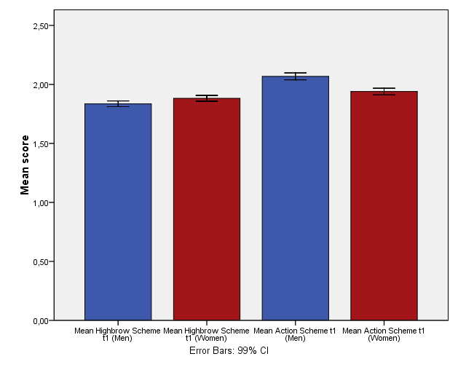
Lifestyles: Gender Differences

Slide 14
Homogamy (t1): Action Scheme

Slide 15
Homogamy (t1): Highbrow Scheme

Slide 16
Convergence (Action Scheme)

Slide 17
Convergence (Highbrow Scheme)

Slide 18
a) Effects of homogamy and convergence on marital stability

Slide 19
Impact of homogamy and convergence on union dissolution
 | model
 | 1 | 2 | 3
Couple mean | Logit coefficient (b)
Action scheme | 1.20** | .28⁺ | .21
Highbrow scheme | -.69** | -.13 | .14
Absolute intracouple difference
Action scheme | .39* | .61* | .49⁺
Highbrow scheme | .56* | -.13 | .98*
Action scheme * marriage | ‒ | -.63⁺ | ‒
Highbrow scheme * marriage | ‒ | .98* | ‒
Convergence (change of partner difference 1998-2003)
Action scheme | ‒ | ‒ | -.57*
Highbrow scheme | ‒ | ‒ | -.29
n (couples) | 3,490 |  | 2,962
Number of separations | 183 |  | 88
Pseudo-R² (Nagelkerke) | .03 | .20 | .14
Controls: Education and age (level and homogamy), months of fulltime employment per year, children up to age 3 living in the household, relationship type and duration

Slide 20
Homogamy: Action Scheme
a) nonmarital cohabitation
b) marital unions

Slide 21
Homogamy: Highbrow Scheme
a) nonmarital cohabitation
b) marital unions

Slide 22
Convergence (Action Scheme)
Relationship duration
(years)

Slide 23
b) Alignment across the life course

Slide 24
Alignment: Action scheme
Action scheme man (t1)
.56**
Action scheme man (t2)
.13**
.68**
.53**
.18**
Action scheme woman (t1)
Action scheme woman (t2)
.52**

Slide 25
Alignment: Highbrow scheme
Highbrow scheme man (t1)
.50**
Highbrow scheme man (t2)
.11**
.62**
.48**
.10**
Highbrow scheme woman (t1)
Highbrow scheme woman (t2)
.54**

Slide 26
Moderated Actor-Partner-Interdependence Model (APIM)
lifestyle feature man (t1)
lifestyle feature man (t2)
Transition (e.g., birth of a child)
lifestyle feature woman (t1)
lifestyle feature woman (t2)
15.10.2010
European Network for the Sociological and Demographic Studies of Divorce, Valencia
26

Slide 27
Alignment across the Life Course
general finding: reduced alignment during the family-work phase

Slide 28
Summary
Twofold impact of lifestyle homogamy on marital stability:
(time-varying) degree of lifestyle homogamy is negatively associated with union dissolution
marriage: highbrow scheme more important than action scheme
reduction of partner discrepancy (convergence) concerning the action scheme predicts relationship stability, beyond degree of initial similarity

Slide 29
Discussion
Variations of divorce risks across the life course partly due to differing degree of homogamy / alignment?
speculative origin of convergence: common fate, influence / compliance processes
no information about shared leisure time
homogamy: absence of a discrepancy between both partners‘ patterns of leisure behavior

Slide 30
If you want to learn the whole story…
Arránz Becker, O. & Lois, D. (2010). Selection, alignment, and their interplay: Origins of lifestyle homogamy in couple relationships.
Journal of Marriage and Family, 72, 1234-1248.
Thank you for your attention!
Contact: oliver.arranz-becker@soziologie.tu-chemnitz.de

Slide 31
Actor-Partner-Interdependence Model (APIM)
Residual: man‘s lifestyle (t2),
net of his previous lifestyle (t1)
lifestyle feature man (t1)
a1
lifestyle feature man (t2)
b1
c1
c2
b2
lifestyle feature woman (t1)
lifestyle feature woman (t2)
a2
Residual: woman‘s lifestyle,
net of man‘s lifestyle (t1)

