Slide 1
Theme 3. Group description
1. Introduction.
2. Central tendency: mode, median, arithmetic mean and other measures. Definitions, calculations,
characteristics and criteria of use.
3. Variability: Range, Variance, Standard Deviation (sample and population) and other measures
(interquartile range, and coefficient of variation). Definitions, calculations, characteristics and criteria of
use.
4. Asymmetry: Definition, calculation and interpretation.
5. Kurtosis: Definition, calculation and interpretation.
6. Graphical representation: box plots and error bars.

Slide 2
Central Tendency
Measures of central tenden indicate a value representative of the bulk of the data:
Example: the data 4,7,5,6,5,4,5,5,5,6,5,4,4,
it is clear that (by eye) the center is around five, which could be taken as an index of central tendency.
We will see 3 most common indices central tendency (mode, mean and median) first. Then we will see other indices.

Slide 3
(Arithmetic) Mean
Formula:
It is simply adding all values, and then that amount is divided by the number of values.
If we have the data: 4,6,5,3,7
The mean is (4+6+5+3+7)/5=4
Note: You can use weighted means. Consider that there are 2 data, one (5) weighs 0'6 and the other (6) weighs 0.4. Then, the average will be (5 * 6 * 0.6 + 0.4) / (0.6 + 0.4) = 5'4

Slide 4
Properties of the mean
-The Sum of differences (all values) relative to the mean is always 0
-If we add a constant to each of the values, the new arithmetic average result will be the original more the constant.
If we multiply each value by a constant, the new arithmetic mean is the original mean multiplied by the constant.

Slide 5
Median
The median (MDN or Md) is defined as the “middle” value in a sortered data set.
For example, in the sequence (ordinate) 3,4,5,6,7,8,9
the median is 6
In the sequence (ordinate) 2,3,4,6,7,9
the median is 5 (the arithmetic mean between the two central values, observe that n is even, in the above example it was odd)

Slide 6
Properties of the median
It does not use all the elements
It can be calculated with ordinal data
It is less affected by atypical data than the arithmetic mean.

Slide 7
The mode
The Mode (Mo) is defined as that value of the variable corresponding to the higher frequency.
In the data set: 4,5,6,6,3,6,4,5 Mo = 6
properties:
--It's not necessarily unique (there may be several modes)
--It is possible to compute mode with a nominal scale
--Its calculation does not involve all elements

Slide 8
Which one shall we use?
Mode
Mean
Median

Slide 9
Resistence and robustness
Resistant statistics: Those who are not influenced (or only slightly) by small changes in the data.
Obviously, the average is not resistant to changes in statistical data, since it is influenced by each and every one of them.
The median, however, is a highly resistant index.

Slide 10
3. Variability
In the previous section we studied several measures (mean, median, etc.) central tendency. Clearly, to know how representative is the value of such a measure of central tendency, it is also necessary to have a measure of variability.
For example, someone may have an average of 5 with the following data (5, 4, 6, 5, 5) and another one having an average of 5 to data (10, 0, 5, 9, 1). Obviously the first subject shows less variability.

Slide 11
How can we measure the variability?
A first strategy would be to use the formula
But it is always zero
A second strategy is to use absolute values
But it is tricky to use absolute values…
What is left then? Employ the sum of squared differences .... It is the first step for the variance

Slide 12
Variance
Formula
As we will see in the second half (inferential statistics), the variance is a biased estimator of the population variance; therefore the use of "quasivariance" which is the same except that the variance is divided by n-1 is preferred; the quasivariance is an unbiased estimator of population variance:

Slide 13
Standard deviation
Fórmulae
An obvious advantage of the standard deviation of the variance is the standard deviation is given in the same units as the original data (in the variance units are squared).
NOTE: SPSS always offers the n-1 option (which is the usual one, as it is un unbiased estimator).

Slide 14
Properties of the variance and stand.dev.
Variance and SD are essentially positive values.
(Notice that the differences on the mean are squared)
2. Neither the variance or desv.típica are altered when we add a constant.
Then we know that

Slide 15
Then we know
This applies to the SD as well.

Slide 16
If each data point is multiplied by a constant, the new SD is the original SD multiplied by the absolute value of this constant, and new variance is the original multiplied by the square of that constant

Slide 17
Other measures of variability
1. Amplitude (or Range)
It is the difference between the extreme values
Its advantage is the simplicity of calculation; the only problem is that it is too sensitive to extreme values

Slide 18

Other measures of variability
2. Semi-interquartile range (Q)
JASP indicated the “interquartile range”, which is just Q3-Q1
It is based on the first and third quartile—it is a robust statistics
It may be used when the MEDIAN is the best option for central tendency, and it is relatively common (usuallly as “interquartile range”, a.k.a. IQR).
4. Variation Coefficient
Ratio scale
Indicates the number of times the deviation average contains mean: the higher the CV greater variability.
There are no units, so it allows the comparison between different variables.

Slide 19

Robust measures of variability
MAD (Median of Absolute Deviations)
The MAD is much more resistant to outliers than the standard deviation.
Example: 2,2,3,4,5,6,6 (Mean=4)
Absolute deviations: 2, 2, 1, 0, 1, 2, 2. ------ordered 0 1 1 2 2 2 2
MAD=2 (i.e., the median of the absolute deviations)
It is often multiplied by a scaling factor to provide (somewhat) similar estimations as the standard deviation—this may depend on the underlying distribution.
JASP provides this index (both without and with the correction).

Slide 20
4. Asymmetry
In the above two points we have seen measures of central tendency and variability.
While obtaining such measures is key to describe a sample and make inferences about the population of origin, it is also essential to know the form of a distribution to obtain an adequate characterization of the shape of the data distribution.

Slide 21
Asymmetry
While it is easy to have an idea of whether the distribution is symmetrical or not after seeing the graphical representation (e.g., a histogram or a box-and-whisker diagram), it is important to quantify the asymmetry of a distribution.
Recall that when data distribution is symmetric, the mean, median and mode match. (And the distribution is the same shape on the left and right of center)
While many psychological distributions is assumed that tend to be symmetrical and unimodal distribution in many cases we find it is asymmetric (e.g., distributions of reaction times on almost any task is positive asymmetric).

Slide 22
Positive asymmetry
Difficult test
Saleries
Response times
Moda
Media
Mediana
Negative asymmetry
Easy test
Media
Moda
Mediana

Slide 23
Index of asymmetry based on moments (SPSS)
It is based on the difference of the data on the mean and variance, although this time the coefficients rise are cubed
If the distribution is symmetrical As will be 0
If the distribution is positively skewed, As will be greater than 0
If the distribution is negatively skewed, As will be less than 0
Disadvantage: Very influenced by atypical-scores

Slide 24
Kurtosis
It refers to the shape of distribution in relation to a standard, which is the normal distribution.
This standard is the normal distribution: mesokurtic distribution.
If the distribution is more peaked than the normal distribution we have a leptokurtic distribution.
If the distribution is flatter than the normal distribution we have a platykurtic distribution.

Slide 25
Kurtosis
IMPORTANT: Kurtosis is independent of the variability (in the sense of "variance").
A leptokurtic distribution is higly peaked in the center (more than the normal distribution ), it decays very rapidly at first, but in the end is somewhat higher than the normal distribution.
That means a leptokurtic distribution is more likely to yield more extreme values than the normal distribution.

Slide 26
Example (Mesokurtic distribution-normal)

Slide 27
index of kurtosis
For a normal distribution (mesokurtic) we know that
And this will be the reference for the index that will employ kurtosis
If the distribution is normal (mesokurtic), the index is 0
If the distribution is leptokurtic, the index is greater than 0
If the distribution is platykurtic, the index is less than 0

Slide 28
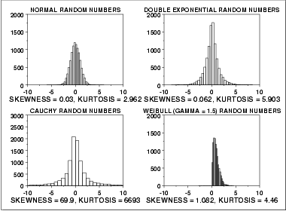
More examples

Slide 29
6. Exploring the central tendency, variability and asymmetry in a graph
While it is possible to use different graphics to assess the variability (and central tendency, asymmetry, etc.), it is interesting to use box and whisker diagrams .
The box is defined by the first quartile and third quartile, with the median within the box. This will be discussed in detail in practice.
Here goes an example from Ratcliff, Perea, Colangelo and Buchanan (2004, Brain & Cognition) (see next slide)

Slide 30
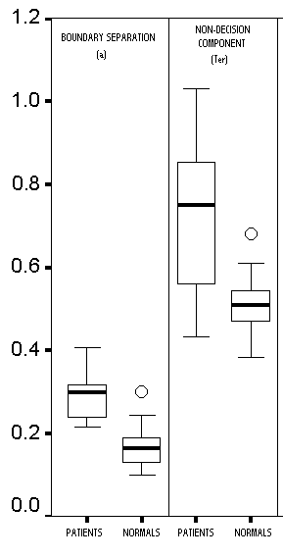
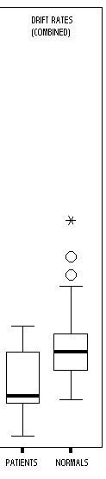
6. Viewing the trend, variability and asymmetry in a graph
The median is the thick line inside the boxes (between first and third quartiles).
"Atypical" scores are presented individually (see there are two types of outliers).
Notice that the controls are clearly different from patients in a "boundary separation" and the "non-decision component", while there is much more overlap in the "quality of information".

Slide 31
6. Viewing the trend, variability and asymmetry in a graph
In the case of "drift rate" (patients), the distance between P75 and P50 is much larger than the one between P50 and P25, thus suggesting that there are positive asymmetry.
P25 P50 P75
In the case of "non-decision component" (patients), the distance between P75 and P50 is much smaller than that between P50 and P25, suggesting that there is negative asymmetry.

