Slide 1
Ultrahigh-resolution spin-resolved ARPES of novel low-dimensional systems
WS10-ETLODs, Valencia-Spain
May 31, 2010
Seigo Souma
Collaborators:
A. Takayama, K. Sugawara, T. Sato, and T. Takahashi
Tohoku University
Notes:
First of all, I like to thank to the orgazizer…..
Today I talk about spin-resolved ARPES.
As talked by the last speaker in the previous session, angle-reolved ……
Recent progress in energy resolution of ARPES makes un opportunity to study the very fine electron structure near the Fermi level, which is directly connected to the physical properties.
However, if you want to detect electron spin direction, energy resolution is much lower, not much different from 20 years ago.
Recently we have constructed a new spin-resolved photoemission spectrometer with high energy resolution.

Slide 2
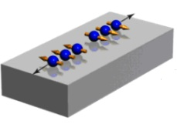
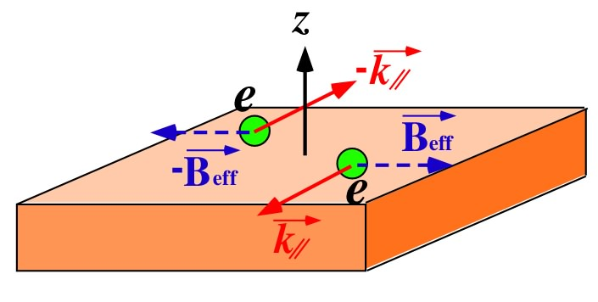

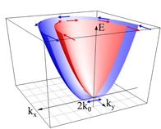
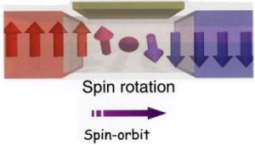
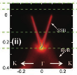
Anomalous electron spin phenomena
Rashba effect
Topological insulator
Spintronics
Spin-orbit interaction
Rashba term
Electronic-field induced spin-current
Bi₂Te₃
Spin switch via S.O. interaction
Y.L.Chen et al.,
Science 325 (2009) 178.
Edge state (surface state)
Time reversal invariant
E(k,↑) = E(-k,↓)
Spin dependence of electronic structure
High-resolution spin-resolved ARPES
Notes:
Recently, exotic phenomena caused by electron spin has attracted a lot of attention.
One famous phenomena is surface Rashba effect.
In 2D system, like a surface or interface, space inversion symmetry breaks, and only time reversion symmetry holds.
Such a special symmetry causes a interesting spin-splitting of energy band by a spin-orbit interaction.
In this case rashba term in spin-oribt interaction works as an effective magnetic field strongly depends on the electron momentum.
By using this peculiar spin structure, an exotic material, so-called topological insulator has been proposed and studied very intensively.
In topological insulator, mother material is bulk insulator, but surface states produced in the bulk band gap should be Rashbe-split state.
The reason why topological insulator attract a huge attention is that spin polarization can be controlled via external electron filed,
This is important technology to make an spintronics devise smaller and smaller.
In order to understand the mechanism of such a electron phenomena, experimental determination about how the electron spin behaves depending on the energy and momenutm, in other words, spin-dependence of electronic structure is very important.
In this purpose, we have developed high-resolution spin-resolved ARPES method.

Slide 3
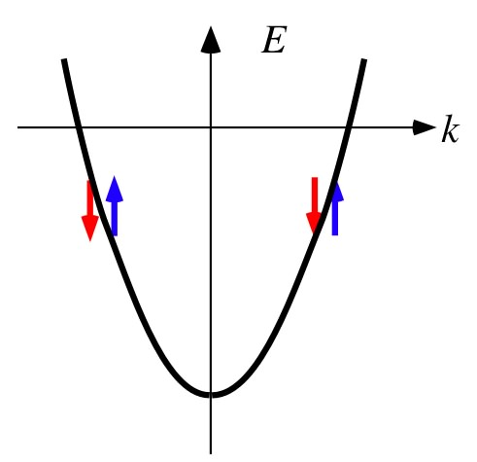
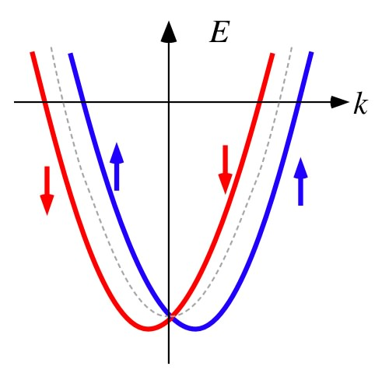
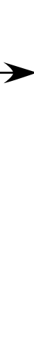
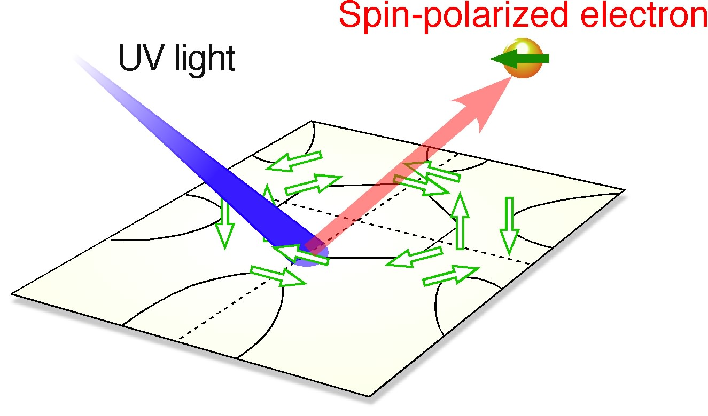
Spin-splitting of surface Rashba effect
Surface Rashba effect
Space inversion symmetry
E(k,↑) = E(-k,↑)
Time reversal symmetry
Spin-orbit interaction
E(k,↑) = E(-k,↓)
surface potential
∇V= (0, 0, E_{z})
Effective magnetic field
spin-resolved ARPES

Slide 4
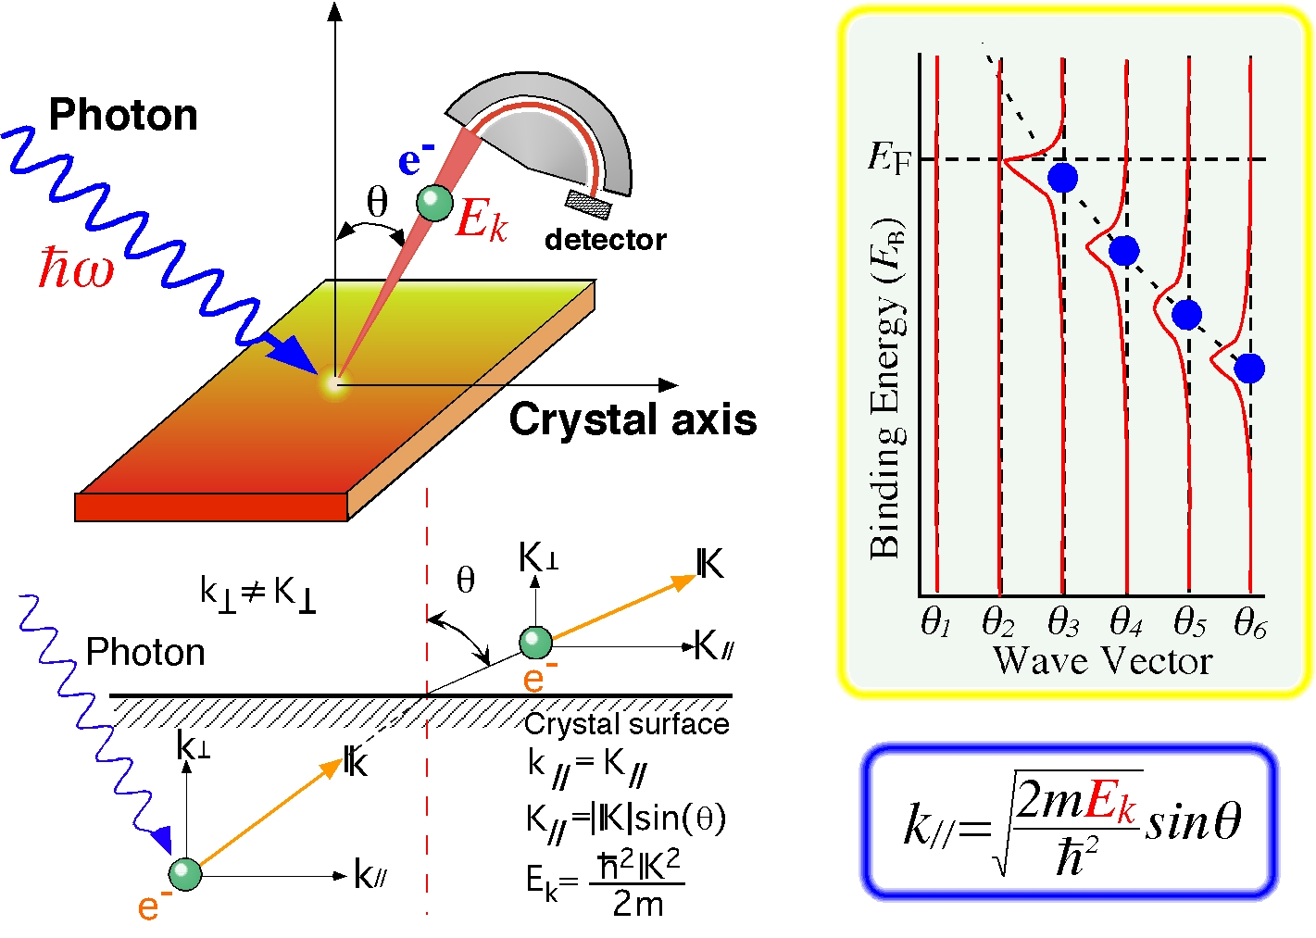
Angle-resolved PES (ARPES)
e⁻ freedom
Energy
Momentum
Notes:
…
In photoemission process, electron spin is also conserved, so basically you can determine the electron spin in solid by using proper dector at here.
But, the spin-resolved measurement is very difficult because the instrumental efficiency is quite low by 3-4 order.
In spin…, you have to sacrifice the energy resolution. In the conventional instrument, energy resolution is at most 100 meV,…

Slide 5
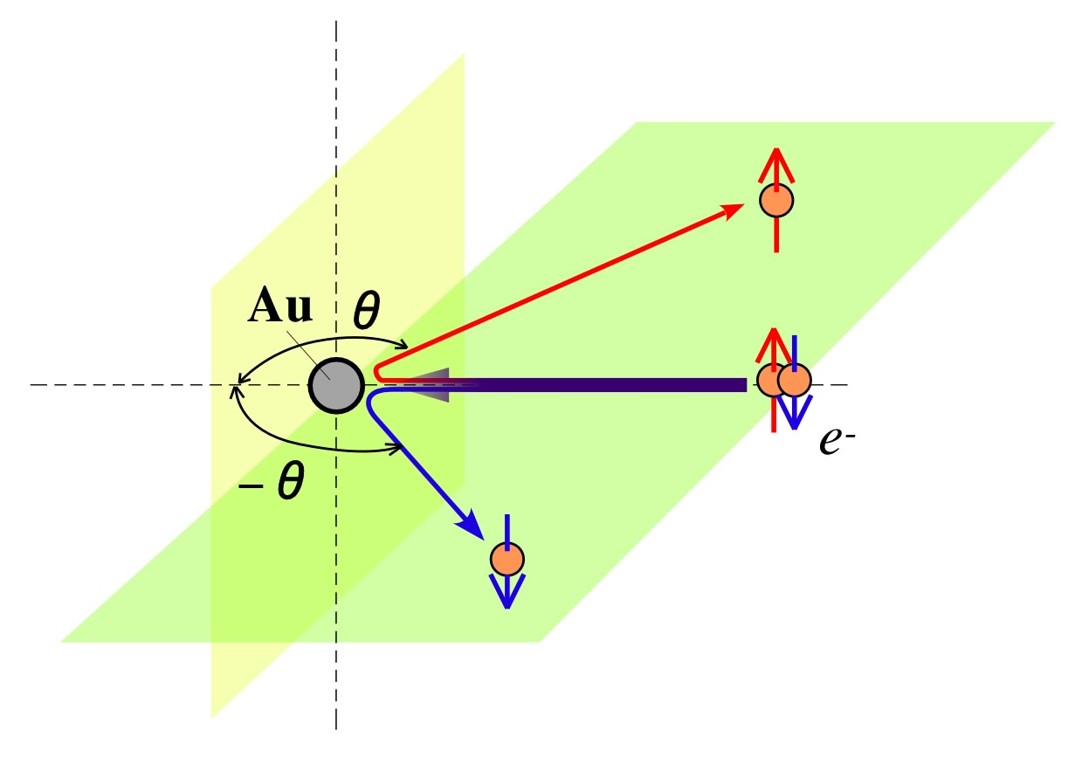
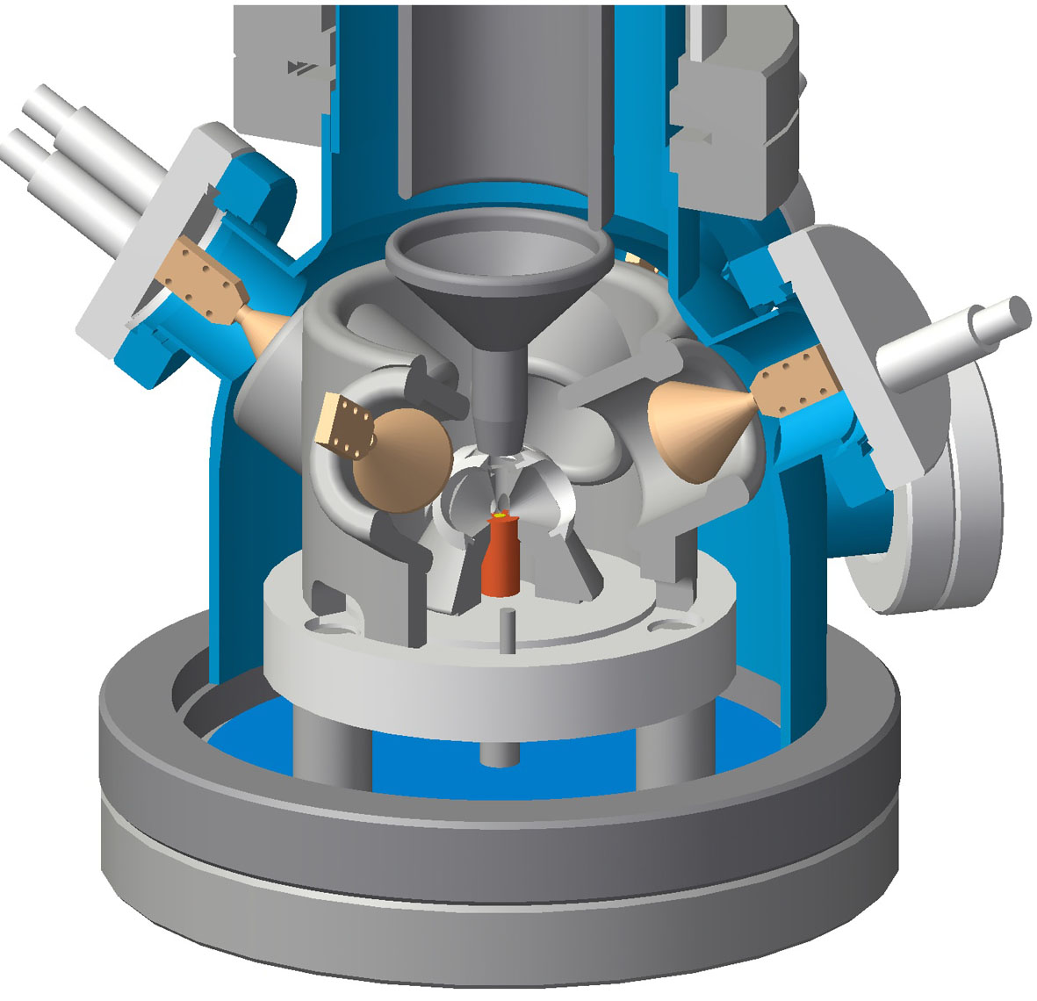
Spin-resolved ARPES
Mott scattering
Detection of electron spin is difficult !!
25 keV
e⁻ freedom
Mini Mott Detector
Energy
Momentum
Spin
Efficiency of instrument goes down by 3-4 order
Energy Resolution 100 meV

Slide 6
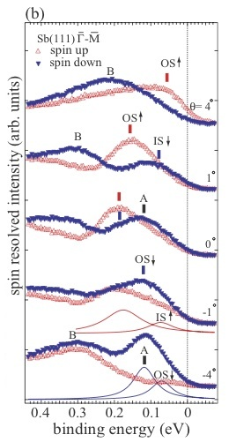
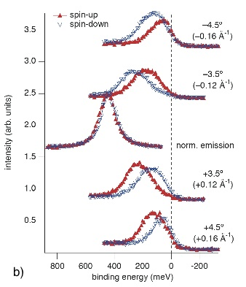
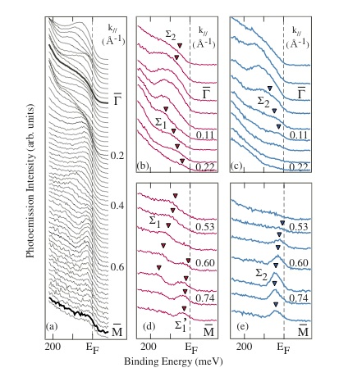
Recent spin-resolved ARPES studies
[1,2]
[4,5]
[7,8]
c
Mott detector
Mott detector
VLEED
(retarding-type)
(high-energy type)
(Fe(001)p(1x1)-O)
Mott scattering E_{K} = 25 keV
Mott scattering E_{K} = 60 keV
Electron diffraction E_{K} = 6 eV
Sb(111)
[3]
Au(111)
[6]
[9]
Bi_{1-x}Sb_{x}(x=0.13)
ΔE = 70 meV
ΔE = 70 meV
ΔE = 30 meV
[1] K. Iori et al., RSI 77 (2006) 013101.
[4] V. N. Petrov et al., RSI 68 (1997) 4385.
[7] R. Bertacco et al., RSI 73 (2002) 3867.
[2] S. Qiao et al., RSI 68 (1997) 4390.
[5] M. Hoesch et al., JESRP 124 (2002) 263.
[8] T. Okuda et al., RSI 79 (2008) 123117.
[3] T. Kadono et al., APL 93 (2008) 252107.
[6] M. Hoesch et al., PRB 69 (2004) 241401(R).
[9] A. Nishide et al., PRB 81 (2010) 041309(R).

Slide 7
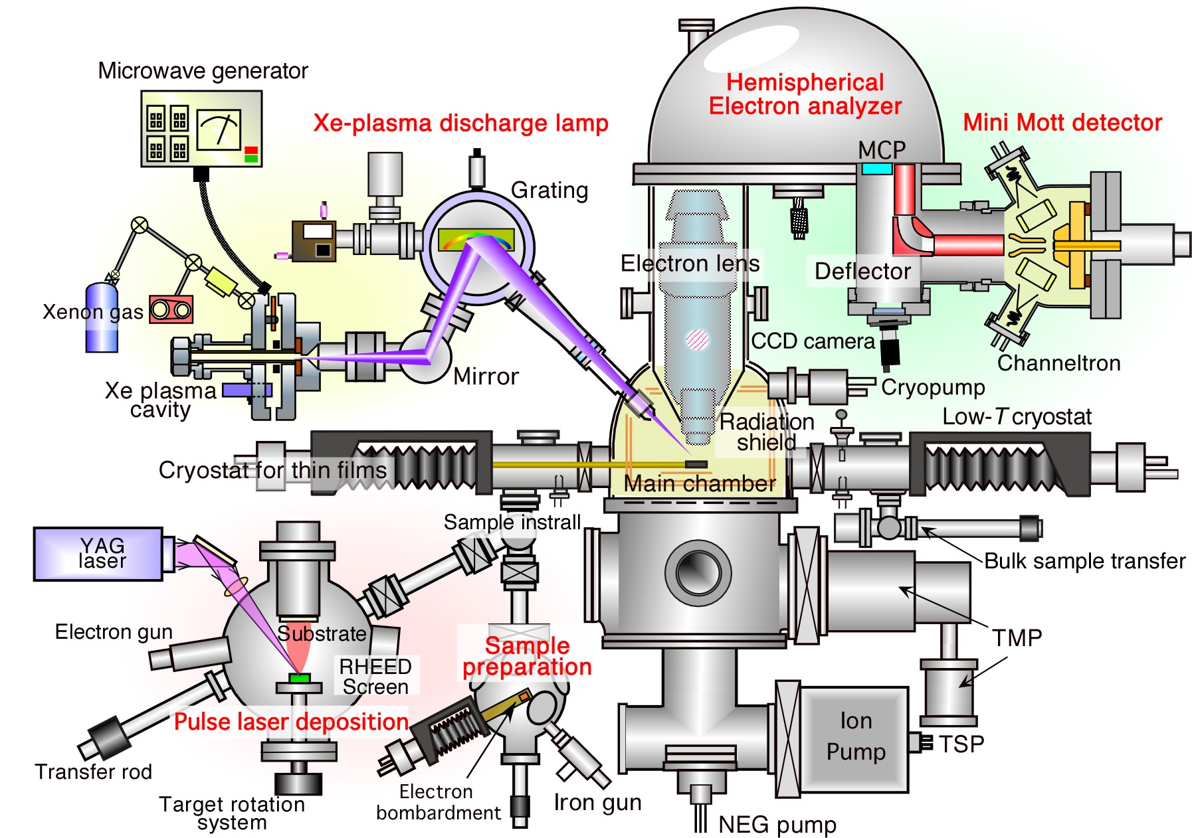
High-resolution spin-resolved photoemission spectrometer
Notes:
UHV condition.
For high-energy resolution , we increase the instrumental efficienvy as a whole of photoemission machine.
One point is a strong light source. We have developed the new discharge lamp, so called xe-plasma discharge lamp.
This new lamp compensate the low efficieny of spin detectore more or less.
We also applied large diameter ehemispherical electon analyser For high efficiency and high energy resolution,
Most important point is efficiency of spin detector itself.
To detect the electron spin polarization, we utilize well-kwon Mott scattering of the atomic target like gold.
Due to a spin-orbit interaction in the scattering process, the back scattering cross section of electron depends on the spin direction normal to the scatering plane.
From the difference in back scattering intensity, we can determine the spin of incoming electron.
This is more realistic picture of electron spin detector by Mott scattering, so-called Mott detector.

Slide 8
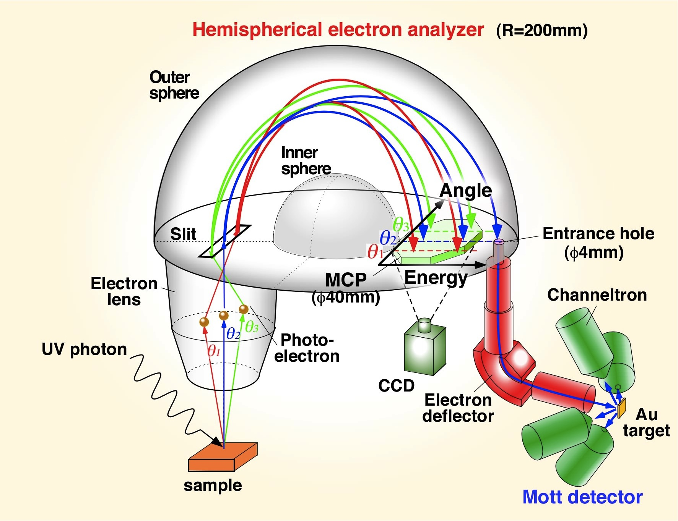
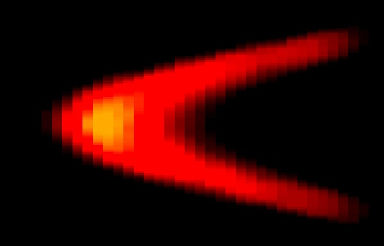
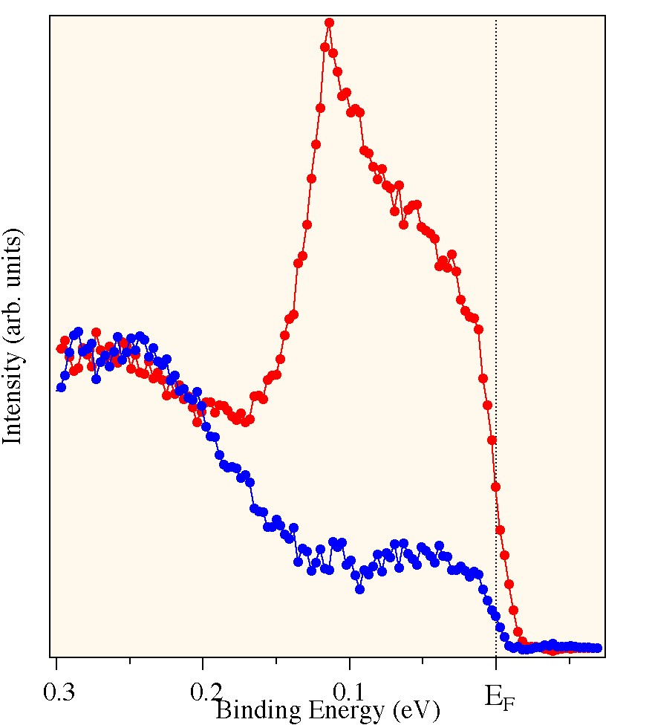
Spin-resolved ARPES system
Spin-integrate ARPES
Spin polarization
P_{z}
(A,B)
Angle
P_{y}
(C,D)
Energy
Spin-resolved ARPES
spin up
D
B
spin down
z
y
A
x
C
Notes:
We also

Slide 9
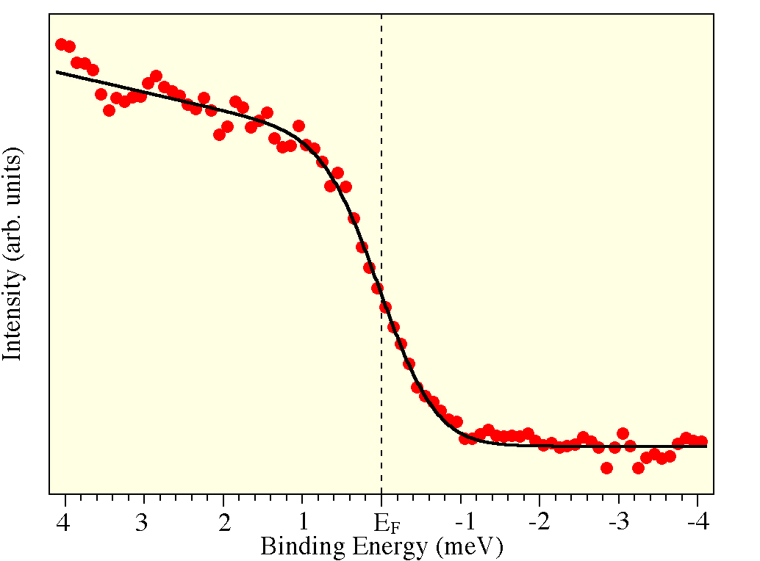
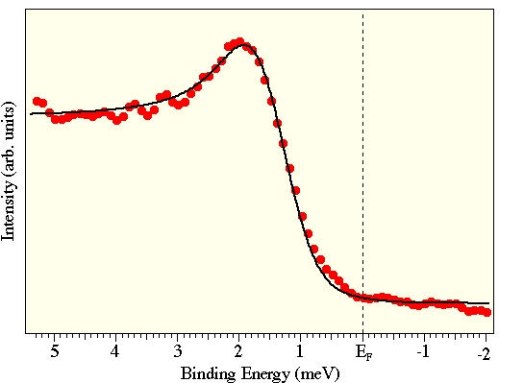
Energy resolution at MCP
metal
superconductor
Au
Nb
T = 3.5 K
Tc = 9.2 K
Xe I 8.437 eV
T = 3.5 K
simulation
Xe I 8.437 eV
simulation
BCS function
FD function
Gap size Δ = 1.5 meV
Broadening Γ = 200 μeV
Energy resolution at MCP
900 μeV

Slide 10
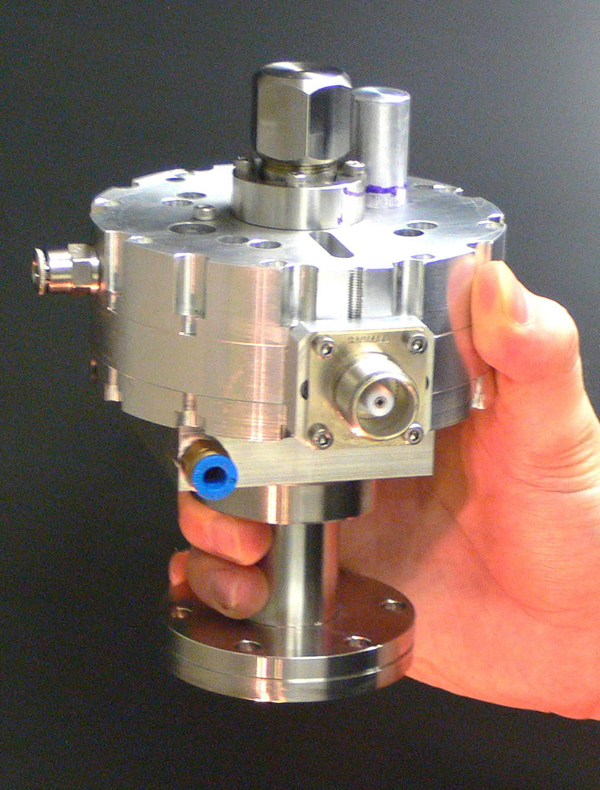
High-resolution spin-resolved photoemission spectrometer
Ep: pass energy
Energy resolution @ Mott
~ 0.008Ep eV
Xe I photons
8-11 eV
Intensity
2 x 10¹³ photons/sec
Operation pass energy Ep = 1,2,5 eV
Energy resolution @ Mott
= 8-40 meV
S. Souma et al., RSI 78 (2007) 123104.
Notes:
UHV condition.
For high-energy resolution , we increase the instrumental efficienvy as a whole of photoemission machine.
One point is a strong light source. We have developed the new discharge lamp, so called xe-plasma discharge lamp.
This new lamp compensate the low efficieny of spin detectore more or less.
We also applied large diameter ehemispherical electon analyser For high efficiency and high energy resolution,
Most important point is efficiency of spin detector itself.
To detect the electron spin polarization, we utilize well-kwon Mott scattering of the atomic target like gold.
Due to a spin-orbit interaction in the scattering process, the back scattering cross section of electron depends on the spin direction normal to the scatering plane.
From the difference in back scattering intensity, we can determine the spin of incoming electron.
This is more realistic picture of electron spin detector by Mott scattering, so-called Mott detector.

Slide 11
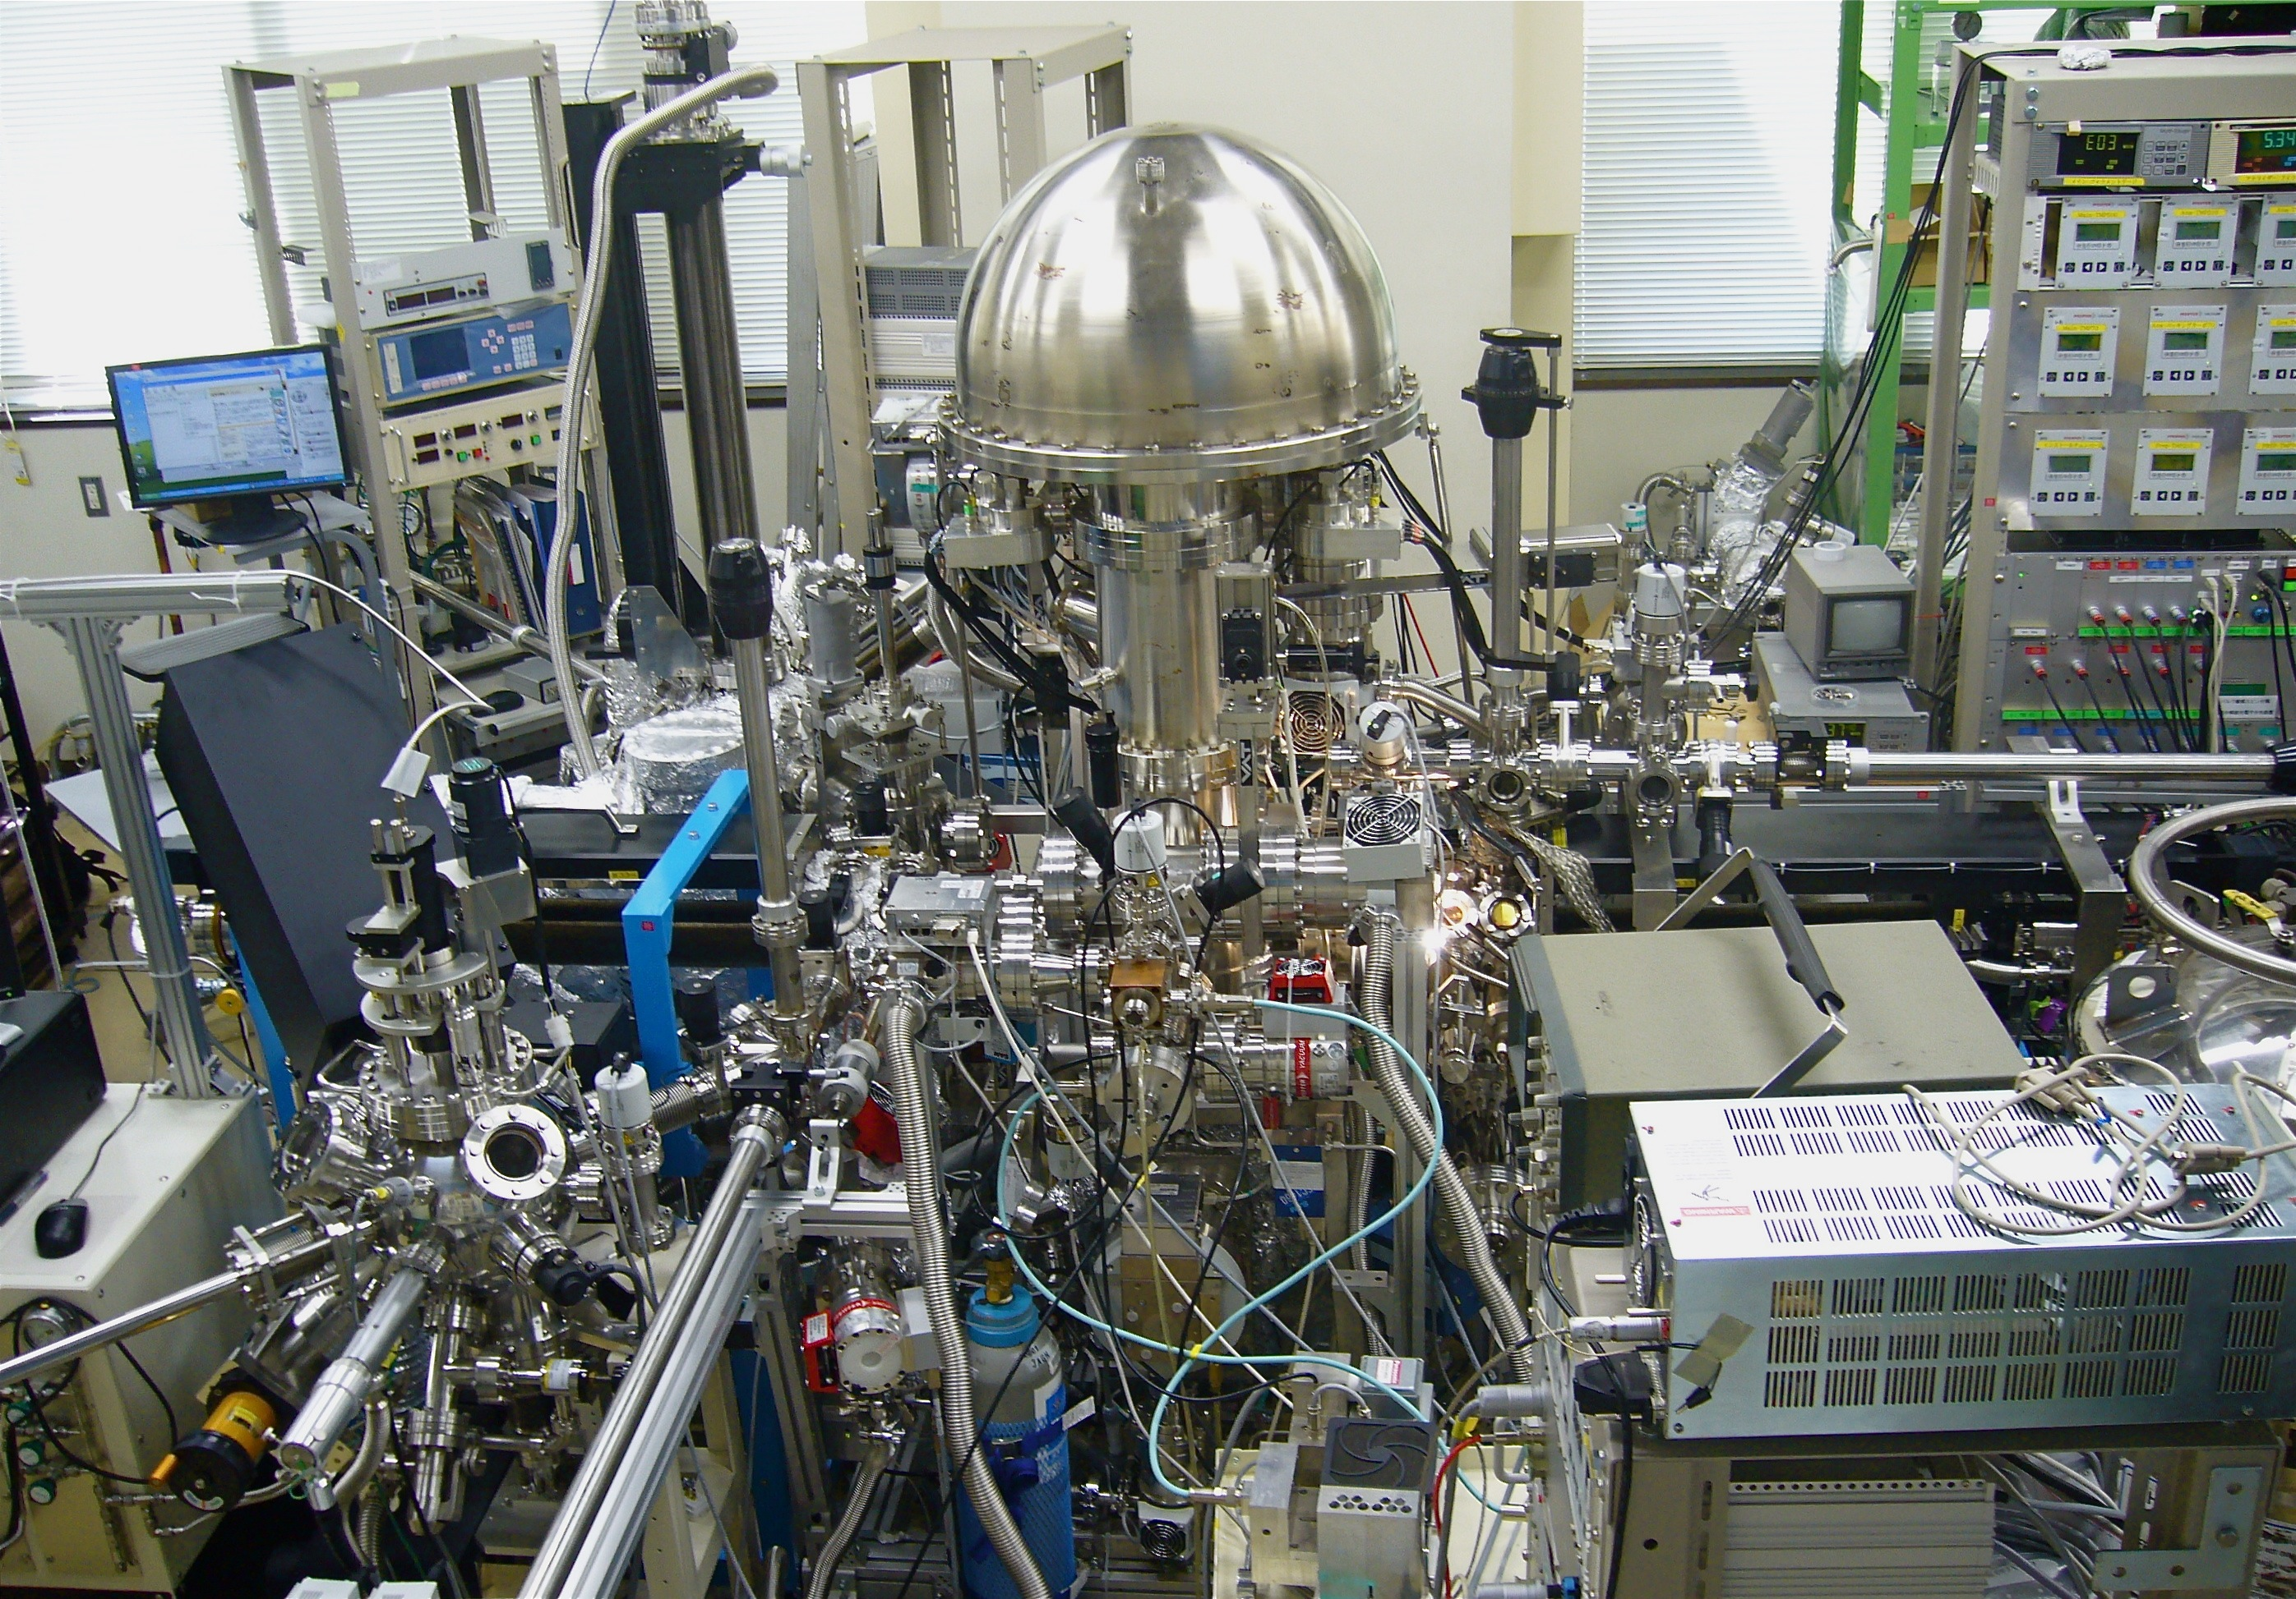
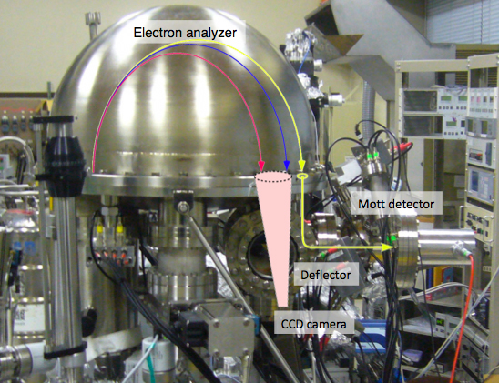
High-resolution spin-resolved photoemission spectrometer
Side view
Notes:
…
We achived energy resoltuion 8meV in Mott detector. This value is better by 1-2 order than the currently used spin-resolved photoemssion spectrometr.
By using this new instrument, we have studied the peculiar surfacte of group^V semimetals

Slide 12
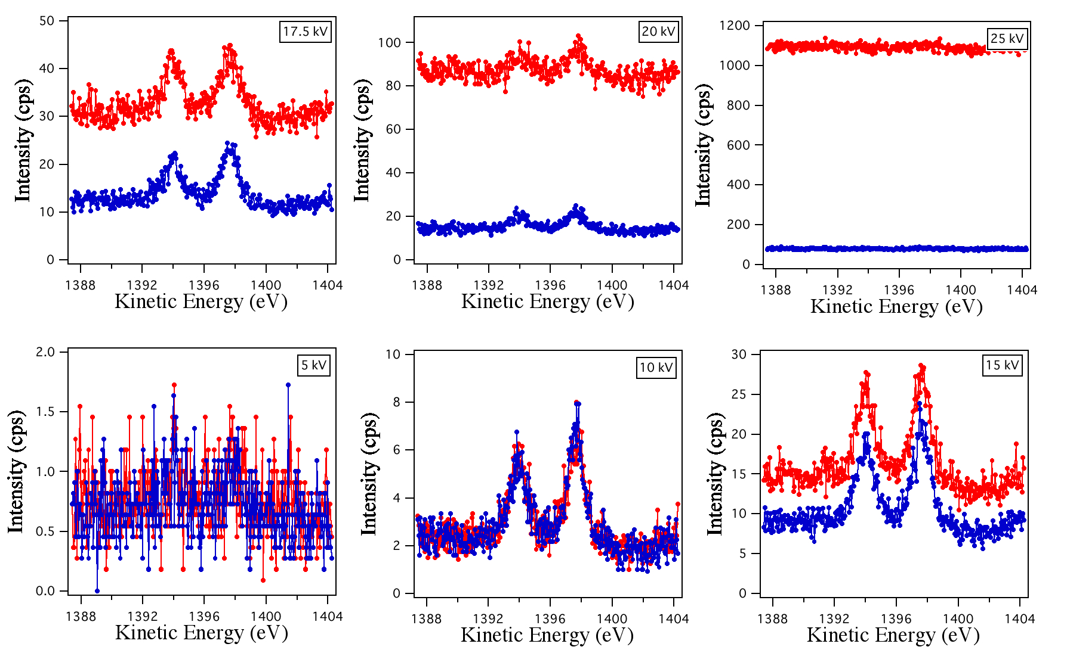
Discharge problem
Au4f
ch1
ch2
ch2
ch1

Slide 13
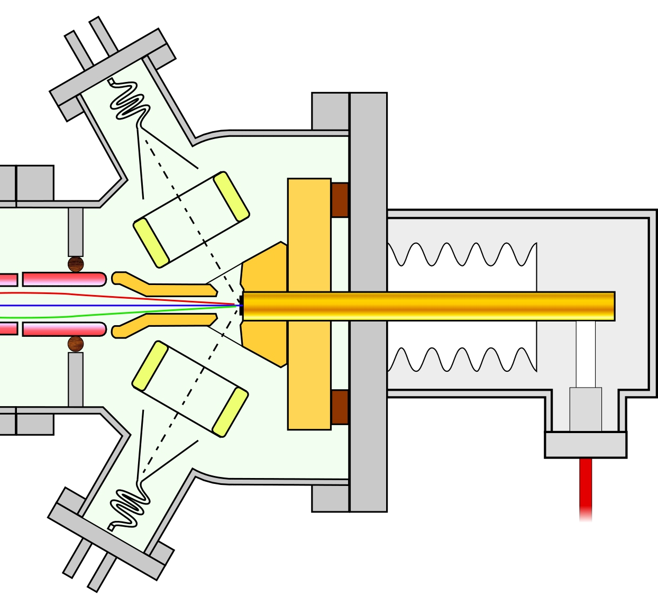
Solving for discharge of Mott detector
Spark
Roughness of surface
Focus cup
Au target
Field emission
Safety cover
BG noise depends on voltage difference between the electrodes
Feed through
－Solutions－
1. Re-polishing of high voltage electrodes
2. Coating of electrodes with TiC
3. Washing all parts
4. Baking
5. Conditioning of electrode’s surface by applying HV
To HV supply
Scattering chamber
Channeltron
Noise at channeltron
Scattering chamber
25000 V
100,000 cps
@18kV
0.1 cps
@25kV
Focus cup
2200 V
Channeltron
1300 V

Slide 14
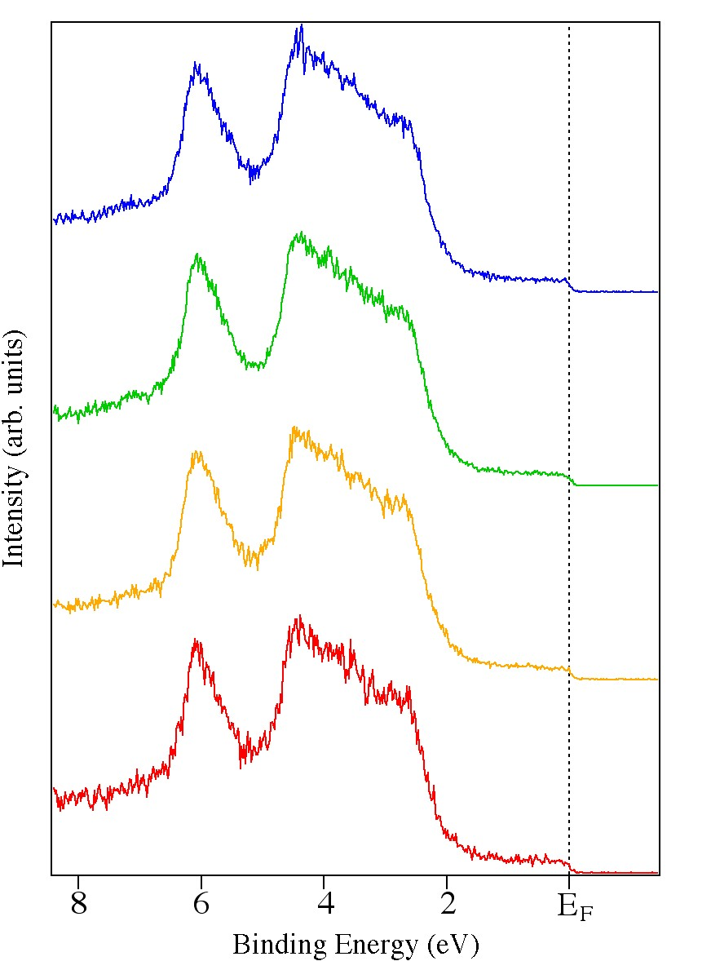
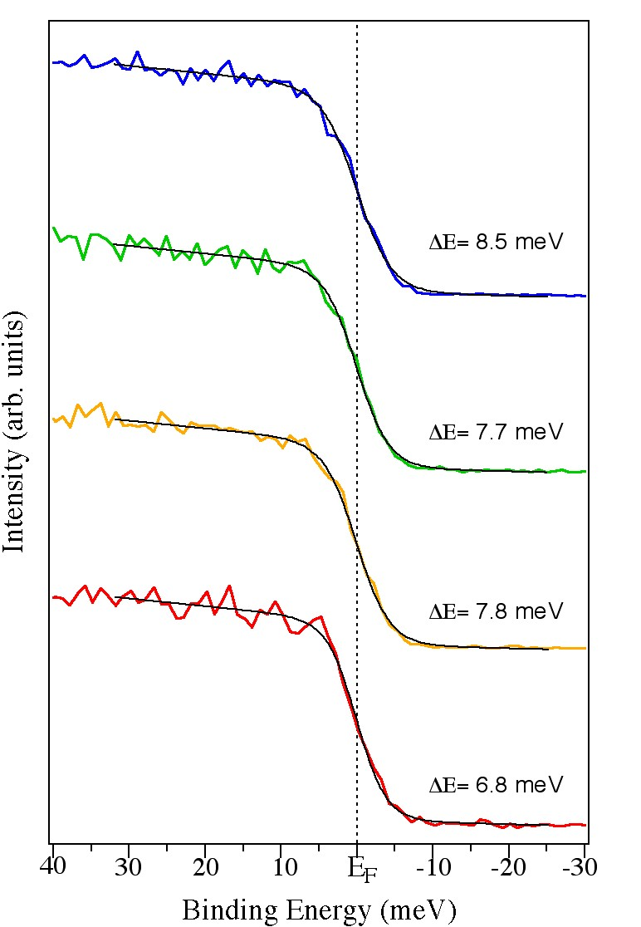
Test measurement with gold sample
Au
Au
He Iα
Ep 1eV
Ep 10eV
ch D
T=10K
T=300K
Xe I 8.437 eV
ch D
ch C
Energy resolution @ Mott
ch C
= 8 meV
ch B
ch B
ch A
ch A

Slide 15
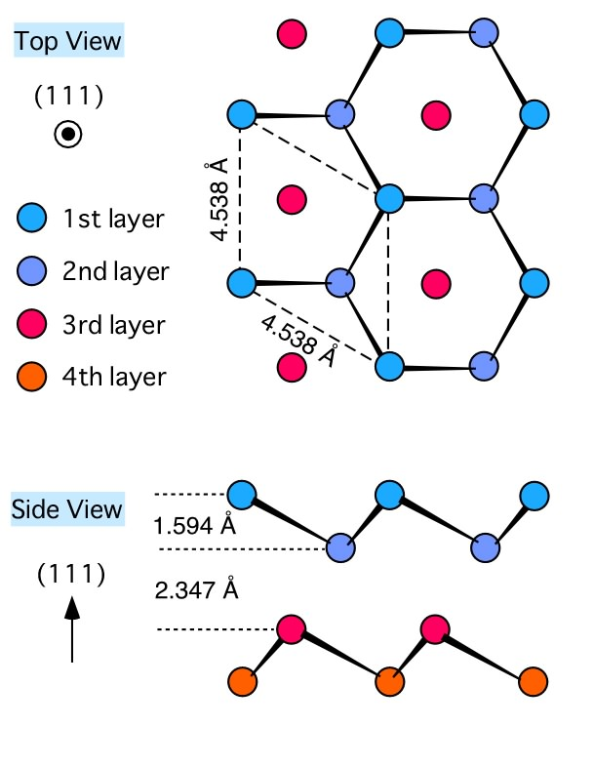
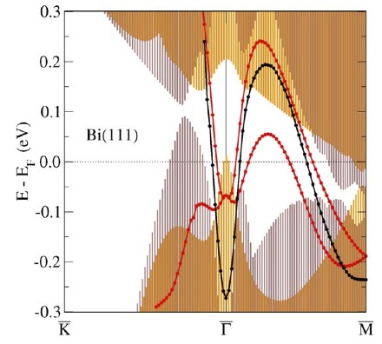
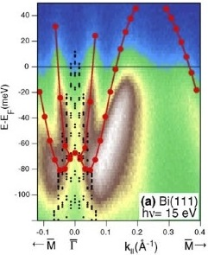
Peculiar surface states of group-V semimetals
bulk
Surface
Bi, Sb
semimetal
peculiar metal
Crystal structure of Bi
Surface Rashba effect
without S.O.
with S.O.
Yu. M. Koroteev et al.,
PRL 93 (2004) 046403.
Notes:
Bulk is semimetal.
On the other hand, surface band becomes metallic and shows many intersting properties.
In guranular particle of Bi, surperconducting transition is found. Since transision temperatur depends on absorbed spicies on surface, it is proposed that the surface stare it metal and shos super .. Transition.
Actually calculation shows mtallic band on surface state.
…
With spin-orbit interactionm surface band is split in the complicated way.

Slide 16
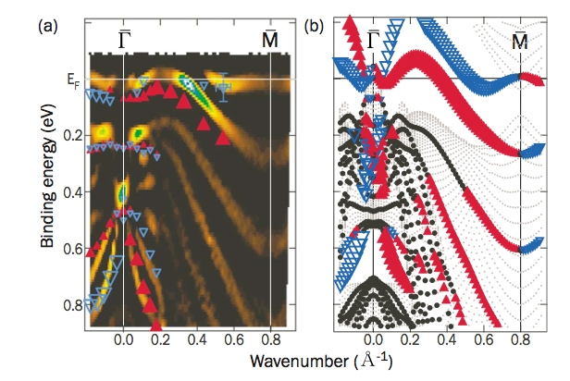
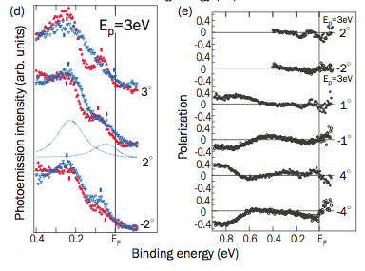
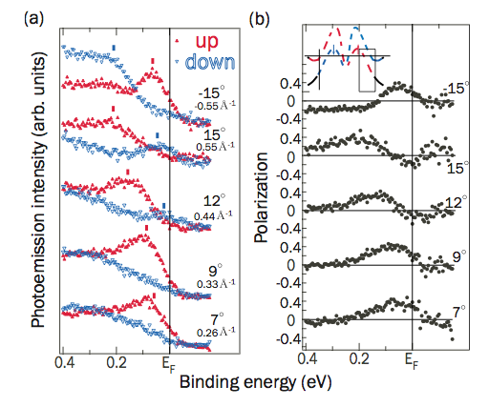
Previous spin-resolved ARPES studies
Bi(111) film
H. Hirahara et al., PRB 76 (2007) 153305.

Slide 17
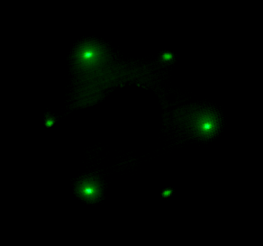
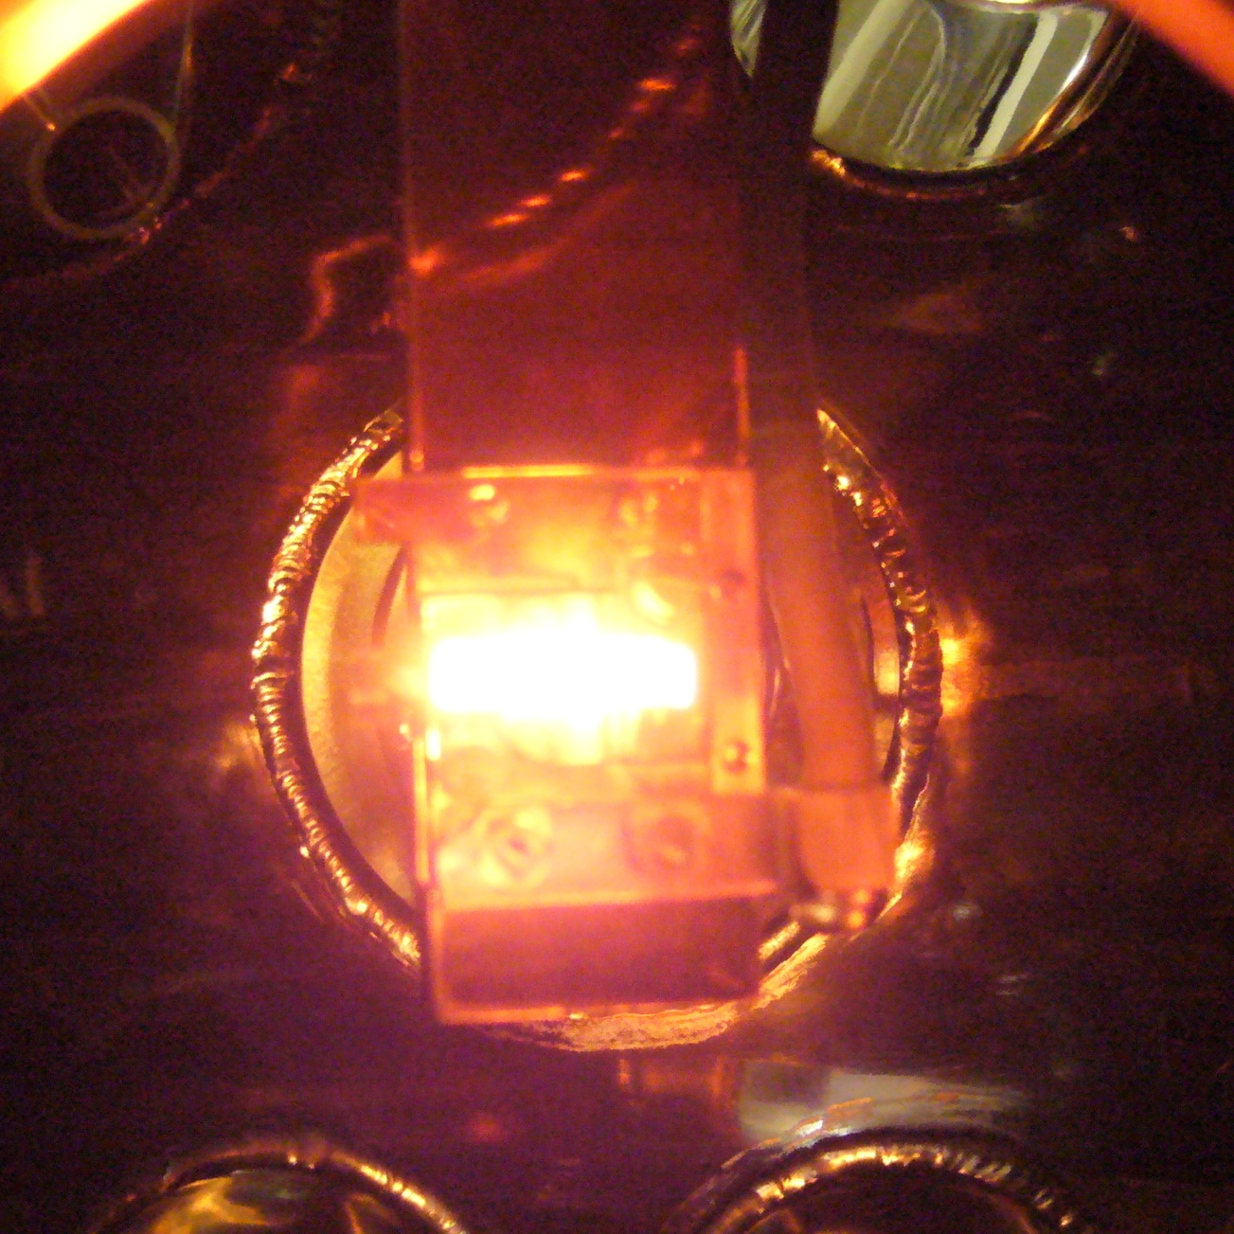
In-situ preparation of Bi thin film on Si(111)
Si(111) 7×7
Bi(111) 1×1
LEED
Flash annealing
substrate
Bi thin film (80ML) epitaxially grown on Si(111) surface

Slide 18
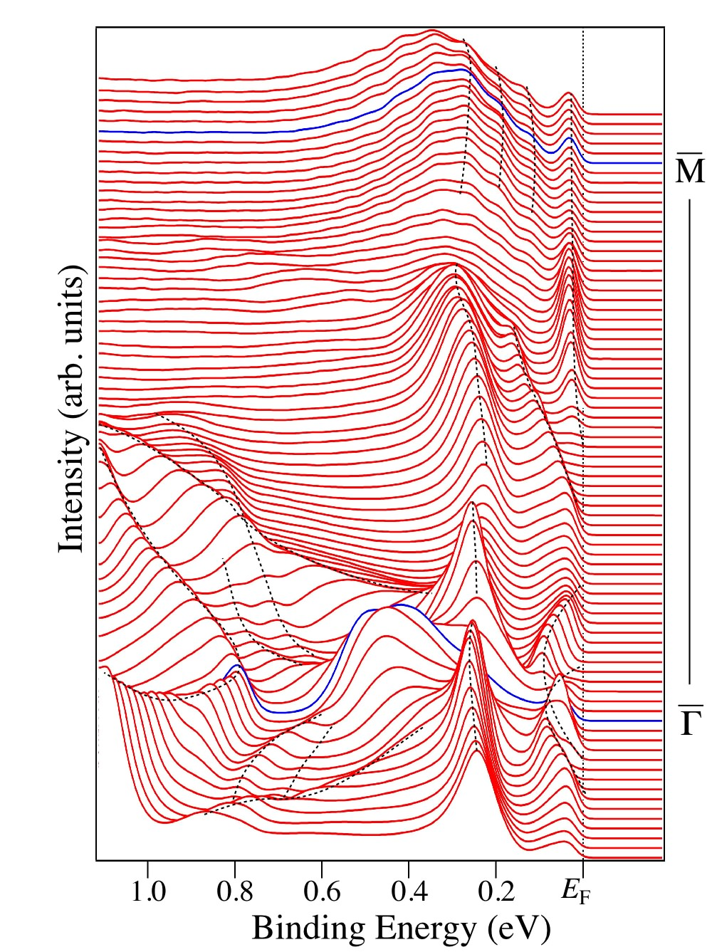
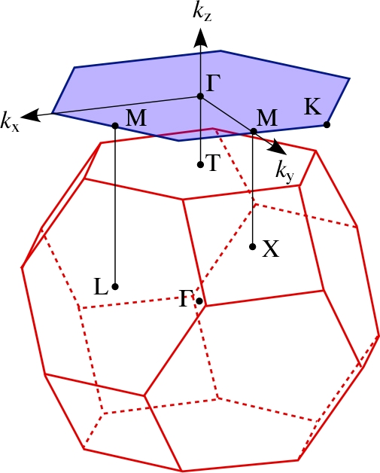
ARPES spectra of Bi(111) surface
Experiment
Xe I (8.436 eV)
T = 30 K
(111)
surface
BZ
bulk BZ

Slide 19
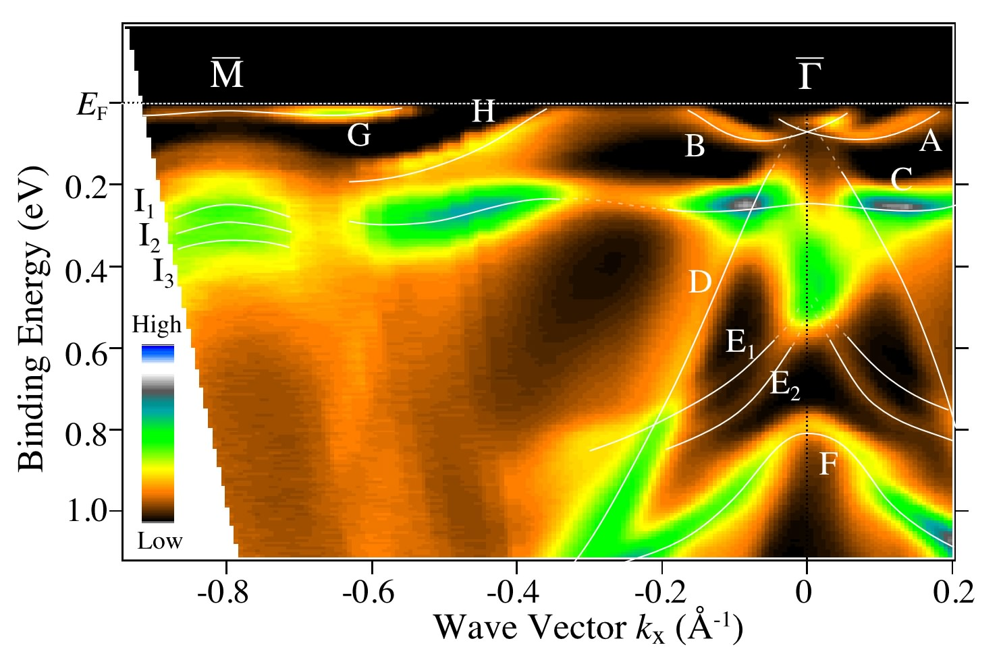
Band structure of Bi(111) surface

Slide 20
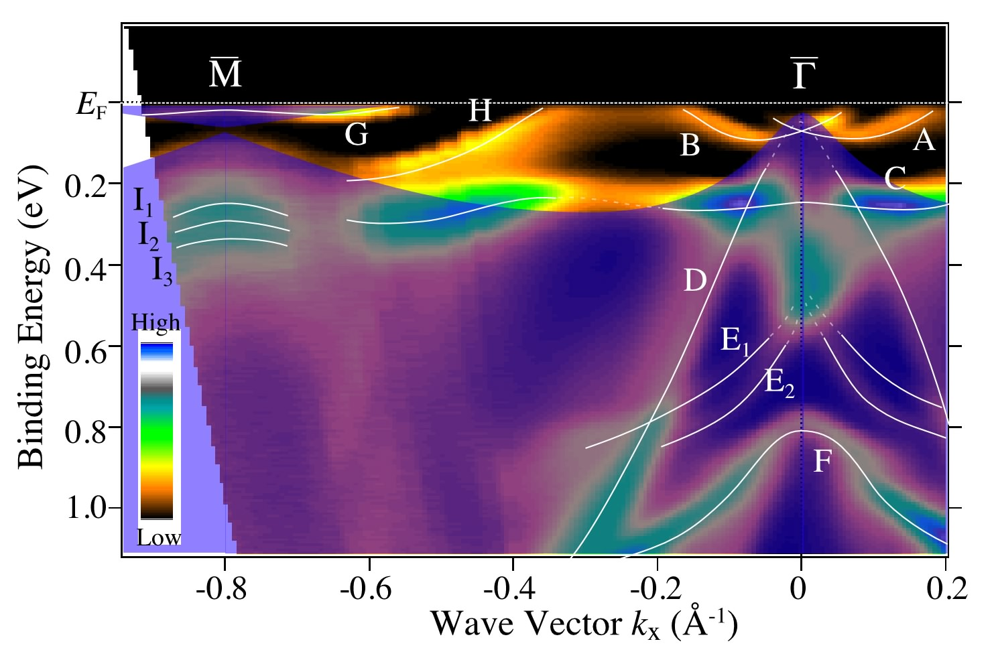
Spin-integrate band structure of Bi(111) surface

Slide 21
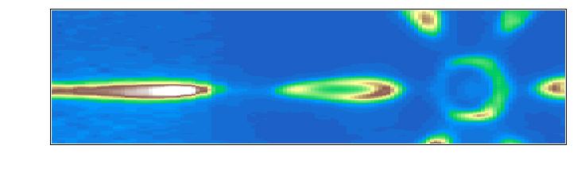
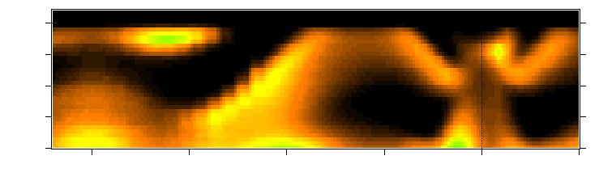
Electronic structure near E_{F} of Bi(111) surface
0.1
electron pocket
0.05
hole pocket
Wave vector k_{y} (Å⁻¹)
0.0
-0.05
-0.8
-0.6
-0.4
-0.2
0.0
0.2
Wave vector k_{x} (Å⁻¹)
E_{F}
electron pocket
0.05
hole pocket
0.10
Binding Energy (eV)
0.15
0.20
-0.8
-0.6
-0.4
-0.2
0.0
0.2
Wave vector k_{x} (Å⁻¹)

Slide 22
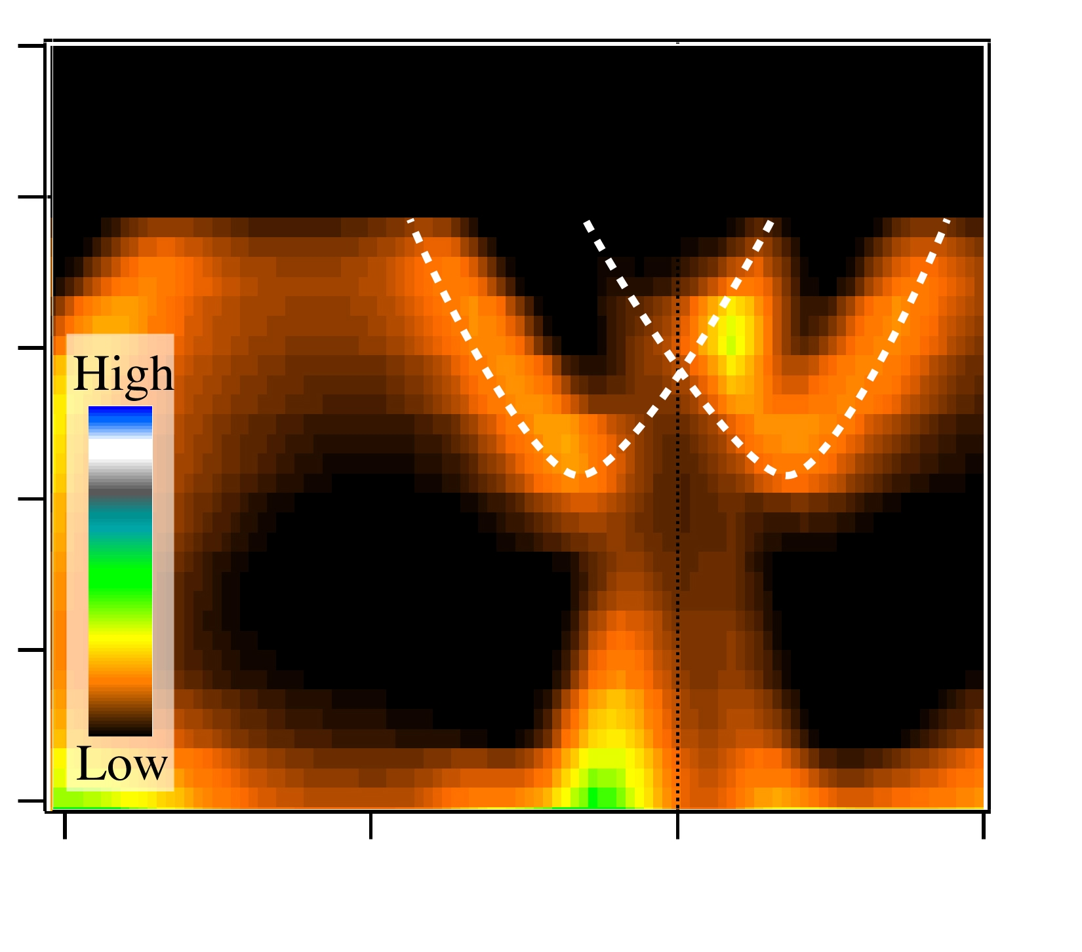
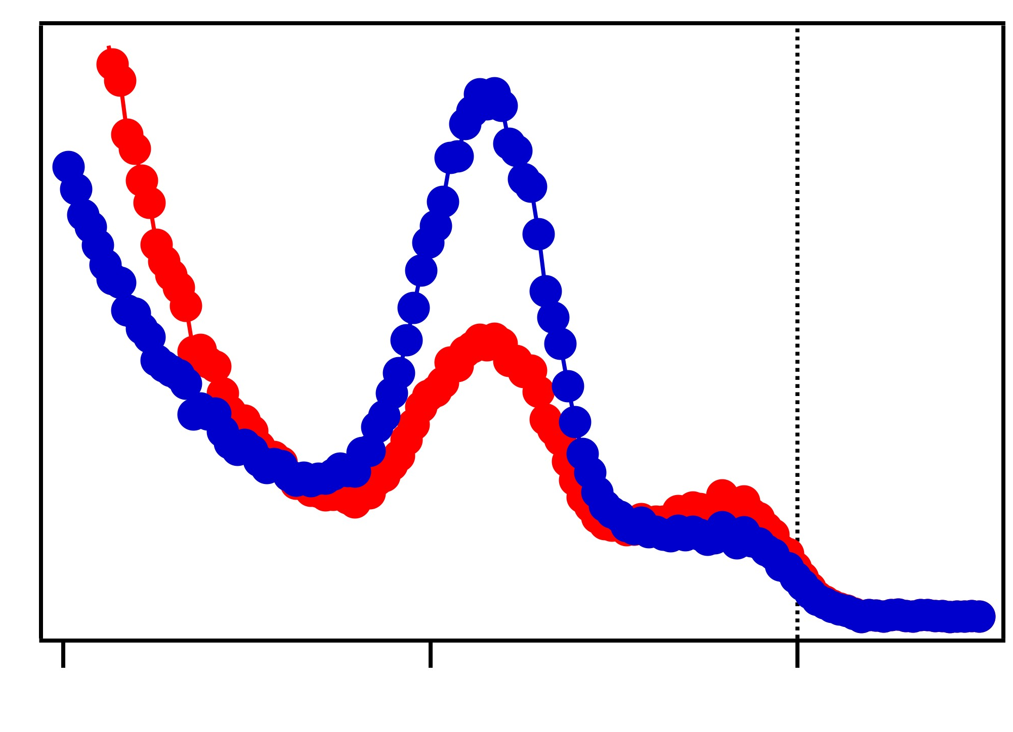
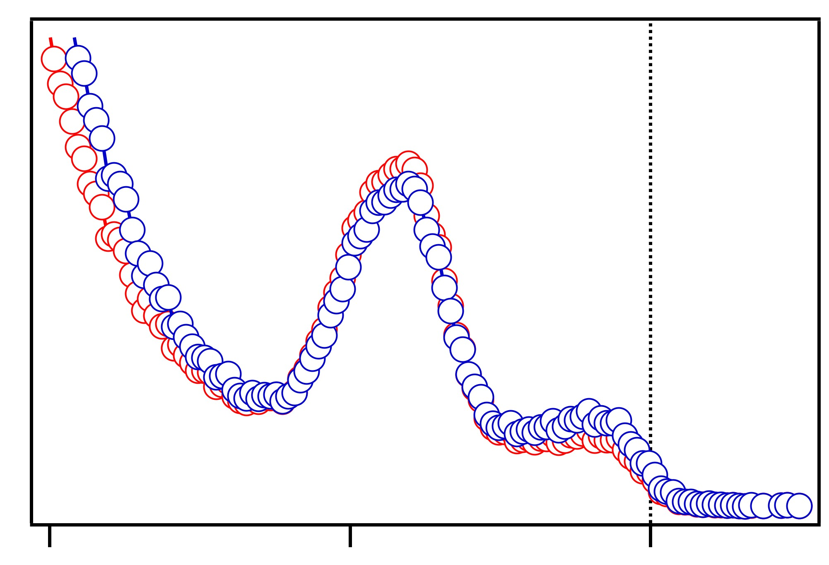
Spin-resolved ARPES of Bi(111) surface
B
up spin
Γ
E_{F}
down spin
Binding Energy (eV)
Intensity (arb. units)
0.1
y direction
0.2
-0.4
-0.2
0
0.2
Wave Vector k_{x} (Å⁻¹)
up spin
down spin
Intensity (arb. units)
z
z direction
y
0.2
0.1
E_{F}
Binding Energy (eV)

Slide 23
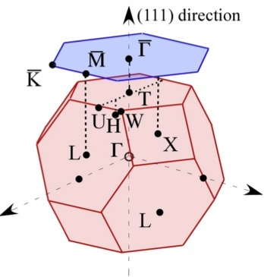
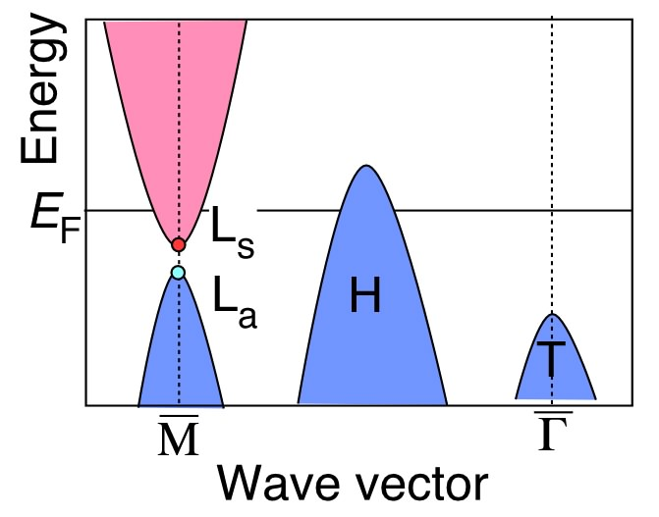
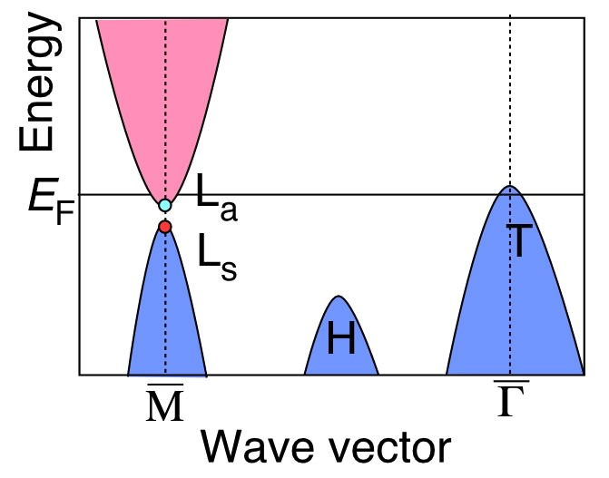
Problem in Bi(111) surface state
Sb(111)
E_{F}
Bi(111)
Binding Energy (eV)
0.1
0.2
-0.4
-0.2
0
0.2
Wave Vector k_{x} (Å⁻¹)
E(k,↑) = E(-k,↓)
Time reversal symmetry
Degeneracy of surface band at Γ (k=0) point
Bi(111): surface band is unclear at Γ due to bulk band projection
ARPES on Sb(111)
same crystal structure
no bulk projection at Γ near E_{F}

Slide 24
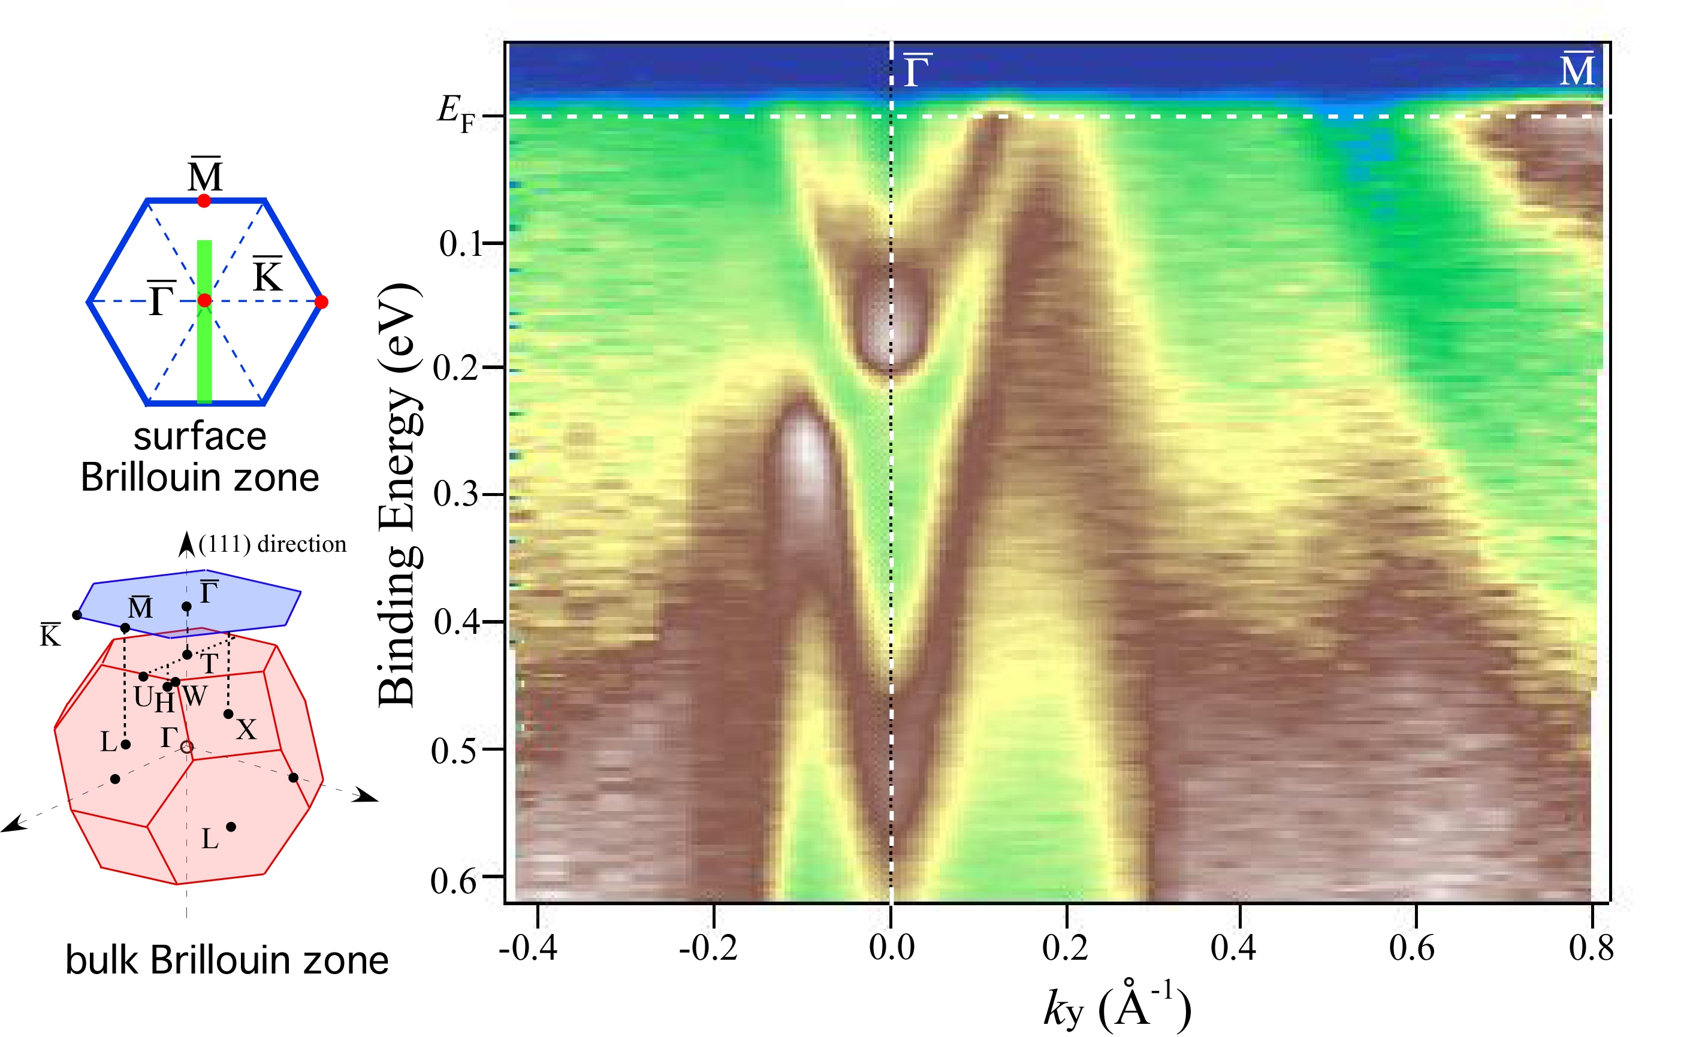
Band structure near E_{F} of Sb(111) surface
K. Sugawara et al., PRL 96 (2006) 046411.

Slide 25
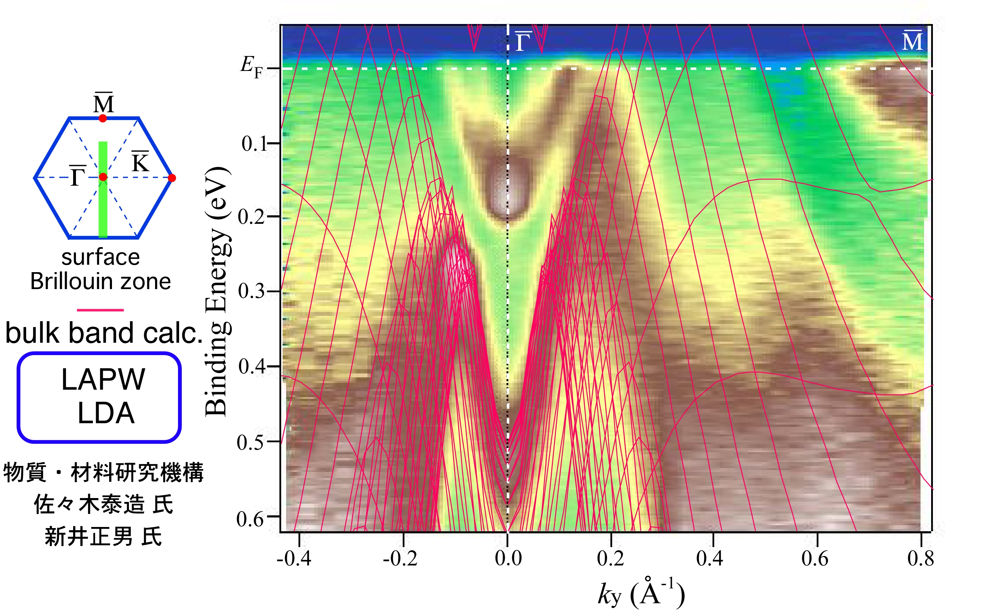
Band structure near E_{F} of Sb(111) surface
K. Sugawara et al., PRL 96 (2006) 046411.

Slide 26


Surface band of Sb(111) at Γ point
2nd derivative
K. Sugawara et al., PRL 96 (2006) 046411.

Slide 27
Spin-resolved ARPES spectra of Sb(111)
spin up
Surface band
Bulk band
spin down
K. Sugawara et al., PRL 96 (2006) 046411.

Slide 28



SUMMARY
Spin-resolved ultrahigh-resolution ARPES study of Rashba effect on semi-metal surface
Energy resolution ΔE= 8 meV
Observation of Spin-splitting of surface band on Bi and Sb (111)
Time reversal symmetry holds at Γ
Surface Rashba effect on group-V semimetal surface

