Slide 1
Internal dynamics of neutron star magnetic fields
Ashley Bransgrove
Advisors: Andrei Beloborodov,
Yuri Levin

Slide 2
http://chandra.harvard.edu/photo/2002/0052/animations.html

Slide 3
Outline
Neutron star structure and phenomenology
Magnetic field evolution in the crust
Magnetic field evolution in the core
Coupled crust core evolution – implications
Elastic back-reaction in magnetars
Conclusions

Slide 4
Ocean: Heavy plasma $(\sim$10 m)
Neutron star structure
Solid crust: Ionic lattice, degenerate electrons ($\sim$1 km)
Liquid core: n, e, p (possibly superconducting p, superfluid n)
($\sim$9 km)
Mass: A few solar masses
Radius$: \sim$10 km

Slide 5
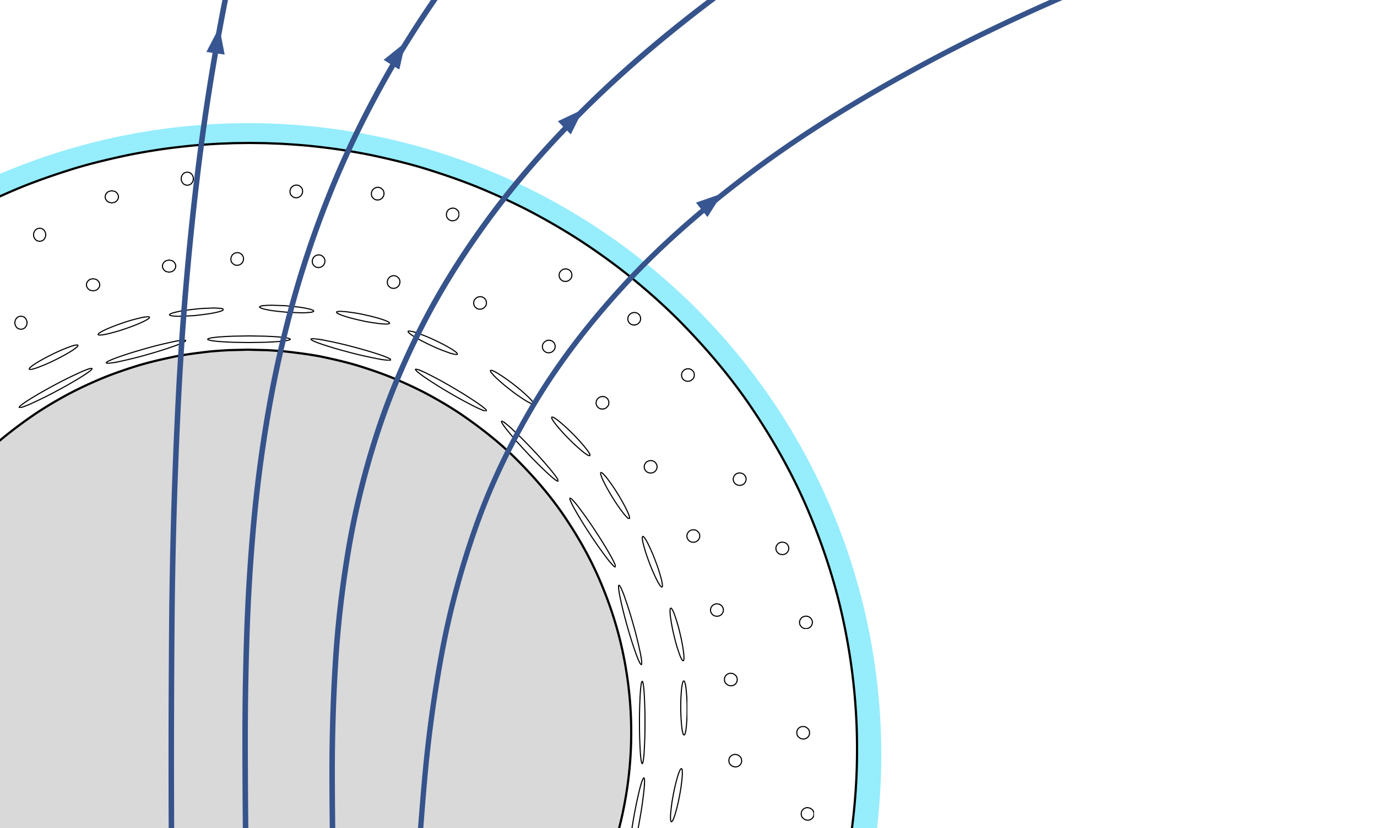
Ocean: Heavy plasma $(\sim$10 m)
Neutron star structure
Highly magnetized ($B={10}^{8}−{10}^{15}$ G)
Solid crust: Ionic lattice, degenerate electrons ($\sim$1 km)
Liquid core: n, e, p (possibly superconducting p, superfluid n)
($\sim$9 km)
Mass: A few solar masses
Radius$: \sim$10 km

Slide 6
Neutron star population
T. M. Tauris, V. M. Kaspi, R. P. Breton, A. T. Deller, E. F. Keane, M. Kramer, D. R. Lorimer,
M. A. McLaughlin, A. Possenti, P. S. Ray, B. W. Stappers, and P. Weltevrede, Understanding the
Neutron Star Population with the SKA," arXiv:1501.00005 [astro-ph], Dec. 2014. arXiv: 1501.00005.

Slide 7
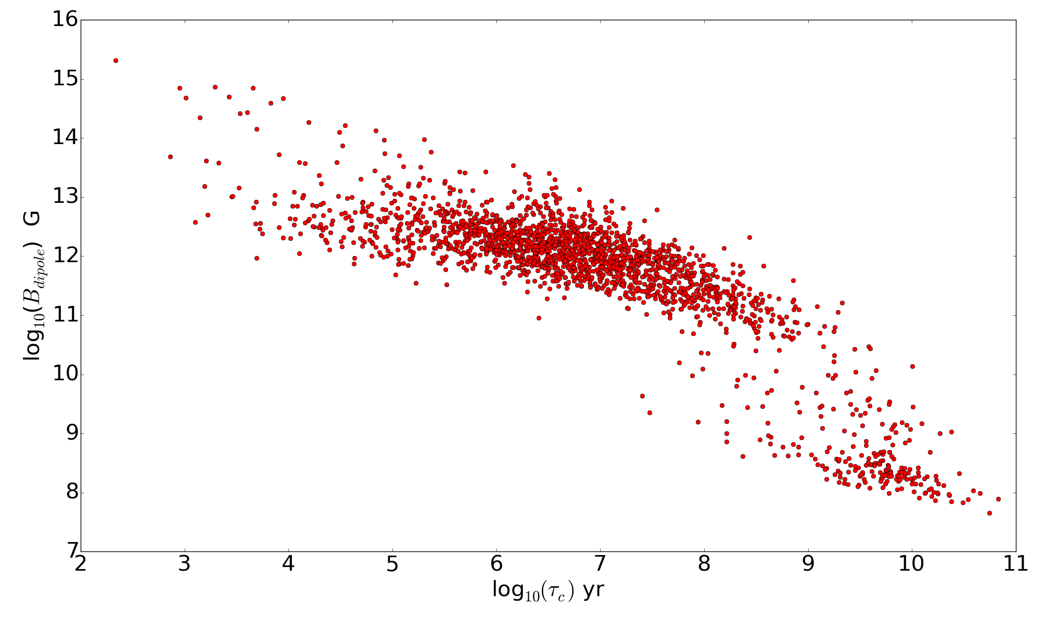
Neutron star population
Data courtesy of the ATNF Pulsar Catalogue

Slide 8
Neutron star population
Magnetars
Ultra-strong $B={10}^{14}−{10}^{15}$G
Powered by magnetic energy
Data courtesy of the ATNF Pulsar Catalogue

Slide 9
Neutron star population
Radio Pulsars
$B={10}^{8}−{10}^{13}$G
Powered by rotational energy
Magnetars
Ultra-strong $B={10}^{14}−{10}^{15}$G
Powered by magnetic energy
Data courtesy of the ATNF Pulsar Catalogue

Slide 10
Neutron star population
Radio Pulsars
$B={10}^{8}−{10}^{13}$G
Powered by rotational energy
Millisecond Pulsars
Much weaker $B={10}^{8}−{10}^{10}$G
Powered by rotational energy
High spin frequencies
Magnetars
Ultra-strong $B={10}^{14}−{10}^{15}$G
Powered by magnetic energy
Data courtesy of the ATNF Pulsar Catalogue

Slide 11
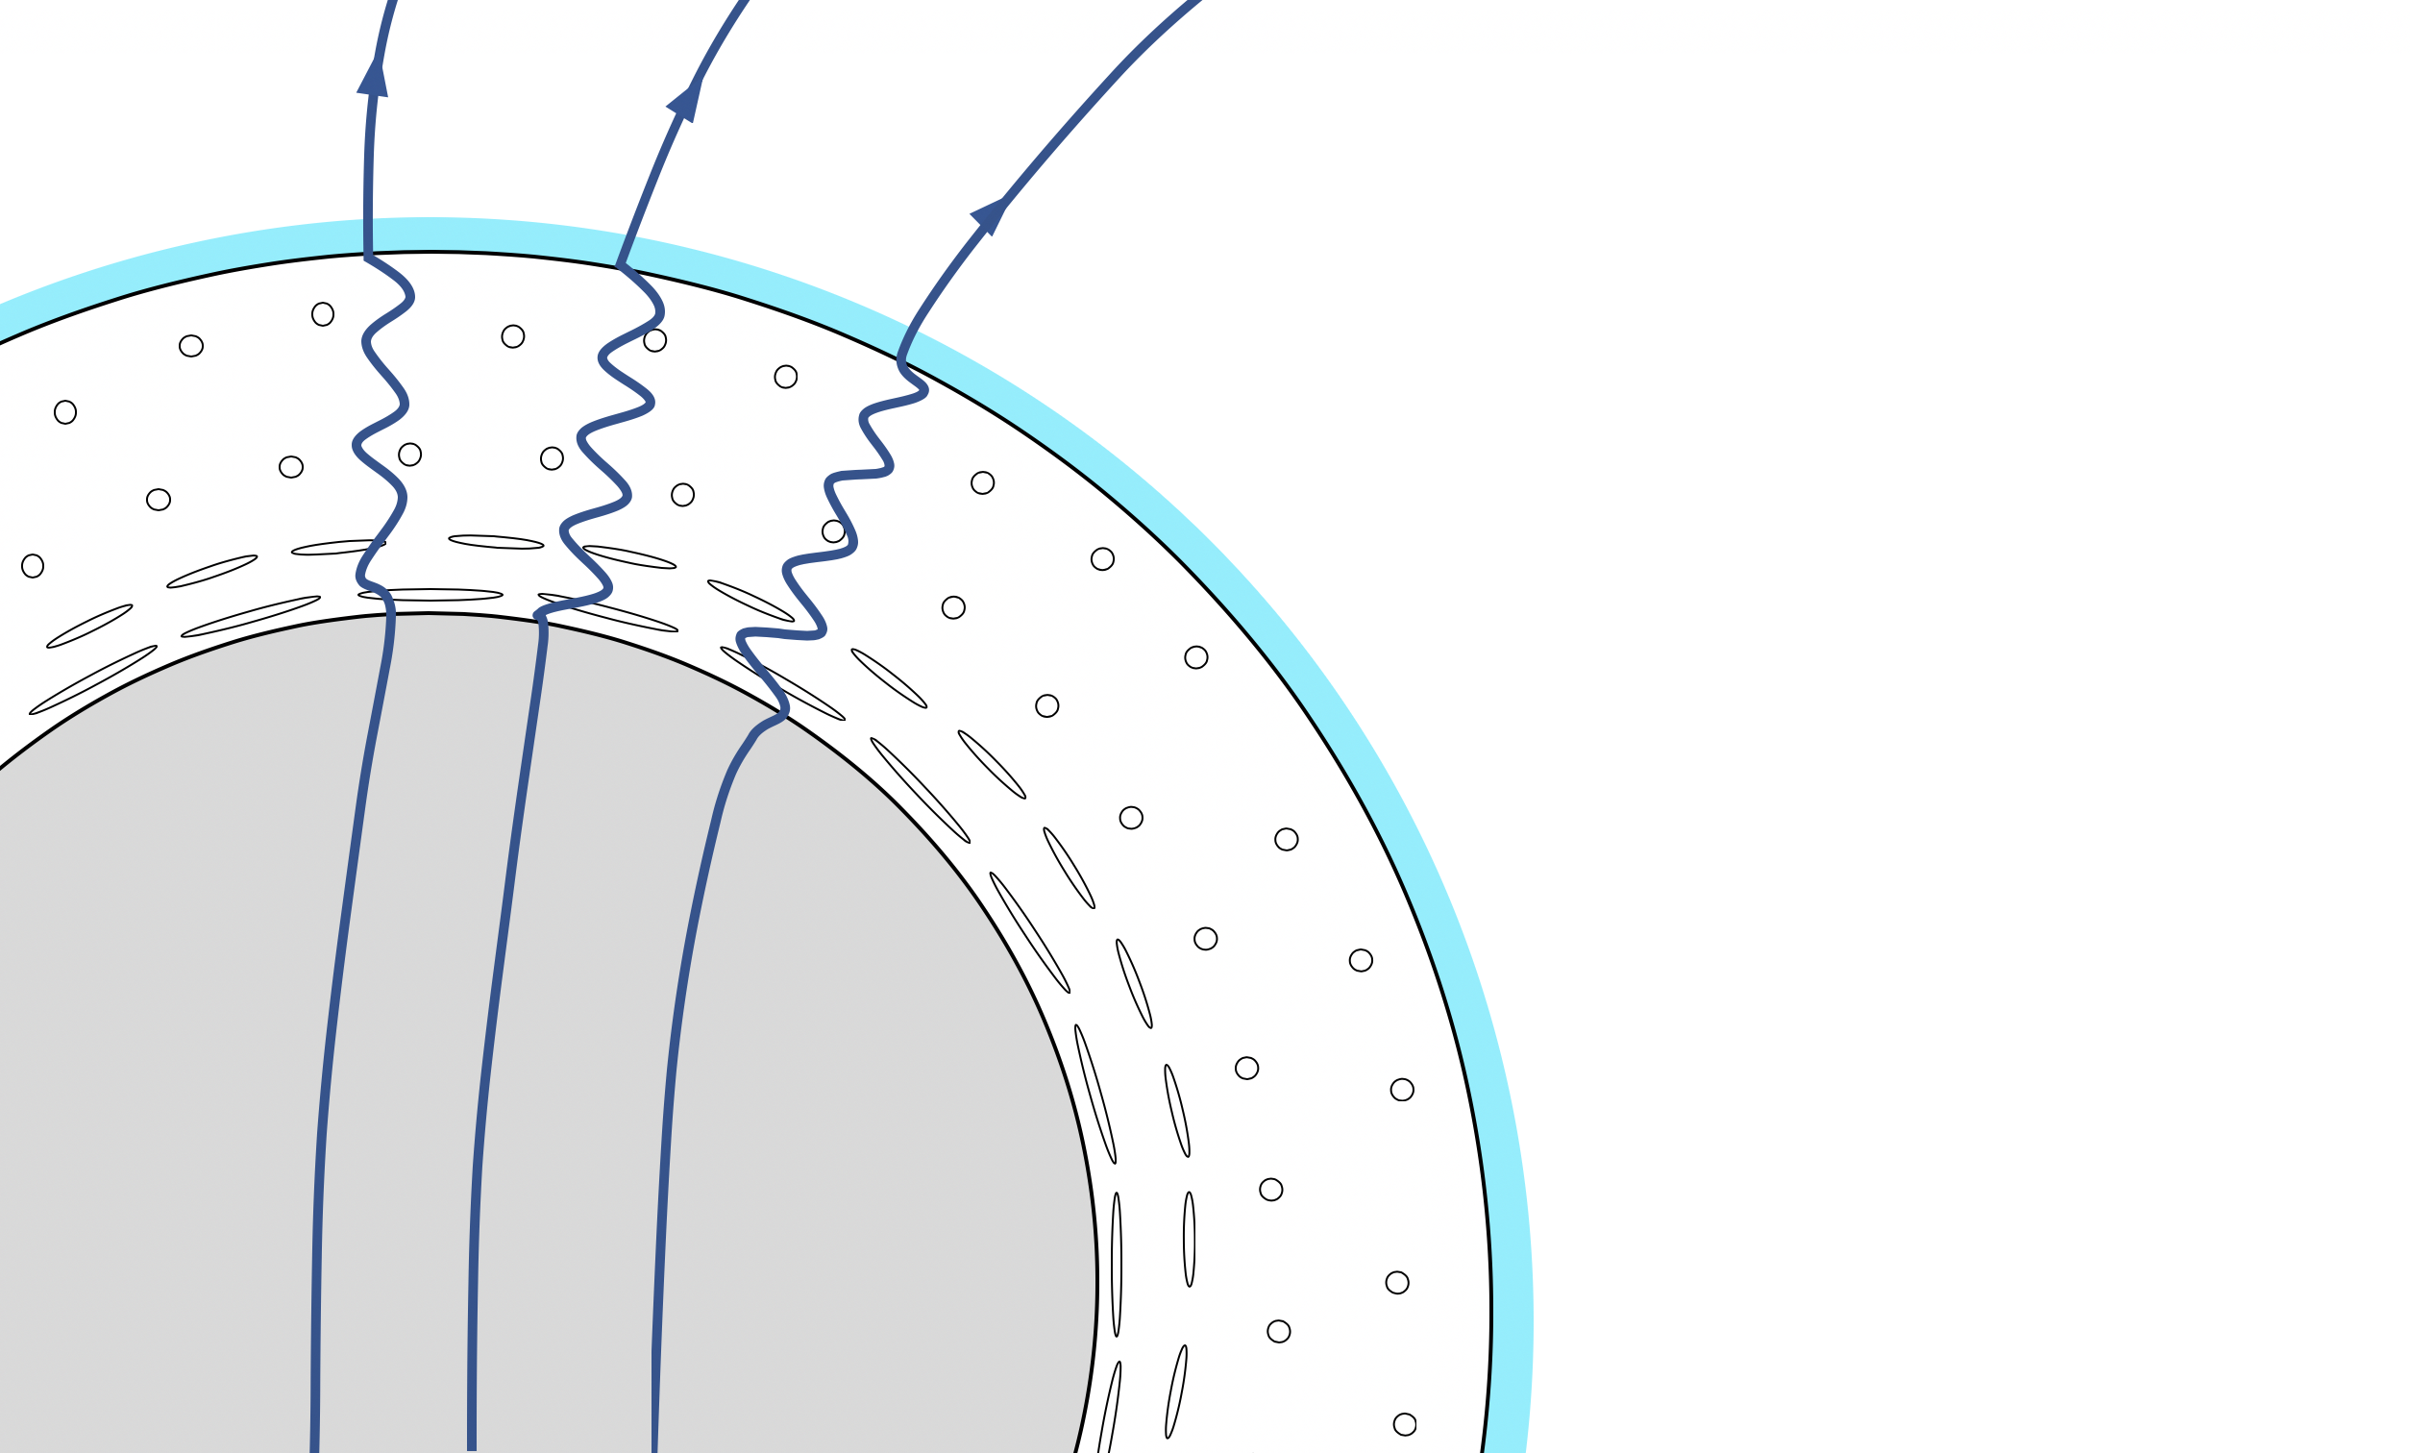
Magnetic field evolution in the crust
Magnetic field is advected by the electron fluid velocity
(Hall Drift)

Slide 12
Magnetic field evolution in the crust
Ohmic diffusion of magnetic field

Slide 13
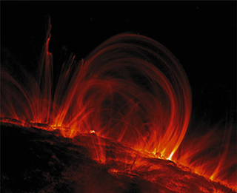
Magnetic field evolution in the crust
Hall Drift
Crustal Deformations
Ohmic Diffusion
Converts magnetic energy into heat
Non-linear advection/wave-like
The engine of magnetar activity!
Ultraviolet light by NASA’s TRACE satellite: http://cse.ssl.berkeley.edu

Slide 14
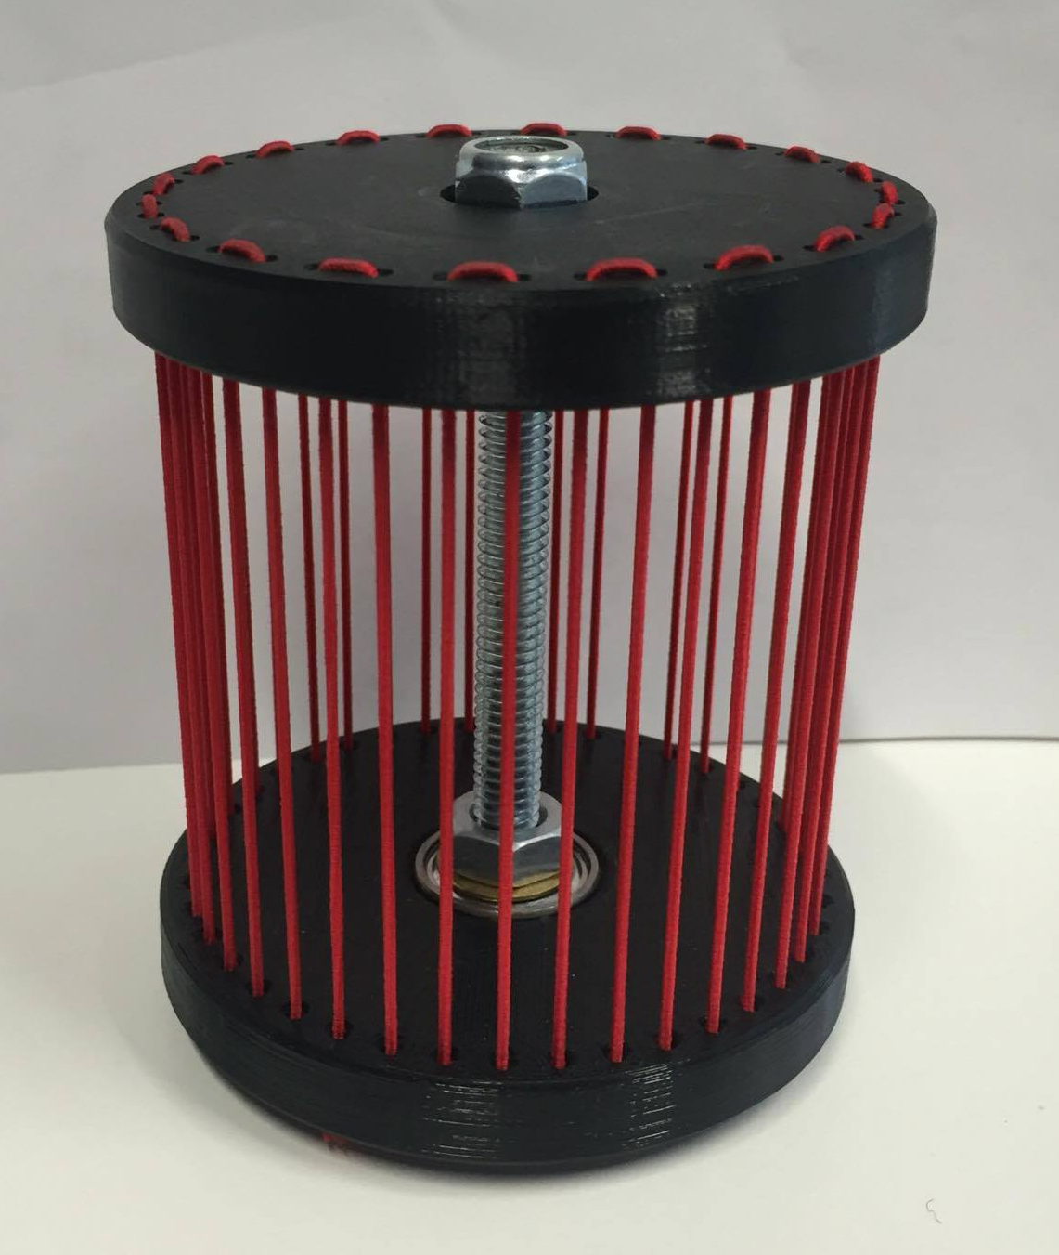
Coupling the crust and the core

Slide 15
Coupling the crust and the core
Magnetic field lines
Neutron star core

Slide 16
Coupling the crust and the core
Quasi-static tension equilibrium

Slide 17
Coupling the crust and the core
Quasi-static tension equilibrium
Hydromagnetic equilibrium

Slide 18
Coupling the crust and the core
Equatorial symmetry: Rigid Rotation
Broken Equatorial Symmetry: Differential Rotation

Slide 19
Hydromagnetic equilibrium
Magnetic field
into/out of the page
$B=2×{10}^{14}$G (Broken equatorial symmetry)
Crust: Hall drift + Ohmic diffusion
Core: Hydromagnetic Equilibrium
(relaxation method)

Slide 20
Hall attractor: Crust-confined fields
Angular velocity of electron fluid
Angular velocity of electron fluid:
Constant along field lines
Gourgouliatos & Cumming 2014

Slide 21
Hall attractor: Core-penetrating fields
Angular velocity of electron fluid $→$ constant along magnetic field lines

Slide 22
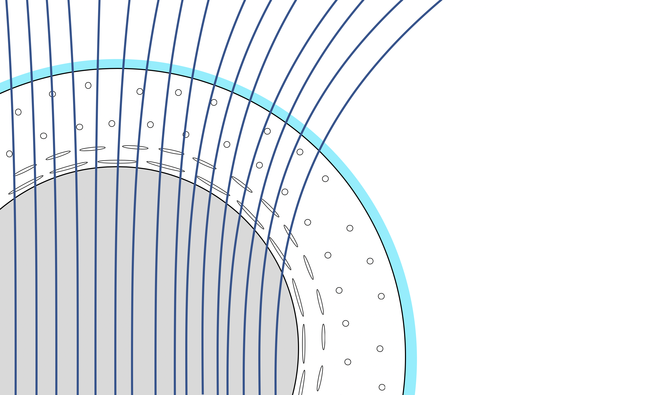
Magnetic fields in the core
$$T{>T}_{crit}$$
$$B>B_{crit}$$
Continuous magnetic field

Slide 23
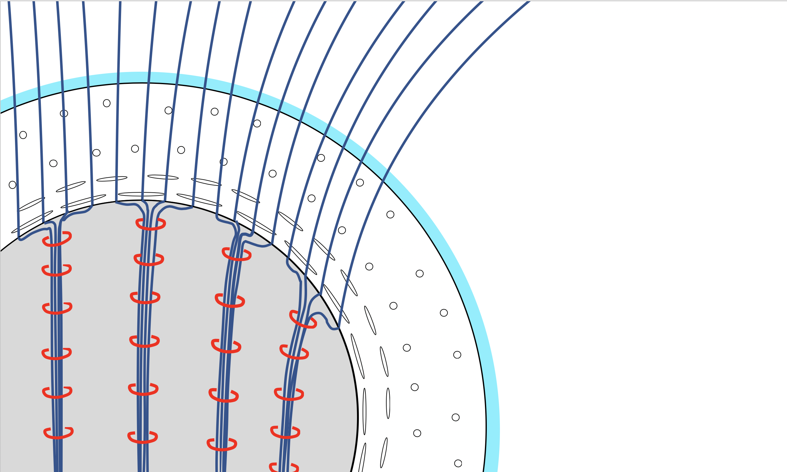
Magnetic fields in the core
$$T{<T}_{crit}$$
$$B<B_{crit}$$
Type-II superconducting protons
Microscopic magnetic flux tubes
(supported by proton supercurrents)

Slide 24
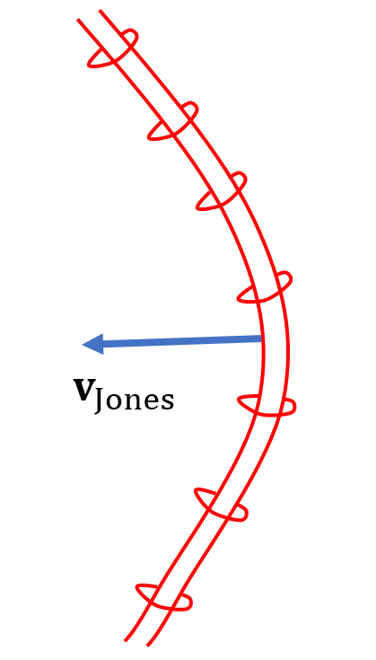
Jones flux tube drift
Flux tubes are straightened
by magnetic tension - P.B Jones.
$$×{(v}_{Jones}×B)$$
*Note: The model of flux tube motion by P.B. Jones is one of many - This is a topic of hot debate in the literature

Slide 25
Jones flux tube drift
$B=2×{10}^{14}$G (Magnetar)
Crust: Hall drift + Ohmic diffusion
Core: Jones flux tube drift

Slide 26
Jones flux tube drift
$B=2×{10}^{12}$G (Pulsar)
Crust: Ohmic diffusion
Core: Jones flux tube drift

Slide 27
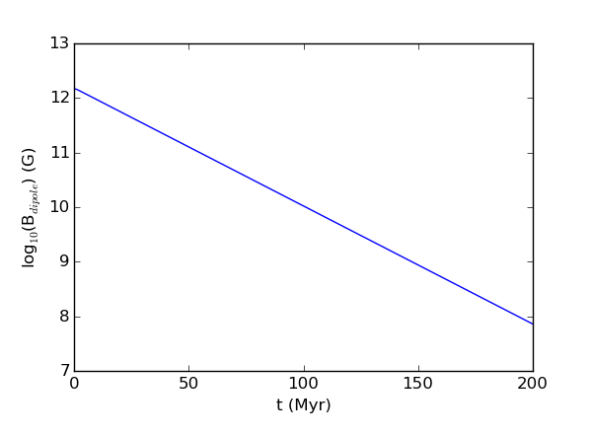
Jones flux tube drift
Depletion of pulsar magnetic fields
$B=2×{10}^{12}$G (Pulsar)
Crust: Ohmic diffusion
Core: Jones flux tube drift

Slide 28
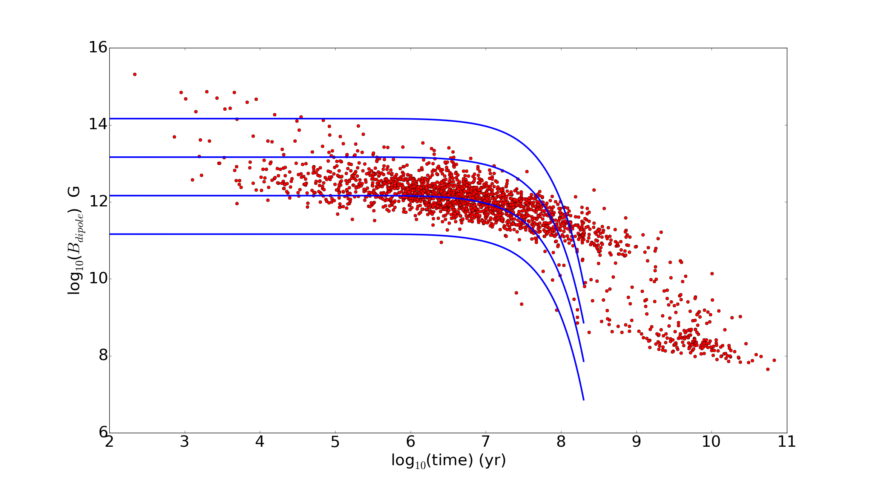
Jones flux tube drift
Depletion of pulsar magnetic fields
$B=2×{10}^{12}$G (Pulsar)
Crust: Ohmic diffusion
Core: Jones flux tube drift

Slide 29
Flux expulsion by superfluid neutron vortices
$$×{(v}_{⊥}×B)$$
Magnetic flux tube
is pulled along by the vortex
The outward motion of vortices can push flux tubes out of the core – M. Ruderman
Magnetized neutron superfluid vortex

Slide 30
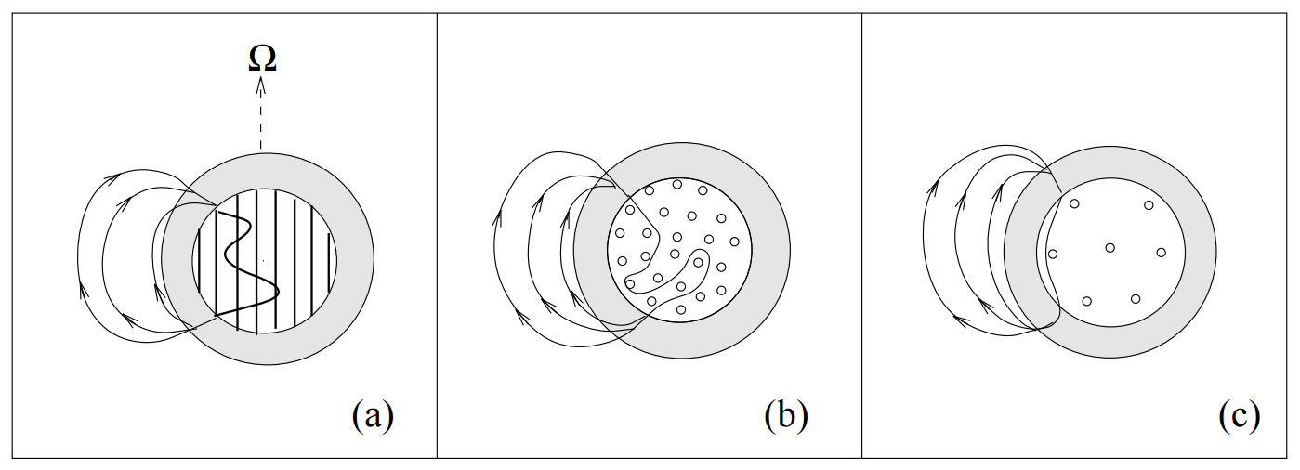
Flux expulsion by superfluid neutron vortices
Later time
Ruderman. et al 1998

Slide 31
Flux expulsion by superfluid neutron vortices
Possible birth scenario (rapid spin-down)
Initial Conditions
Birth spin period $P=1$ ms
$E_{rot}≫E_{mag}$
Crust: Hall drift + Ohmic diffusion
Core: Advection by superfluid
neutron vortices
T. M. Tauris, V. M. Kaspi, R. P. Breton, A. T. Deller, E. F. Keane, M. Kramer, D. R. Lorimer,
M. A. McLaughlin, A. Possenti, P. S. Ray, B. W. Stappers, and P. Weltevrede, \Understanding the
Neutron Star Population with the SKA," arXiv:1501.00005 [astro-ph], Dec. 2014. arXiv: 1501.00005.

Slide 32
Flux expulsion by superfluid neutron vortices
Initial Spin period: $P_{0}=1 ms$
Low-B
$B=5×{10}^{12}$ G
High-B
$B=2×{10}^{13}$ G

Slide 33
Elastic back-reaction in magnetars
Hall drift generates magnetic stress
The crust deforms elastically and plastically
Motion of the crust induces evolution of the magnetic field
$⇒$ coupled magneto-elastic evolution

Slide 34
Elastic back-reaction in magnetars
Hall drift generates magnetic stress
The crust deforms elastically and plastically
Motion of the crust induces evolution of the magnetic field
$⇒$ coupled magneto-elastic evolution

Slide 35
Toroidal Crust Displacement

Slide 36
Conclusions
A new method for enforcing hydromagnetic equilibrium in the core
Core penetrating fields demonstrate the Hall Attractor
Jones flux tube drift in the core and Ohmic diffusion in the crust can deplete pulsar magnetic fields on a timescale of $t\sim 150$ Myr (depending on temperature)
The neutron-vortex driven flux expulsion can push magnetic fields out of the core during the rapid spin-down of a new born magnetized neutron star
A new method for studying coupled magneto-elastic evolution in the crust.

Slide 37
Interesting problems/future work
Understanding the origin of millisecond pulsars
Resolving the flux tube controversy
Thermal evolution
Detailed understanding of Hall Drift in 3D
Magnetar giant flares and other activity
Timing noise in radio pulsars
Glitches

