Slide 1


ALMA and Herschel observations of dust and molecules in SNRs
Mikako Matsuura
(Cardiff University)

Slide 2
What can we understand by observing molecules and dust?
Searching for footprints of SN explosion in SNRs
  Hydrodynamics
  Mixing
Chemistry and physics of forming molecules and dust in SNRs

Slide 3
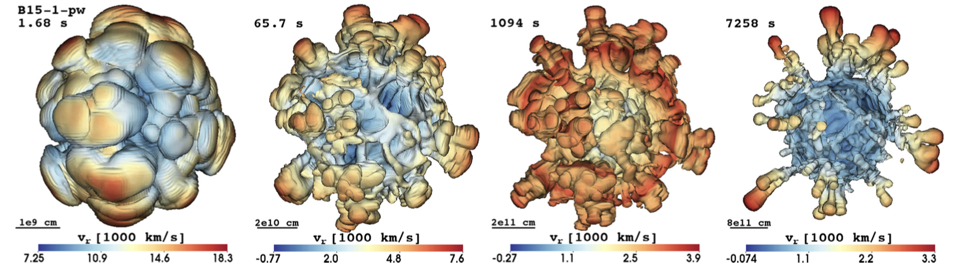
How does a core-collapse SN explode?
Hydrodynamic simulations of neutrino driven explosion
Wongwathanarat et al. (2015)
Notes:
Isosufrace of mass

Slide 4
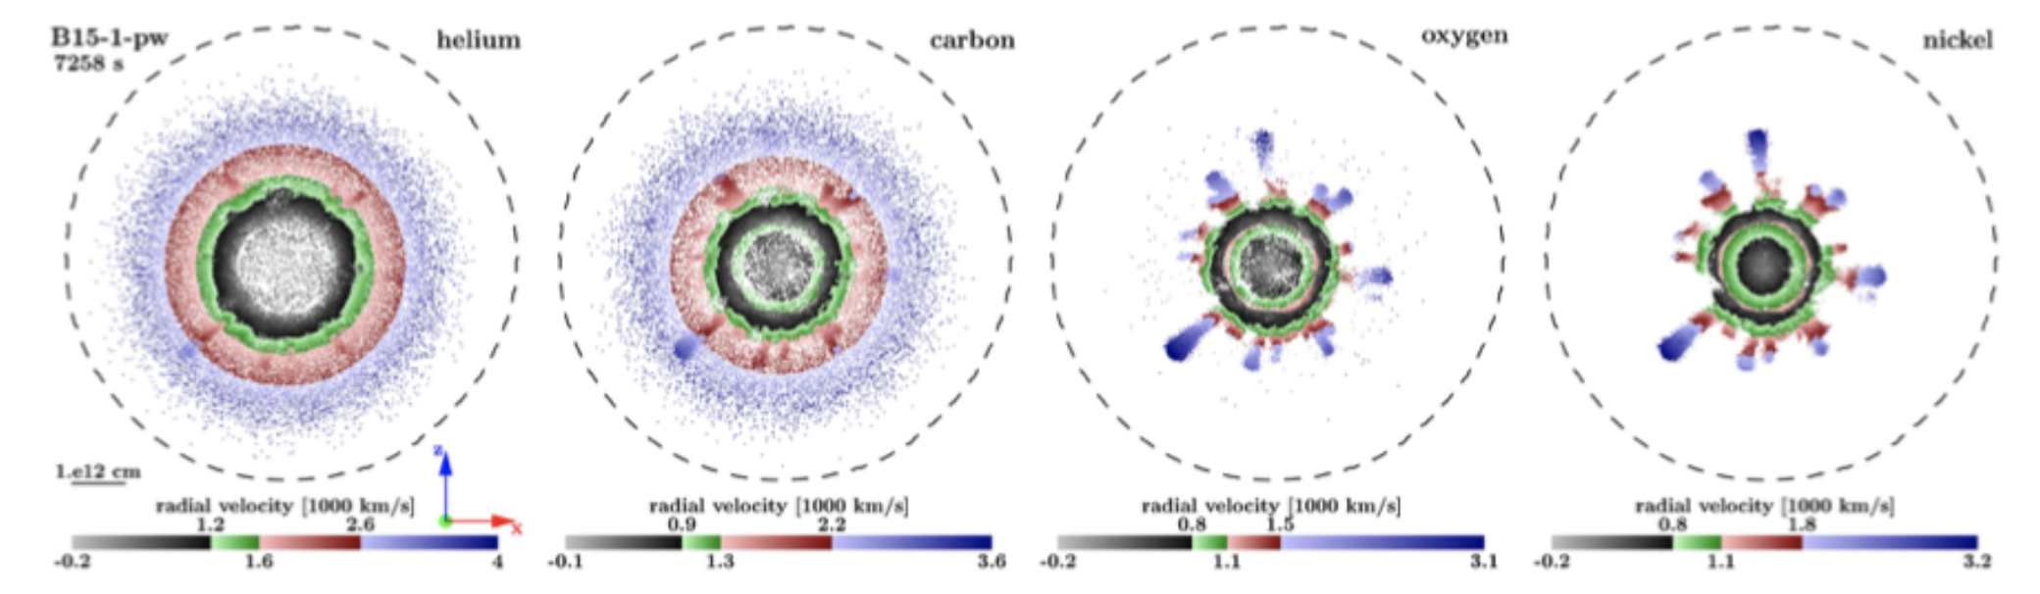
How does a core-collapse SN explode?
Hydrodynamic simulations of neutrino driven explosion
Wongwathanarat et al. (2015)
Notes:
Partical representation of spatial distributions of atoms

Slide 5
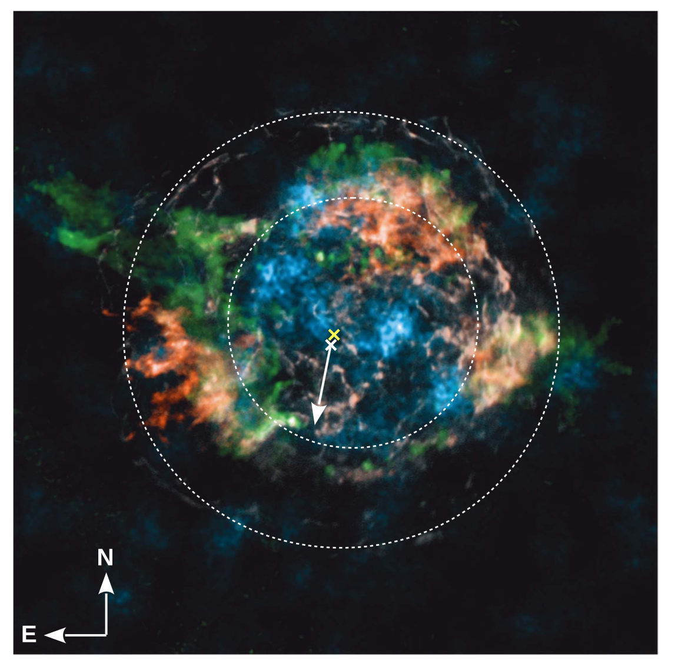
Aftermath of explosion (1) Cas A
NuStar observations of ⁴⁴Ti Cassiopeia A
Cas A
  ~340 years old
  Type IIb
⁴⁴Ti (blue)
Si/Mg ratio image (green)
Fe K-shell (red)
4-6 keV continuum (white)
Grefenstette et al. (2014)
Notes:
Diameter of cas A is about 3-5 arcmin in diameter

Slide 6
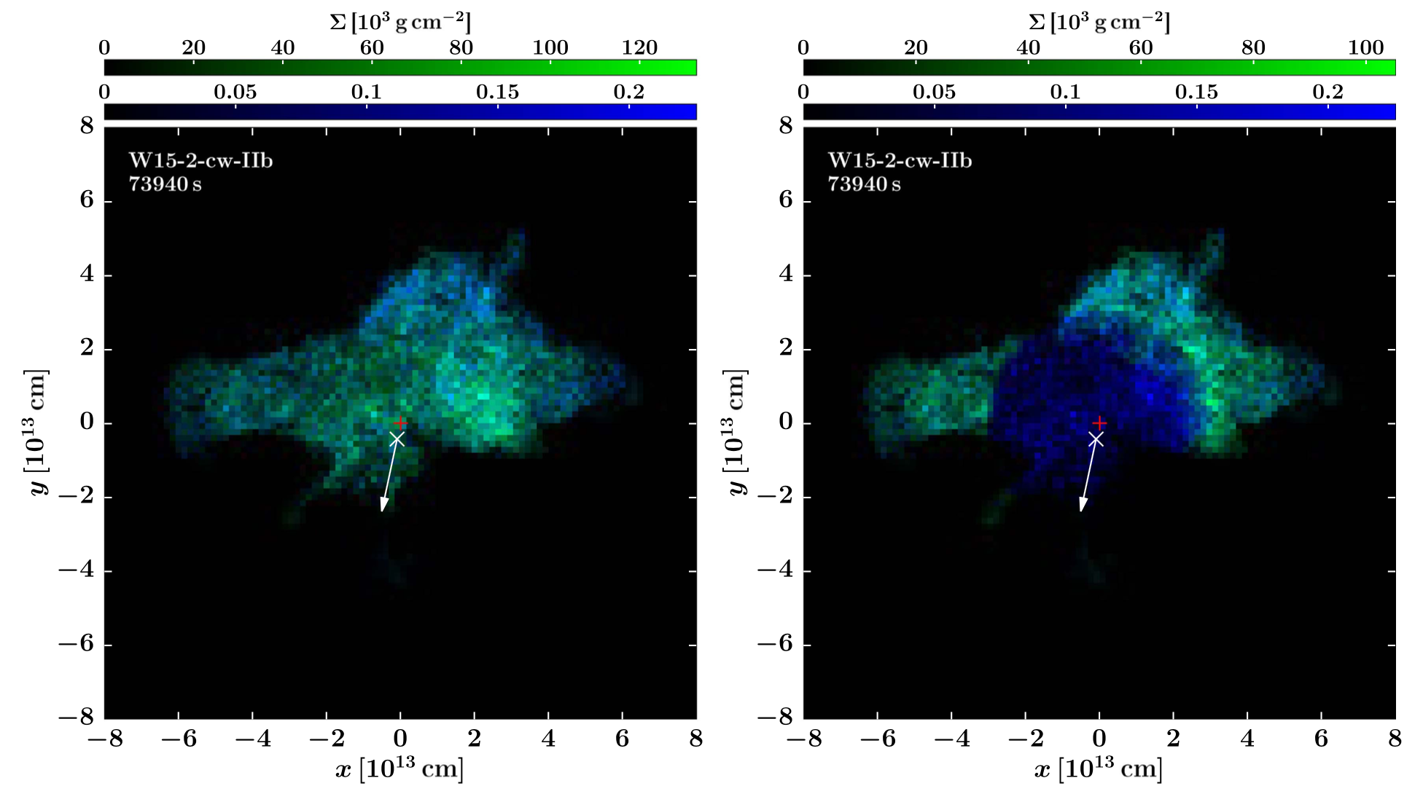
Comparing spatial extent of elements from observations and simulations
NuStar
⁴⁴Ti (blue)
Si/Mg ratio image (green)
Fe K-shell (red)
Hydrodynamic simulation
⁵⁶Ni and ⁴⁴Ti at t=73940 sec
Considering line excitation after reverse shocks
Wongwathanarat et al. (2017)
Notes:
Annop
Fe K-shell (red) - Ni

Slide 7
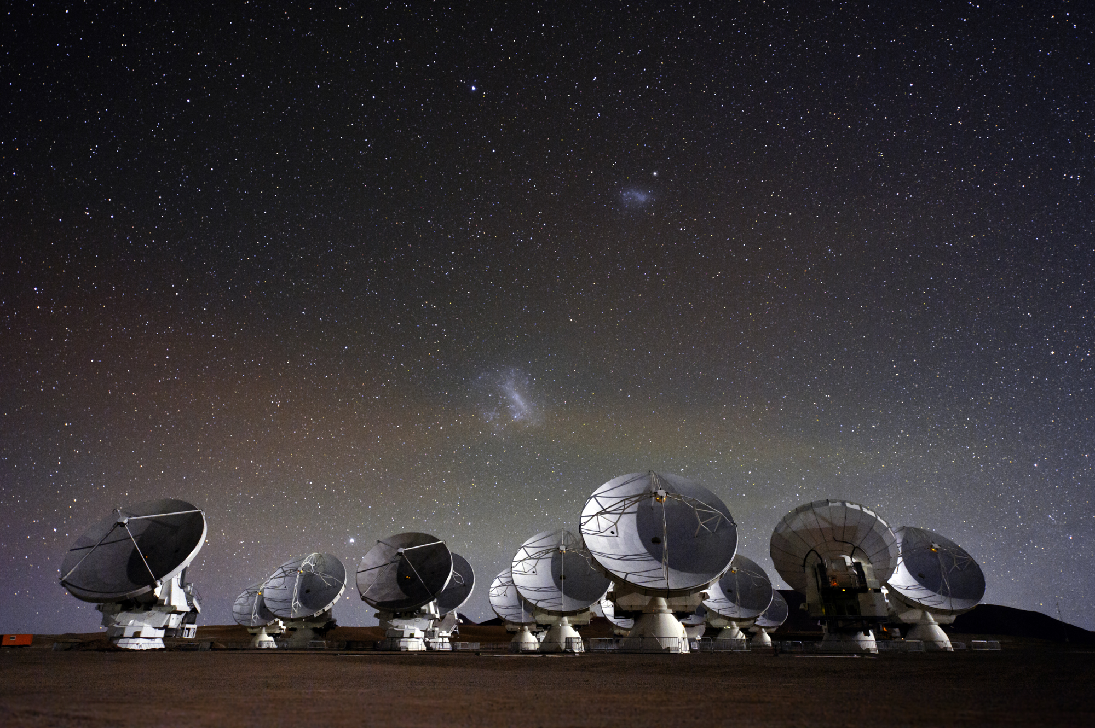
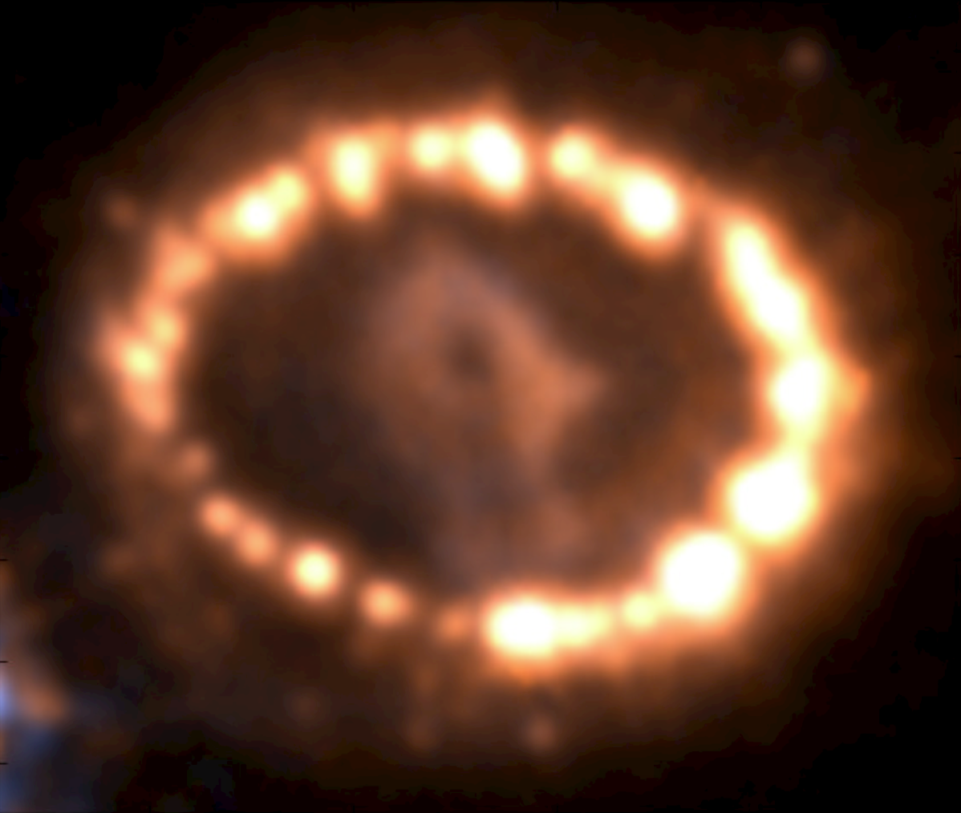
ALMA
(Atacama Large millimetre and sub-millimetre array)
High sensitivities
  (RMS~33 μJy in less than hour at 200 GHz)
High angular resolutions (0.05 arcsec – 0.3 arcsec)
SN 1987A
Ejecta
~0.9 arcsec
Ring

Slide 8
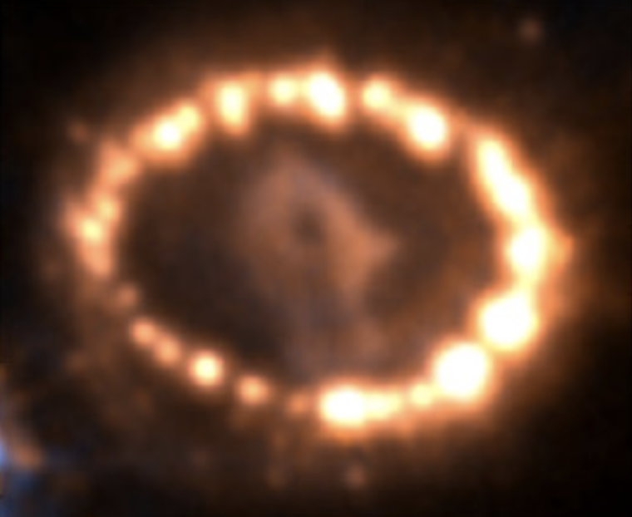
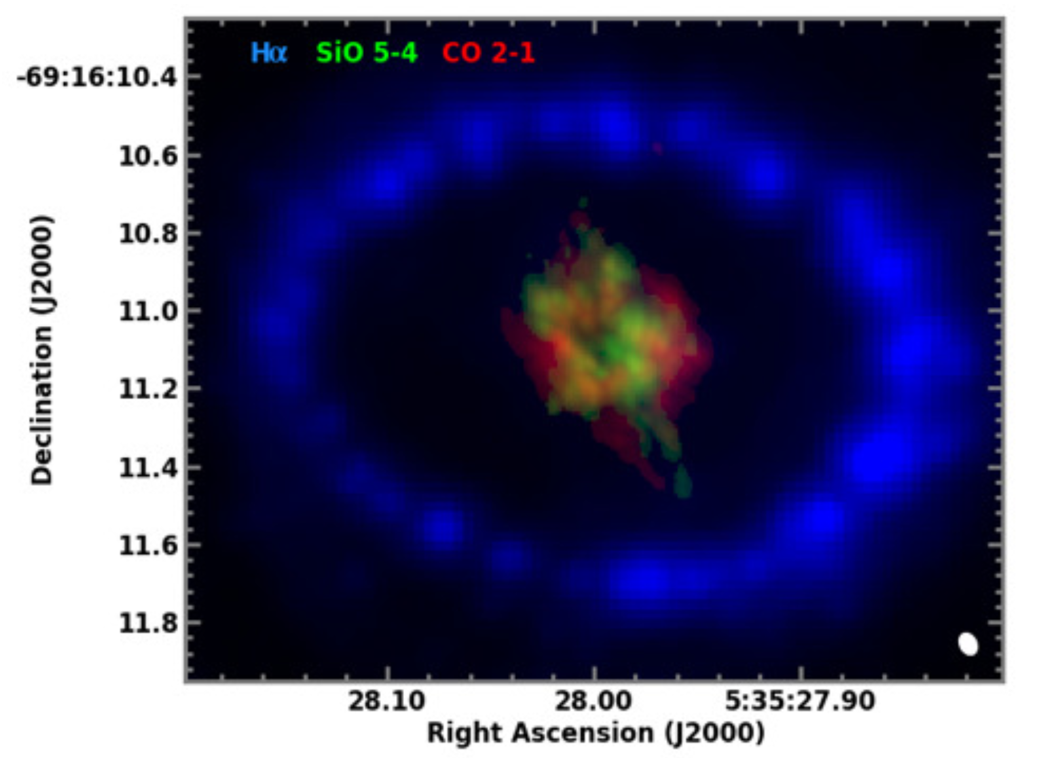
Aftermath of explosion (2) SN 1987A
Sizes of the extents: SiO < CO < Hα
SiO & CO are clumpy & torus shaped
SiO (green) & CO (red)
HST Hα in 2014
ALMA observations in 2014 & 2015
Fransson et al. (2015)
Abellan et al. (2017)
Notes:
27 years after the explosion – much younger than Cas A
ALMA can provide resolutions of 50 mas

Slide 9
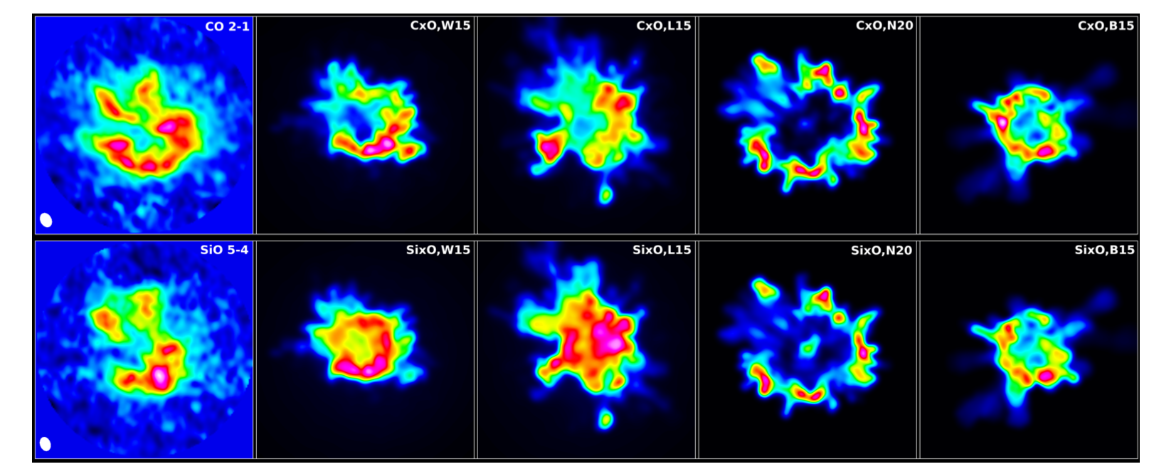
Comparisons of observations & simulations
CO 2-1
SiO 5-4
Hydrodynamic simulations from Gabler
ALMA
Very good agreements in clumpy structures & the extents between observations and simulations
Abellan et al. (2017)
Notes:
Michael Gabler

Slide 10
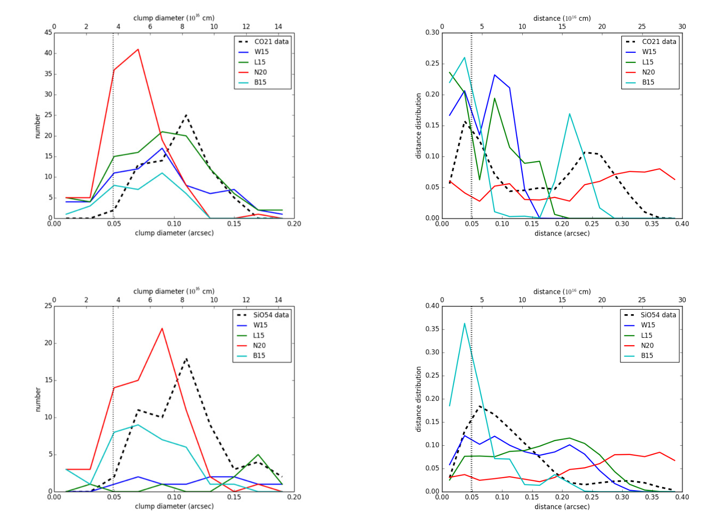
Statistical comparison between ALMA & simulations
Clump diameters
Extent of the material
ALMA
CO
Hydrodynamic model with different explosion models
W15
L15
N20
Counts
B15
Some discrepancies in details
SiO
Abellan et al. (2017)

Slide 11
What could be potential cause of discrepancies between observations & simulations
Simulations
  Adjustments in model parameters
Chemistry
  CO, SiO, dust vs atomic lines
Adiabatic phase
  Line cooling could be more important than previously thought (Jerkstrand et al. 2011)
  Could impact on the expansion velocity

Slide 12
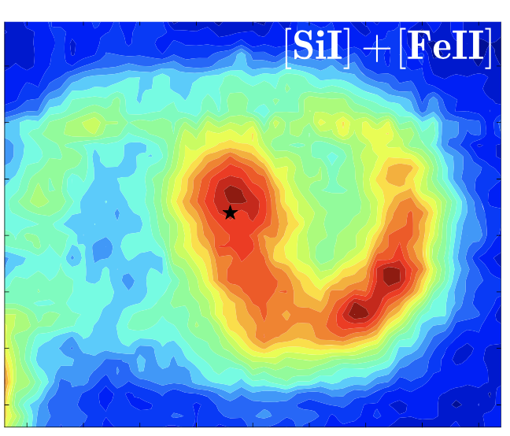
What could be potential cause of discrepancies between observations & simulations
Simulations
  Adjustments in model parameters
Chemistry
  CO, SiO, dust vs atomic lines
Adiabatic phase
  Line cooling could be more important than previously thought (Jerkstrand et al. 2011)
  Could impact on the expansion velocity
SiO (green) & CO (red)
Larsson et al. (2016)
Notes:
[SiI] might be slightly more extended
Atomic lines - illumination of X-ray radiation from the ring, where interactions between the ring and fastest part of the ejecta caused X-ray radiation
Comes back about chemistry later on

Slide 13
What could be potential cause of discrepancies between observations & simulations
Simulations
  Adjustments in model parameters
Chemistry
  CO, SiO, dust vs atomic lines
Adiabatic phase
  Line cooling could be more important than previously thought (Jerkstrand et al. 2011)
  Could impact on the expansion velocity

Slide 14
By observing molecules and dust
Searching for footprints of SN explosion in SNRs
  Hydrodynamics
  Mixing
Chemistry of forming molecules and dust in SNRs

Slide 15
ALMA molecular survey of SN 1987A
SiO
CO
SiO
CO+SiO
Synchrotron
Matsuura et al. (2017)

Slide 16
Estimating temperature and density by modelling molecular lines
SiO
  T=20–170 K
  Mass: 1x10⁻³ – 2x10⁻⁵ M
  n(H_{corr}): 10⁶ cm⁻³
  Only small fraction of Si (0.2 M) is in SiO (most Si in silicate dust?)
CO
  T=20–50 K
  Mass: 0.5–9x10⁻³ M
  n(H_{corr}): 10⁵–10⁶ cm⁻³
Cold & Relatively high density gas

Slide 17
First detections of SO and HCO⁺ from SNe
SO
+
²⁹SiO
SO
+
²⁹SiO
HCO⁺
+
SO₂
SO
HCO⁺?
Matsuura et al. (2017)

Slide 18
How to form HCO⁺?
Reactions
  H₂⁺+H₂ -> H₃⁺+H & H₃⁺ + CO -> H₂ + HCO⁺
  C+H₂ -> CH + H & CH + O -> HCO⁺+ e⁻

Slide 19
Explosive nucleosynthesis without mixing
C
O
H
Elemental mass fraction
No mixing
= no HCO⁺
Interior Mass (M)
Explosive nucleosynthesis for SN 1987A (Woosley)

Slide 20
Explosive nucleosynthesis with mixing between zones
HCO⁺ formation
H
C
O
Elemental mass fraction
Interior Mass (M)
Explosive nucleosynthesis for SN 1987A (Woosley)
Degree of mixing needs to be answered

Slide 21
Isotopologues
²⁸SiO
At millimeter and submillimeter wavelengths, isotope shifts are larger than the SN expansion velocity (~2000 km s⁻¹)
²⁹SiO
³⁰SiO

Slide 22
Constraints on SN nucleosynthesis: isotope ratio
²⁸SiO
²⁸SiO
CO
²⁹SiO+SO
²⁹SiO+SO
ALMA
²⁸SiO / ²⁹SiO >13
Matsuura et al. (2017)

Slide 23
Si isotope ratios
Measurements in presolar grains
SN 1987A could be slightly offset from presolar grains sequence
Low metallicity effects
  Neutron-rich isotopes are poorer at lower metallicity
²⁸Si/³⁰Si
²⁸Si/²⁹Si
Matsuura et al. (2017)
Notes:
44Ca decay fro 44 Ti

Slide 24
Si isotope ratios
Models slightly under-predict ²⁹Si and ³⁰Si slightly, with respect to ²⁸Si
  SN 1987A (~30% of solar Z)
  (Woosley)
²⁸Si/³⁰Si
Solar metallicity models
Sukhbold et al. (2016)
²⁸Si/²⁹Si
Matsuura et al. (2017)

Slide 25
By observing molecules and dust
Searching for footprints of SN explosion in SNRs
  Hydrodynamics
  Mixing
Chemistry of forming molecules and dust in SNRs
  Can SNe be important source of dust in galaxies?
  How much dust is formed and destroyed by SNRs?

Slide 26
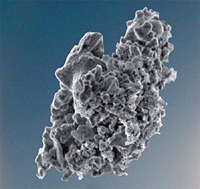
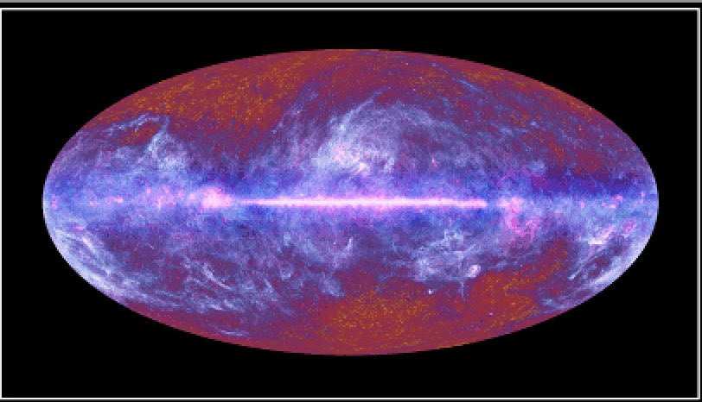
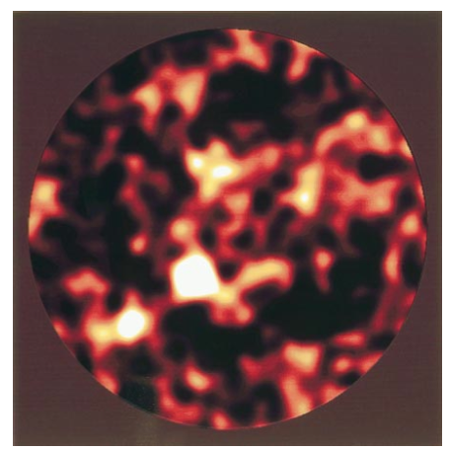
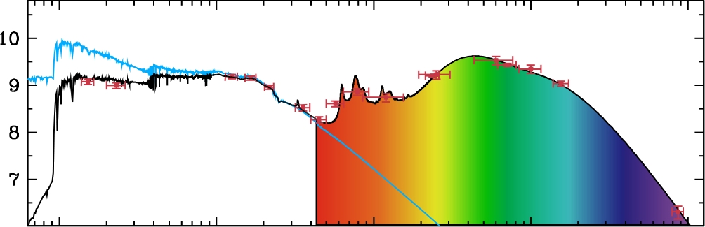
Role of dust in dying stars
Are the death events of stars the major source of dust in the interstellar medium of galaxies?
Infrared/submm = emission from dust
Milky Way
Milky Way
Submm galaxy
Infrared
Spitzer
Herschel
Log (luminosity) (L)
10⁹ M of dust
e.g.
Maiolino et al. 2004, Nature 431, 533
Draine et al. 2009, ASP 414,453
Valiante et al. 2009, MNRAS 397, 1661
Mattsson 2011, MNRAS 414, 781
10⁸ M of dust
At z~6.4; ~0.4 Giga years
(e.g. Bertoldi et al. 2003)
Mrk 33
0.1
1
10
100
1000
Wavelength (micron)

Slide 27
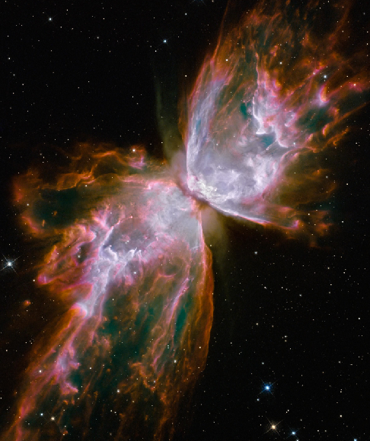
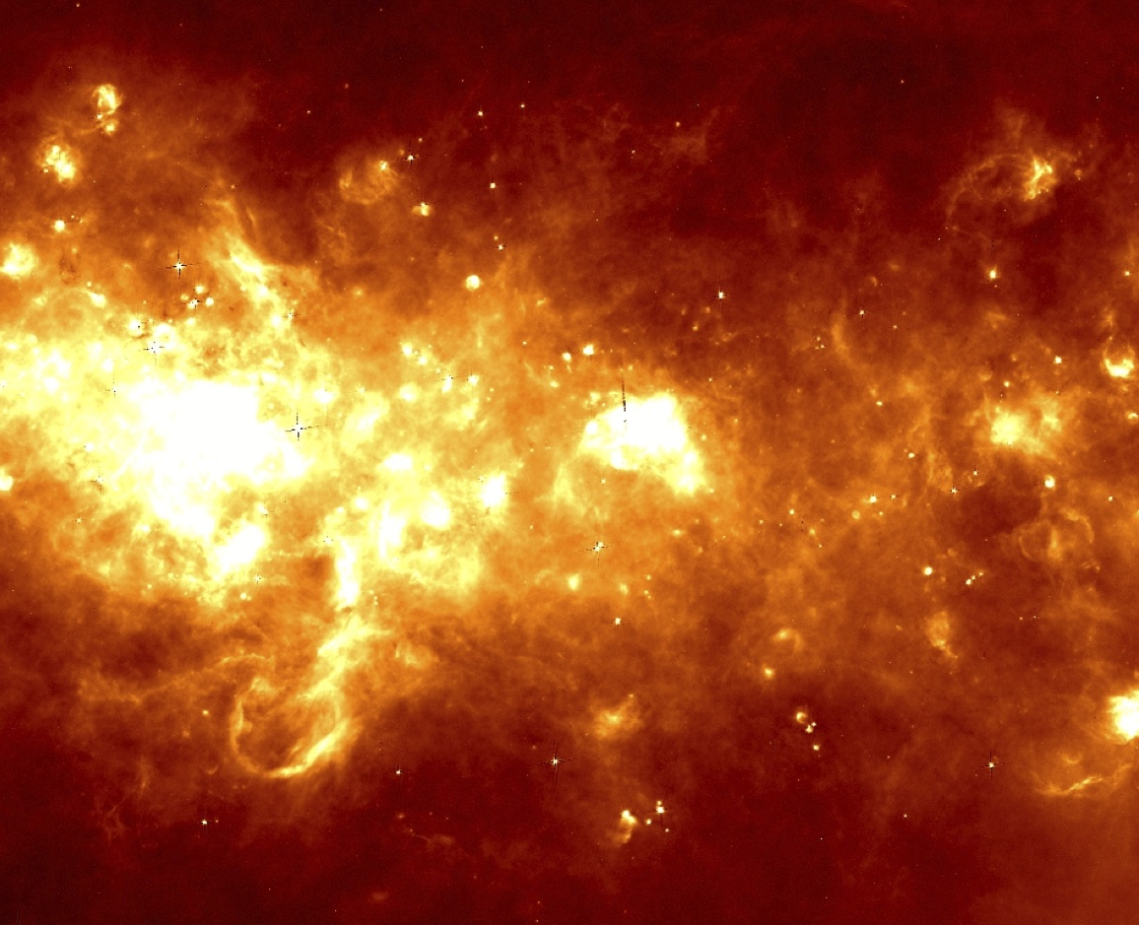
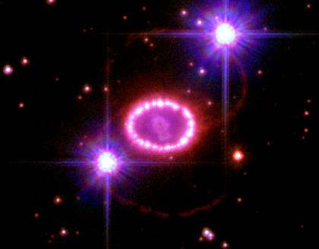
Lifecycle of gas and dust within galaxies
Dust ejected into ISM
Asymptotic giant branch stars
AGB stars
Evolved stars
Interstellar medium (ISM)
Stardust formation
Low- and intermediate-mass stars
Dust destruction by SNe
How much dust?
Supernovae
Star formation
High-mass stars
Stellar evolution

Slide 28
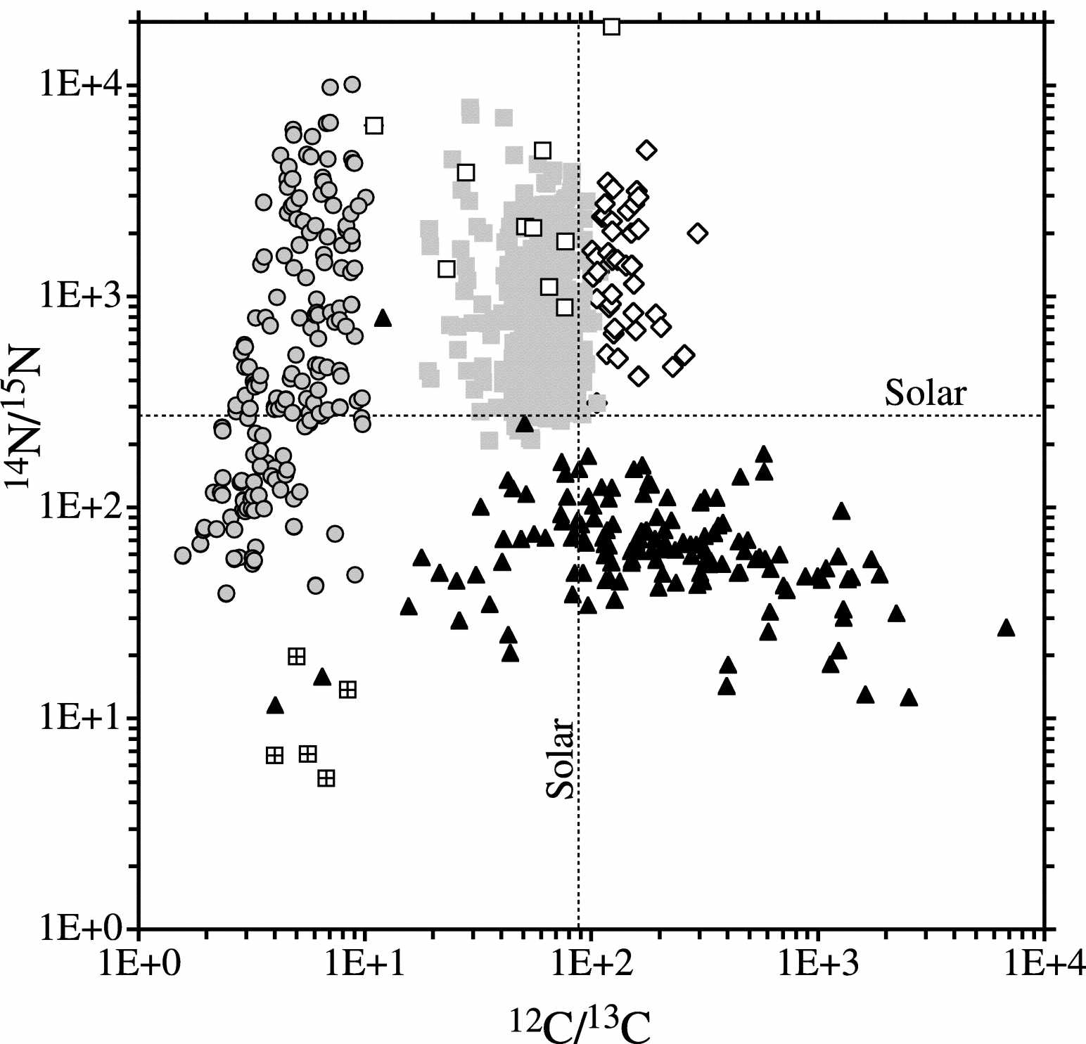
Evidence of dust formation in stars
J-type
carbon stars?
AGB stars
Laboratory measurements of isotope-ratios in pre-solar grains
Supernovae
Novae/supernovae?
(Zinner et al. 2006)

Slide 29
Dust sources in the Milky Way
(1, 2) M kpc⁻² Myear⁻¹
(3) 10⁻² M yr⁻¹
 | Tielens (2005) | Dwek (1998) | Gehrz (1985)
AGB stars | 8.0 | 6.5 | 1.1-6.8
Novae | 0.3 | <0.006 | 0.01
SN Ia | 2.3 | 3.6
Red supergiants | 0.2 |  | 0.02-0.5
SN II | 12 | 8.5 | 0.1-0.6
Wolf Rayet | 0.06 | 0.02 | 0.01
How much dust can be made by AGB stars and supernovae?

Slide 30
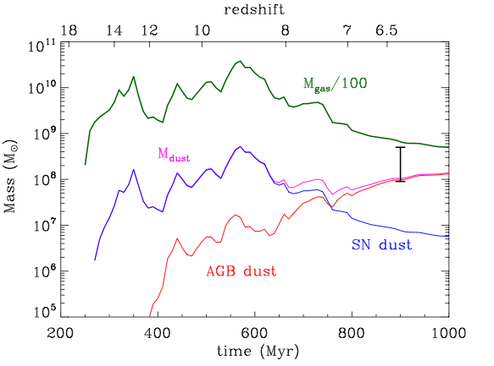
What are the major sources of dust in galaxies?
Two hypothesis
  Stellar origin (SNe + AGB stars)
  ISM grain growth
Measurable
Hard to quantify
Submm galaxy
At z~6.4; ~0.4 Giga years
(e.g. Bertoldi et al. 2003)
Dwek & Cherchneff (2011)
Notes:
A1689-zD1 (z- 7.6; 700 million years old after the big bang)s

Slide 31
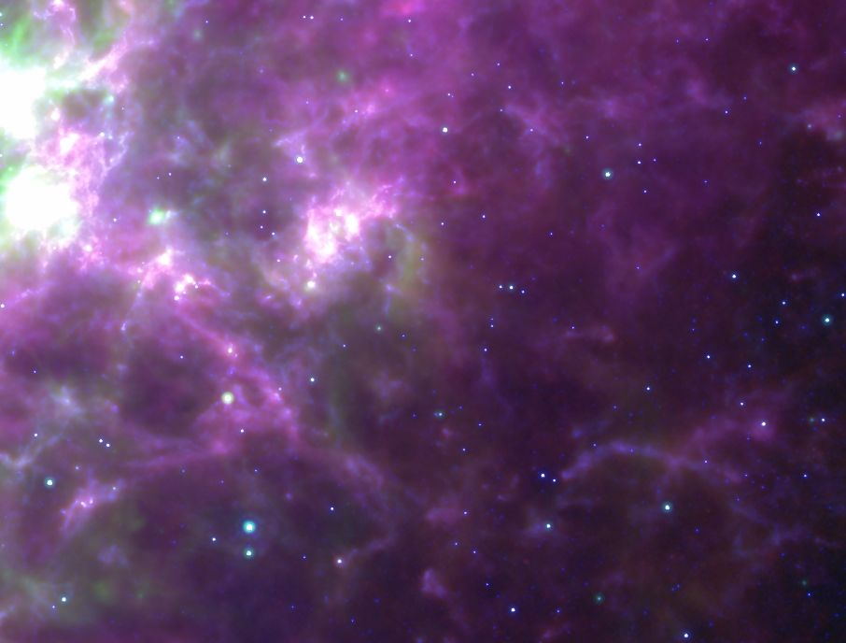
Herschel detection of cold dust in SN 1987A
Herschel Magellanic Clouds survey
(HERITAGE; Meixner et al. 2010)
Herschel 250 micron
Spitzer IRAC 8 micron + MIPS 24 micron
Matsuura et al. (2011)

Slide 32
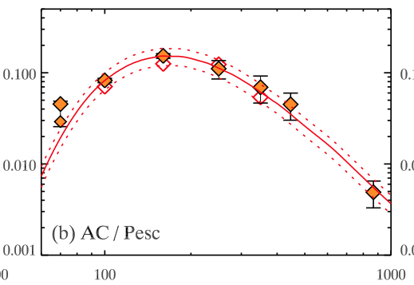
Herschel detection of cold dust in SN 1987A
Herschel + ALMA measurements
Significantly large mass of dust:
0.4-0.7 M of dust
  Must be in the ejecta
  C.f. previously reported mass: 10⁻⁶ -10⁻³ M
Theory predicts 0.1-1 M of dust per SN is required to explain dust in high-z galaxies
Dust formation timescale <25 years
Flux (Jy)
Wavelength (micron)
Matsuura et al. (2015)

Slide 33
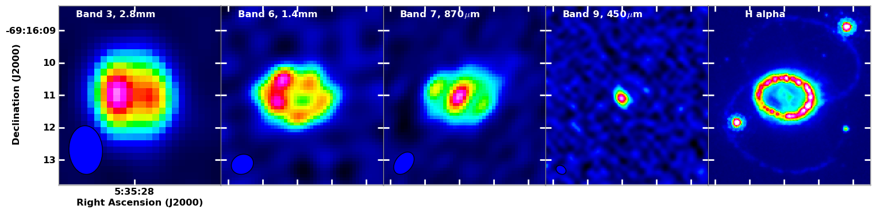
ALMA detection of cold ejecta dust in 2012
450 micron
Dust
1.4 mm
Synchrotron
H alpha
Cold dust in ejecta
SN ejecta
Indebetouw et al. (2014)
Ring: progenitor
Notes:
Expanding shell:
Ring; 100 km s-1
SN ejecta: ~2000 km s-1
Shocks heat the ring / X-ray illumination
Ejecta cools down radiatively in 25 years; temperature below 100K

Slide 34
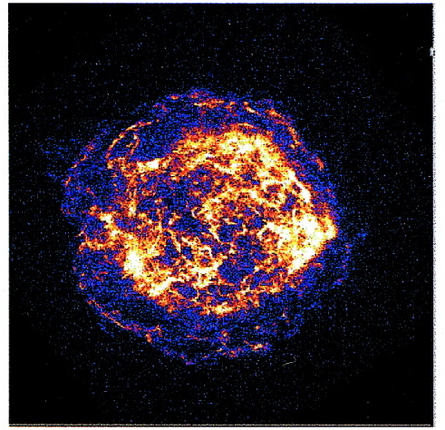
How much dust is destroyed by SN forward & reverse shocks?
Cassiopeia A (AD 1681?)
Forward shocks
Reverse shocks
Gotthelf et al. (2001)

Slide 35
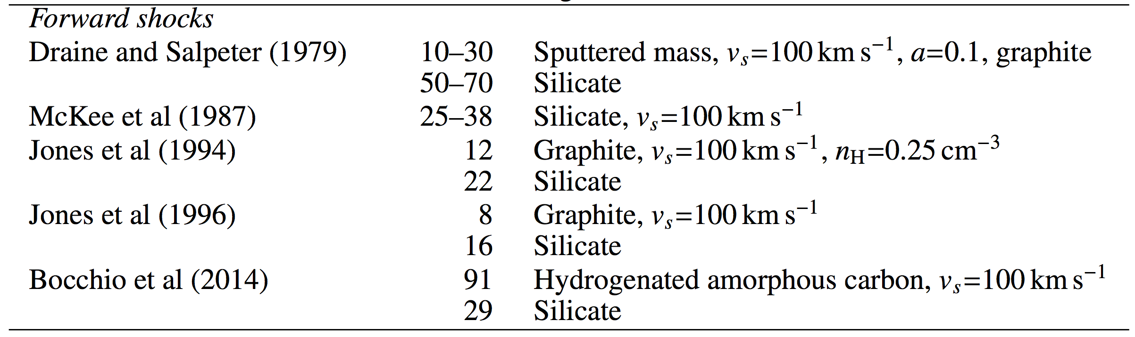
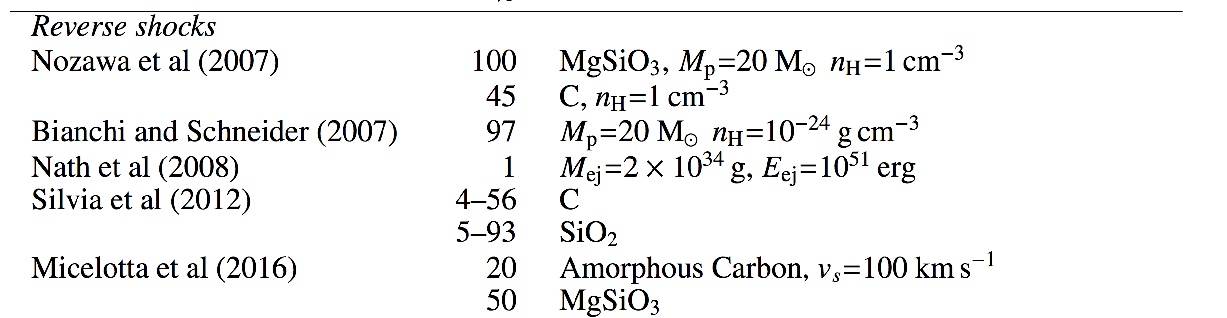
Theoretical prediction of dust destruction by SNRs
Destruction rate

Slide 36
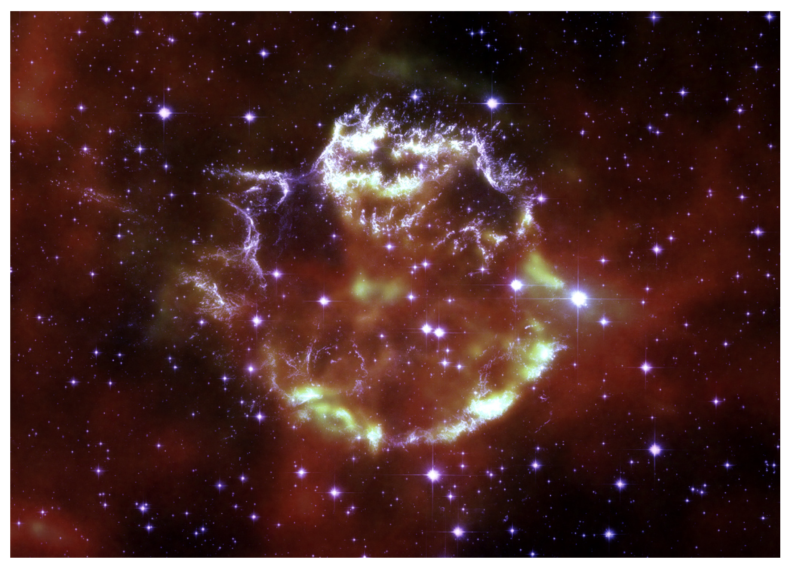
Herschel observations of Cas A
70 micron (red-green) - dust
HST (white – purple) – Hα + continuum
De Looze et al. (2017)

Slide 37
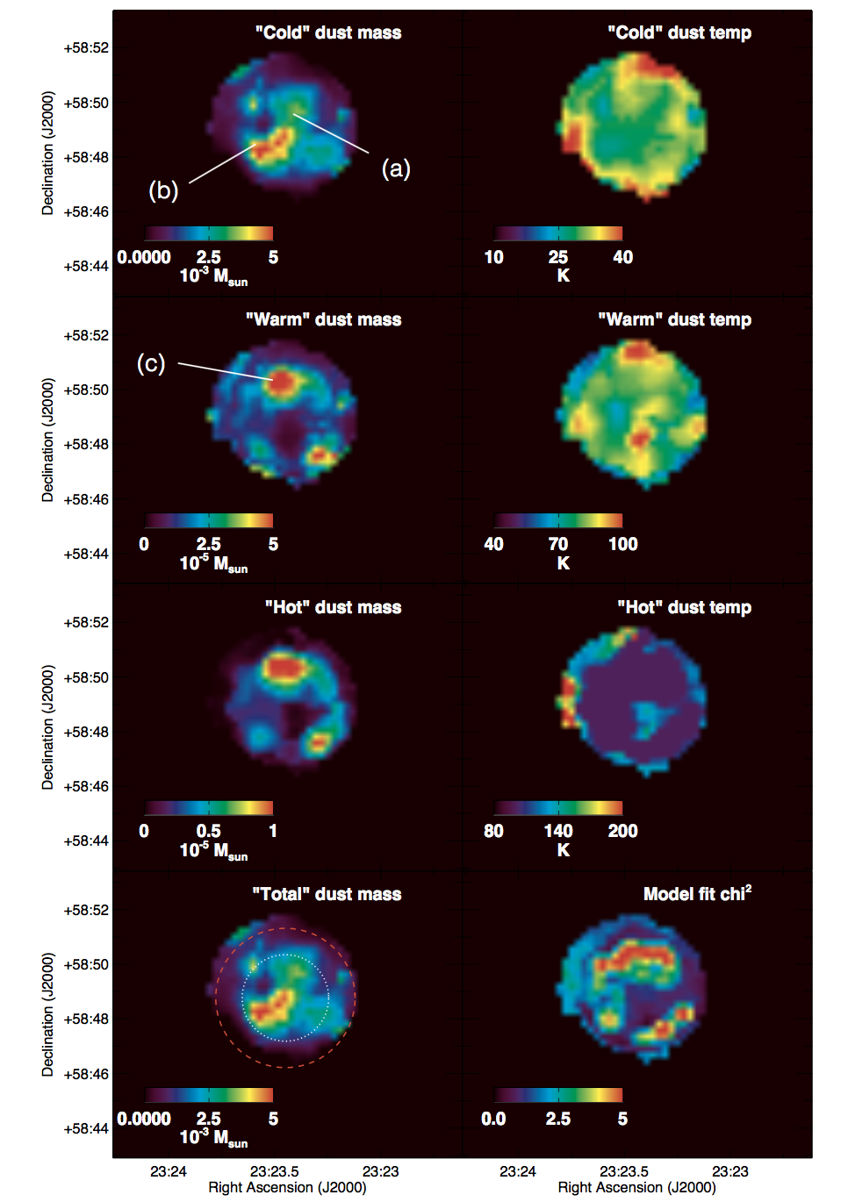
Warm dust: 0.7 M
Cold dust: 0.4 M
(composition dependent)
Reverse shock destruction rate: ~70%
De Looze et al. (2017)
Forward shocks
Reverse shocks
Notes:
Dust mass per volume

Slide 38
Summary
Footprints of explosions
  3-D hydrodynamic simulations of SN explosions
  High angular resolution images
  Clue of mixing via chemical processes
Chemistry of molecules & dust
  Next step is to combine 3-D hydrodynamic simulations with chemical models and radiative transfer models.

