Slide 1
DoCiència
CIÈNCIA, INVESTIGACIÓ I SOCIETAT

Slide 2
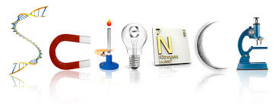



Slide 3
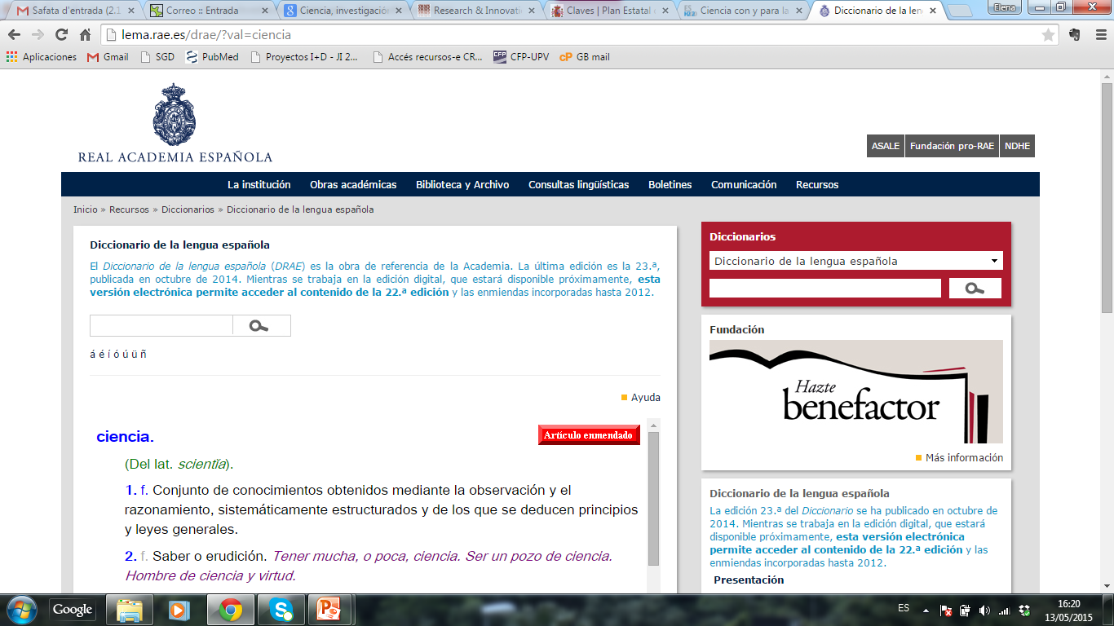
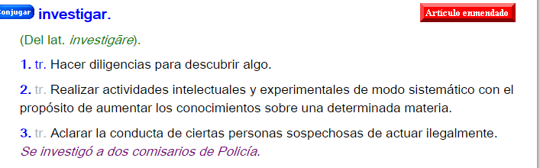
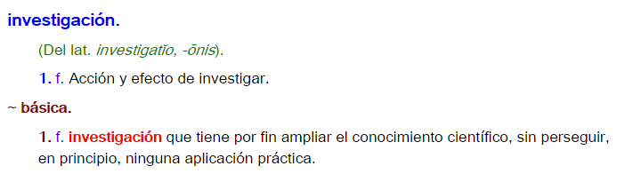
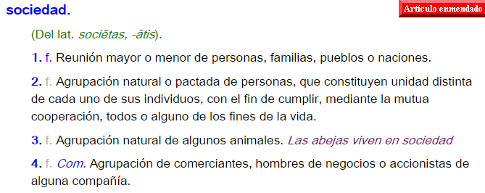

Slide 4
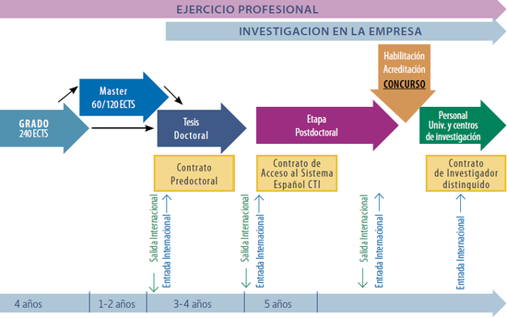
http://www.euraxess.es/servicios/investigadores-extranjeros-en-espana/guia-para-la-gestion-de-la-movilidad-del-personal-investigador-extranjero-en-espana-2014/2.investigar-en-espana/2.3.-la-carrera-investigadora-en-espana

Slide 5
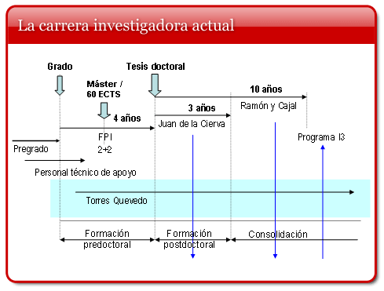
http://www.idi.mineco.gob.es/portal/site/MICINN/menuitem.7eeac5cd345b4f34f09dfd1001432ea0/?vgnextoid=c053941994a01210VgnVCM1000001034e20aRCRD

Slide 6
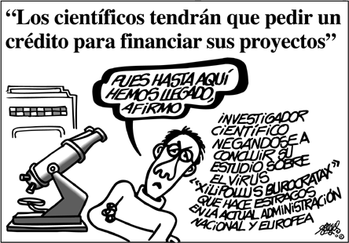
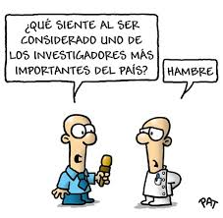
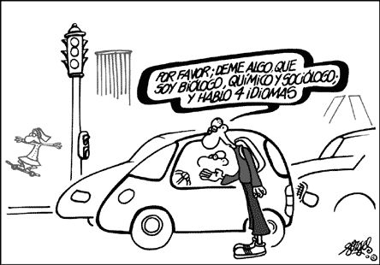
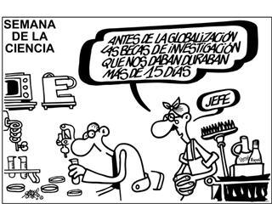

Slide 7
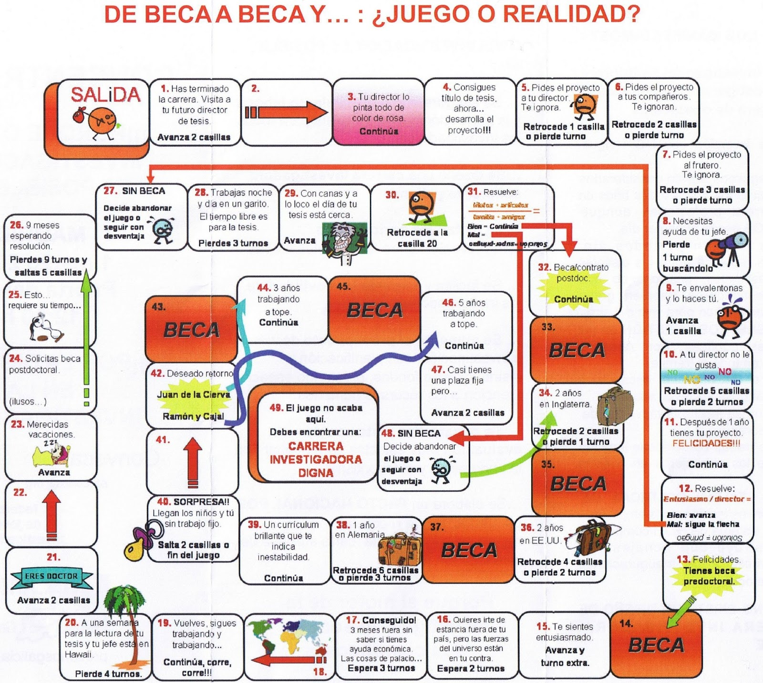
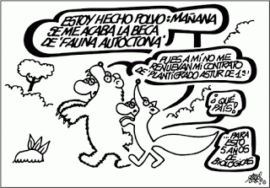

Slide 8
Top 10
http://news.discovery.com/history/archaeology/discoveries-of-the-decade.htm
Human genome mapped
Boson de Higgs
THE RISE OF RARE VARIANTS, http://www.wired.com/2012/12/top-discoveries-2012/
LIFE'S NEW CHEMICAL CODE
Mosser’s discovery of neuroconections (nobel Prize)
Troubleshooting Stem Cell Therapy, https://exploredia.com/top-10-scientific-breakthroughs-of-21st-century/2/
Curing HIV In Germany, https://exploredia.com/top-10-scientific-breakthroughs-of-21st-century/8/
Growing A New Organ From A Patient’s Own Stem Cells, https://exploredia.com/top-10-scientific-breakthroughs-of-21st-century/10/
Life after the synthetic cell, http://www.nature.com/nature/journal/v465/n7297/full/465422a.html

