Slide 1
Economic resources and the dissolution of first unions in Finland
Marika Jalovaara, postdoctoral researcher
Population Research Unit, Department of Social Research (Sociology), University of Helsinki
European Network for the Sociological and Demographic Studies of Divorce. Eighth meeting. València 14–16 October 2010

Slide 2
Postdoctoral researcher’s project (2009–11): “The formation and dissolution of cohabiting unions and marriages”
This study: The economic resources of young adults and the dissolution of first coresidential unions.
Register data, Finland
Cohabiting unions & marriages

Slide 3
Previous research on the economic antecedents of union dissolution
Partners’ economic resources and divorce
Generally an inverse association (e.g. education, his employment, total income, wealth)
Woman’s economic independence may also encourage separation & divorce. But: context.
Cohabiting unions more compatible with egalitarian income patterns?
Some evidence: Equality stabilizes cohabiting unions, whereas traditional specialization stabilizes marriages (Brines & Joyner 1999, Kalmijn, Loeve & Manting 2007)

Slide 4
This study
Description: Separation probabilities by duration; cohabiting unions & marriages
Economic resources and union dissolution, by union type
Education, economic activity and income
Both partners & interactions between partners.
Cohabiting unions and marriages
Important to include both
Comparisons between union types

Slide 5
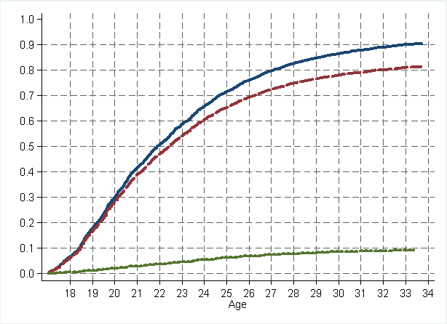
Cumulative probability of entry into first union by union type; women born 1969–81
Either union
Cohabitation
Direct marriage
Source: Jalovaara, submitted

Slide 6
The Palapeli research register
Longitudinal register data from Statistics Finland
The entire population of Finland 1971–2000
and follow-up of data 2001–2003
Individuals & unions & partners & children.
Yearly data on income, employment, occupation, etc.
Here: 11 % random sample of the individuals.
Dates of events to the precision of the month
Unions: marriages, and 1987–2003 cohabiting unions

Slide 7
Coresidential unions
Minimum age: 18 years
a male and a female
registered as domiciled in the same dwelling for >3 months
were not close relatives, e.g. siblings or parent & child
age difference was max 20 years, or the partners had a child together
Not married to each other → cohabiting union

Slide 8
The unions analyzed
First unions of women born in 1969–1981 in Finland
Cohabiting unions & marriages
The marriages include a) direct marriages and b) marriages entered via cohabitation. Means that many couples are in the data first cohabiting & then married.
married
single
cohabiting

Slide 9
Follow-up and events
Entry into follow-up: entry into union.
Followed until separation, or censoring:
death of either partner; emigration during the same month, end of 2002.
For cohabiting couples, marriage.
Separation:
moving apart (min 1 year, or a union with a new partner)
or judicial divorce

Slide 10
Size of data
 |  | Cohabiting unions | Marriages
Subjects |  | 28,476 | 10,457
Events |  | 12,032 | 1,594
Months at risk |  | 926,192 | 582,341
Years at risk |  | 77,183 | 48,528

Slide 11
Event history methods
Descriptive:
Kaplan-Meier failure estimates
Competing events: Cumulative incidences (stcompet)
Piecewise-constant hazard rate model
Analysis time: Time since entry into union, constant over single-year durations
Hazard ratios

Slide 12
Measures of economic resources
All time-varying. All for both partners.
Educational attainment (end of previous month)
Economic activity (end of previous year)
Employed, unemployed, student, military service, other
Income (total taxable; previous year; adjusted for inflation). Euro levels
Interactive patterns:
Combinations of the partners’ income levels (in euros)
Log(household income) and woman’s relative contribution
Notes:
T
*******************
Level of education:
1. Basic (about 9 years or fewer), no data on post-basic education;
2. Secondary level: an occupational training with a duration of 3 or fewer years, or completed matriculation examination;
3. Lowest level tertiary: generally 2–3 years after secondary level;
4. Lower-degree level tertiary: generally 3–4 years after secondary level;
5. Higher-degree level tertiary: generally 5–6 years after secondary level. Or doctoral.

Slide 13
Control variables
Age at entry into the union (cohabitation or marriage)
Parent status (end of previous month)
Pregnancy status (end of previous month)
Degree of urbanization, municipality of residence (end of previous year) urban, semi-urban, rural
Age difference
Marriages: Type of marriage (direct or after cohabitation)

Slide 14
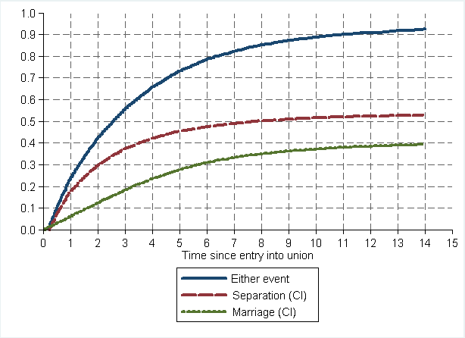
Cumulative probability of separation, marriage, and either event; the first cohabiting unions.

Slide 15
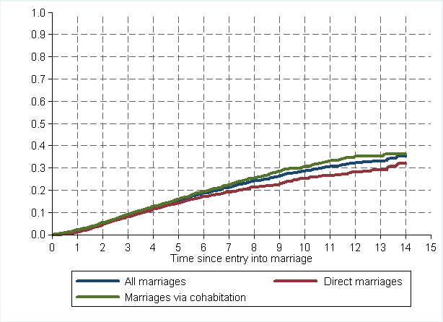
Cumulative probability of separation; the first marriages (direct marriages & via cohabitation.

Slide 16
The predicted separation hazards per year for cohabiting unions and marriages.

Slide 17
Control variable model
Separate models for cohabiting unions & marriages
The control variables
Age at entry into the union
+ Parent status
+ Pregnancy status
+ Degree of urbanization
+ Age difference
+ Marriage type (in the model for marriages)

Slide 18
Hazard ratios of separation by age at entry into union; the control variable model

Slide 19
Hazard ratios of separation by parent status; the control variable model

Slide 20
Hazard ratios of separation by pregnancy and marriage type; the control variable model
 | Cohabiting |  |  |  | Married
Pregnancy | 0.33 |  |  |  | 0.47
Marriage type (ref: direct marriage) |  |  |  |  | 1
Married after cohabitation |  |  |  |  | 1.43

Slide 21
Hazard ratios of separation by place of residence; the control variable model

Slide 22
Hazard ratios of separation by age difference; the control variable model

Slide 23
”Full” model = model B
The control variables
Age at entry into the union + Parent status + Pregnancy status + Degree of urbanization + Age difference [+ Marriage type]
& all SES variables
Education, economic activity and income of both partners.
Separate models for cohabiting unions & marriages

Slide 24
Hazard ratios of separation by woman’s educational attainment (Model B)

Slide 25
Hazard ratios of separation by man’s educational attainment (Model B)

Slide 26
Hazard ratios of separation by woman’s economic activity (Model B)

Slide 27
Hazard ratios of separation by man’s economic activity (Model B)

Slide 28
Hazard ratios of separation by woman’s income; Model B

Slide 29
Hazard ratios of separation by man’s income; Model B

Slide 30
Hazard ratios of separation by woman’s and man’s income; cohabiting unions.
low
high
As model B, but separate income variables replaced
with a combination variable

Slide 31
Hazard ratios of separation by woman’s and man’s income; marriages.
high
As model B, but separate income variables replaced
with a combination variable

Slide 32
Hazard ratios of separation by total income and woman’s relative contribution
 | Economic activities not controlled |  |  | Economic activities controlled
 | Cohabitation | Marriage |  | Cohabitation | Marriage
Total income logged | 0.92 | 0.90 |  | 0.98 | 0.95
Woman’s relative contribution | 1.37 | 1.80 |  | 1.27 | 1.70
All adjusted for: the control variables, and education of both partners

Slide 33
Summary of findings
The first cohabiting unions of young Finnish adults are often short-lived: the partners either marry or separate. Separation was more likely than marriage. Marriages were less likely to end in separation than cohabiting unions.
Higher age at entry, a pregnancy and a baby, rural residence, and a conventional age difference lowered separation rates in both union types.
A negative effect of education: both partners & both union types.
Economic activity: a pos effect of man’s unemployment in both union types.

Slide 34
Summary of findings (continued)
Income: Gendered effects and differences by union type:
Main effects:
Positive effect of woman’s income only in marriages.
Negative effect of man’s income in both union types.
Combinations of the two partners’ incomes
Cohabiting unions: a positive effect, if man’s income is low and no effect if the man’s income is high.
Marriages: low risk if man’s income high and woman’s income low. High risk if woman’s income is high.
It may be that cohabiting unions are a bit more compatible with income equality than marriages are.

Slide 35
Thank you! Questions? Comments?

