Slide 1
Valencian Vowel Harmony at the Interface
Jesús Jiménez (U de València)
Ricard Herrero (U Catòlica de València)
OCP9, Berlin, January 19-21, 2012

Slide 2
Background
Valencian Catalan has a stressed system of 7 vowels ([i e ɛ a ɔ o u]). This inventory is generally reduced to 5 elements in unstressed positions ([i e a o u]).
In unstressed syllables, underlying [−ATR] vowels /ɔ́/ and /ɛ́/ raise to [o] and [e], respectively (cf. Wheeler 2005, e.g.):
Stressed Unstressed
pistola [pistɔ́la] ‘gun’ pistoler [pistoléɾ] ‘gunman’
tela [tɛ́la] ‘cloth’ teler [teléɾ] ‘loom’

Slide 3
Background
Some Valencian varieties exhibit a process of vowel harmony by which word-final low vowels assimilate totally to a preceding [−ATR] vowel (/ɔ́/ or /ɛ́/). Typically, both vowels (/ɔ́/ and /ɛ́/) trigger the process.
  Canals variety
/ɔ́/+/a/: pistola [pistɔ́lɔ] ‘gun’
/ɛ́/+/a/: tela [tɛ́lɛ] ‘cloth’

Slide 4
Background
However, there are varieties in which only one of the mid-open vowels causes assimilation:
Borriana variety
/ɔ́/+/a/: pistola [pistɔ́lɔ] ‘gun’
/ɛ́/+/a/: tela [tɛ́la] ‘cloth’

Slide 5
Background
When conditions for vowel harmony are not met, final /a/ is realized as [a], more or less raised and colored (varieties with final neutralization to [ɛ] or to [ɔ] are also attested):
Borriana variety
/á/+/a/: sala [sála] ‘room’
/ó/+/a/: directora [diɾektóɾa] ‘director (fem)’
/é/+/a/: cera [séɾa] ‘wax’

Slide 6
Background
Vowel harmony is quite common in the southern Valencian dialect.
The distribution of the three different patterns of vowel harmony (only with /ɔ́/, only with /ɛ́/ or with both [−ATR] vowels) is extremely irregular (cf. Jiménez 2001: 225-227; Saborit 2010: 252).
    (Map source: J. Saborit’s blog, “La /-a/ final i les harmonies vocàliques”, http://reocities.com/SoHo/cafe/9308/alvhv.jpg)

Slide 7
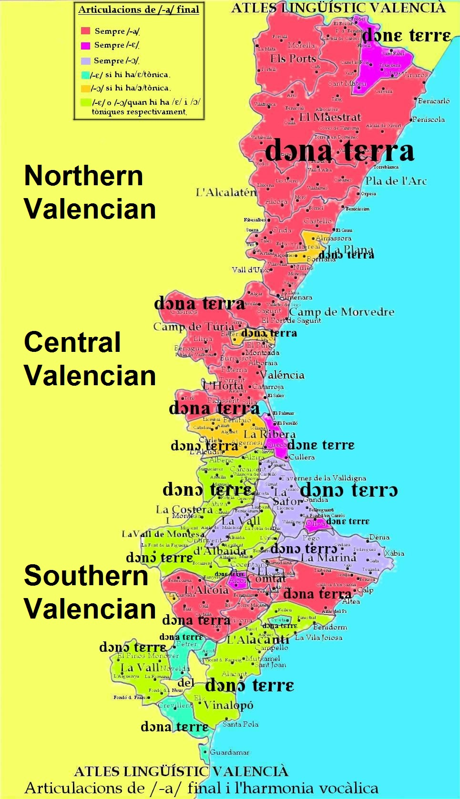

Slide 8
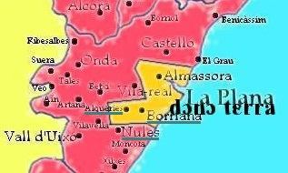
Background
In some towns belonging to the northern dialect (among which Borriana and Les Alqueries) round vowel harmony has been reported as well.

Slide 9
Background
This study will be devoted to two northern Valencian varieties:
  The harmonic variety spoken in Borriana and Les Alqueries (from now on, shortened as ‘Borriana variety’).
  The supposedly non-harmonic variety of the nearby town of Nules.

Slide 10
Goals
To investigate how formant frequency values of both the stressed and the final vowels vary in Borriana and Nules varieties as a function of different combinations of a mid-open vowel and a low vowel.
To show that there is neither generalized neutralization of /a/ to [ɔ] (sala *[sálɔ]), nor significant assimilatory processes triggered by stressed /ɛ́/ (tela *[tɛ́lɛ]) in either variety.

Slide 11
Goals
To demonstrate that Borriana variety displays round vowel harmony from stressed /ɔ́/ to a post-tonic final /a/ (pistola [pistɔ́lɔ]), whereas Nules variety only exhibits high coarticulation levels in the same environment.
To show that, in a perceptually asymmetrical context (toca-la ‘touch it (fem)’ [tɔ́kɔla]), /a/ undergoes round vowel harmony in Nules variety as well.

Slide 12
Goals
To analyze the extent to which the presence of a morpheme boundary, a clitic boundary or a word boundary affects the degree of assimilation.
To discuss whether Nules coarticulation can be considered a phonetic process, prior to the phonologization pattern depicted by Borriana variety.

Slide 13
Outline of the presentation
Acoustic study: Methodology
Leveling of F1 in Nules & Borriana
Leveling of F2 in Nules & Borriana
  The starting point: neutral contexts
  The preharmonic stage: Nules
  The harmonic stage: Borriana
Concluding remarks

Slide 14
I. Acoustic study: Methodology
1. Participants
8 male subjects from each variety
Ranging from 43 to 65-years old
With no studies in Valencian Catalan
    *For Borriana variety, 2 non-harmonic speakers were discarded to prevent interference.

Slide 15
I. Acoustic study: Methodology
2. Task
The participants were provided with the sentences in Spanish and were asked to translate them into Valencian Catalan.
  Spanish: Tiene una pistola, pero pequeña.
  Valencian: Té una pistola, però xicoteta.
    Gloss: ‘S/he has a gun, but small.’

Slide 16
I. Acoustic study: Methodology
3. Sequences analyzed
Final unstressed /a/
In a neutral context (/á/+/a/):
        sala /sál+a/ ‘room’
        Sara /sáɾ+a/ ‘proper name’
      [In these data, + occurs at the site of attachment for an affix and # for a clitic; a major word-boundary is indicated by ##.]

Slide 17
I. Acoustic study: Methodology
3. Sequences analyzed
After the stressed vowels [ɔ́] and [ɛ́], appearing:
  In a prototypically harmonic environment:
    Contiguous syllables within the word:
      Context /ɔ́/+/a/:
      pistola /pistɔ́l+a/ ‘gun’
      cassola /kasɔ́l+a/ ‘pot’
      Context /ɛ́/+/a/:
      tela /tɛ́l+a/ ‘cloth’
      serra /sɛ́r+a/ ‘saw’

Slide 18
I. Acoustic study: Methodology
3. Sequences analyzed
  In two non-prototypically harmonic contexts:
    Adjacent syllables, but separated by a minor morphological boundary, a clitic limit (#):
      Context /ɔ́/#/a/:
      dissol-la /disɔ́l#la/ ‘dissolve it (fem)’
      correspon-la /korespɔ́n#la/ ‘respond to her’
      Context /ɛ́/#/a/:
      perd-la /pɛ́ɾd#la/ ‘lose it (fem)’

Slide 19
I. Acoustic study: Methodology
3. Sequences analyzed
  In two non-prototypically harmonic contexts:
    Adjacent syllables, but separated by a major morphological boundary, a word-boundary (##):
      Context /ɔ́/##/a/
      dissol la farina /disɔ́l##la…/
      ‘s/he dissolves the (fem) flour’
      li correspon la faena /korespɔ́n##la…/
      ‘it’s his/her task’
      Context /ɛ́/##/a/ (/pɛ́ɾd##la…/):
      perd la clau ‘s/he loses the (fem) key’
      perd la jaqueta ‘s/he loses the (fem) jacket’

Slide 20
I. Acoustic study: Methodology
3. Sequences analyzed
For the sake of comparison, the vowels [ɔ́] and [ɛ́], were also registered in a neutral context:
      Monosyllabic words with /ɔ́/:
      sol /sɔ́l/ ‘sun’
      sort /sɔ́ɾt/ ‘luck’
      Monosyllabic words with /ɛ́/:
      cel /sɛ́l/ ‘sky’
      cert /sɛ́ɾt/ ‘certain’

Slide 21
I. Acoustic study: Methodology
3. Sequences analyzed
Whenever possible, the vowels were placed in the same consonantal environment: the stressed vowel was preceded by an unvoiced coronal obstruent and followed by a coronal liquid consonant, as in pistola or tela.
The syllables preceding the stressed syllable and following the final low vowel were generally unstressed.

Slide 22

I. Acoustic study: Methodology
3. Sequences analyzed
The sequences were situated at the end of a phonological phrase…
  …inside the sentence:
    Ex.: Té una pistola, però xicoteta.
      Gloss: ‘S/he has a gun, but small’
  …at the end of the sentence:
    Ex.: Això és una pistola.
      Gloss: ‘That’s a gun’
(In general, this parameter proved to be irrelevant to the assimilation. Therefore, we will leave aside the analysis of occurrences located at the end of the sentence.)

Slide 23
I. Acoustic study: Methodology
4. Recordings
Two different tokens of each context (if possible) were registered.
The sentences were registered in a quiet room.
  Digital recorder Zoom H4.
  AKG C520L Head-worn Cardioid Condenser Microphone.
  44,1 kHz sampling and 24 bits resolution.

Slide 24
I. Acoustic study: Methodology
5. Data labeling and analysis
The mid-point of the vowels was identified using Praat.
A Praat automatic routine was designed to extract the acoustic features: duration of the vowel, and intensity and formant values at the mid-point of the vowel.
SPSS software package (SPSS 19) was used to perform statistical tests (one-way ANOVA; post-hoc Tukey).

Slide 25
II. Leveling of F1 in Nules & Borriana
1. Introduction
The analysis of F1, related to height, is especially relevant in Valencian because /ɛ ɔ/ tend to be extra-open (cf. Recasens 1991, Carrera & Fernández 2005, Saborit 2009).

Slide 26
II. Leveling of F1 in Nules & Borriana
1. Introduction
Hence, Valencian vowel harmony has been attributed to articulatory factors, i.e. to the extreme similarity between the [−ATR] mid vowels and the low vowel.
(Cf. Recasens 1998; Jiménez 1998, 2001, 2002; Saborit 2009. Alternative views, suggesting perception enhancement as the trigger, are developed in Jiménez 1998; Walker 2005, 2011; Jiménez & Lloret 2011).

Slide 27
II. Leveling of F1 in Nules & Borriana
1. Introduction
However, [−ATR, −low] vowels /ɛ/ and /ɔ/ in northern Valencian are not usually as extra-open as in the Southern dialect (cf. Recasens 1991, Herrero 2008).
So, the presence of harmony in northern varieties seems to challenge the purely articulatory hypothesis (cf. Herrero & Jiménez 2011a).

Slide 28
II. Leveling of F1 in Nules & Borriana
2. General pattern
Generally, the Valencian three [−ATR] vowels, /ɛ a ɔ/, contrast among them in height:
/ɛ/ | /a/ | /ɔ/
[−ATR] | [−ATR] | [−ATR]
[−low] | [+low] | [−low]

Slide 29
II. Leveling of F1 in Nules & Borriana
2. General pattern
The realization of /ɛ a ɔ/ in monosyllabic words in Nules and Borriana reflects this contrast: in both varieties, the vowel [á] has the highest degree of aperture; the F1 value of the mid-open vowels [ɔ́] and [ɛ́] is lower and roughly equivalent.
There is a small difference, though, between [ɛ́] and [ɔ́]: the first vowel tends to be slightly more open (a Valencian peculiarity already pointed out by Carrera & Fernández 2005, Herrero 2010b, among others).

Slide 30
II. Leveling of F1 in Nules & Borriana
2. General pattern
Additionally, although /ɛ ɔ/ are usually more closed than in other Valencian varieties, the realization of /a/ is also less open.
So, the similarity in the degree of aperture of all three [−ATR] vowels, which should favor vowel harmony, is still maintained in the varieties under focus.

Slide 31
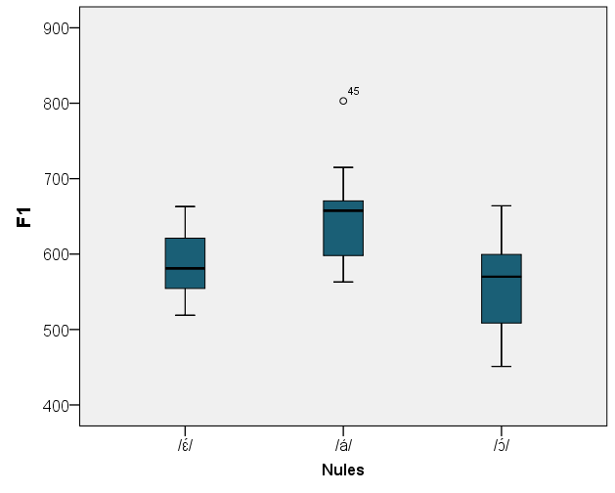
II. Leveling of F1 in Nules & Borriana

Slide 32
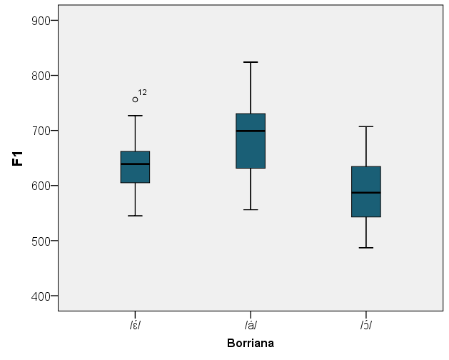
II. Leveling of F1 in Nules & Borriana

Slide 33
II. Leveling of F1 in Nules & Borriana
3. Contextual leveling
The basic contrast in height between mid-open vowels and the low vowel in monosyllabic words tends to disappear somehow when these segments are followed by an unstressed [a] (sala, tela, pistola).

Slide 34
II. Leveling of F1 in Nules & Borriana
3. Contextual leveling
In Nules, all the vowels in the contexts under study are equivalent in height, except the stressed [ɔ́] (the average difference, though, is very small: 43Hz from the [ɔ́] in pistola to the /ɛ́/ in tela, for instance).
    Context /ɔ́/+/a/ (pistola)
    Context /ɛ́/+/a/ (tela)
    Context /á/+/a/ (sala)

Slide 35
II. Leveling of F1 in Nules & Borriana
3. Contextual leveling
In Borriana, the differences in F1 disappear when we compare the two vowels in every potentially harmonic context:
    Context /ɔ́/+/a/ (pistola)
    Context /ɔ́/#/a/ (dissol-la)
    Context /ɔ́/##/a/ (dissol la…)
    (likewise, in the contexts /ɛ́/+/a/ (tela) & /á/+/a/ (sala))

Slide 36
II. Leveling of F1 in Nules & Borriana
4. General remarks
In Nules and Borriana, the matching in height between the stressed and the unstressed vowel is even found in the absence of partial color assimilation (context tela, for example) or total color assimilation (context dissol la farina, for instance).

Slide 37
II. Leveling of F1 in Nules & Borriana
4. General remarks
Hence, we can assume that the leveling of F1 in every potentially harmonic context in Borriana (and in some contexts in Nules) is independent from vowel harmony and probably prior to it.
That is, the leveling of height would not be a parasitic effect of color harmony (against Jiménez 1998).

Slide 38
II. Leveling of F1 in Nules & Borriana
4. General remarks
Typological relevance:
  The Valencian case was special among Iberian harmony processes since it appeared to affect primarily color and to alter height only as a by-product.
  But this set of data provides evidence that, even in Valencian, changes in height are prior to changes in color, and probably also indicate that, in this dialect, contrasts in height among vowels are more unstable than contrasts in color.

Slide 39
II. Leveling of F1 in Nules & Borriana
4. General remarks
According to the traditional hypothesis, the scenario presented so far, with a radical reduction of height contrasts in harmonic contexts, should favor assimilation of color, although…
… similarity in height among segments should especially promote coarticulation & harmony between /a/ and the mid-open front vowel /ɛ́/ (cf. Herrero 2008, Herrero & Jiménez 2011a).

Slide 40
III. Leveling of F2 in Nules & Borriana
Structure:
  The starting point: neutral contexts
    Basic contrast
    Lack of general assimilation or neutralization
  The preharmonic stage: Nules
  The harmonic stage: Borriana

Slide 41
III.1. The starting point: neutral contexts
1. Basic contrast
    [−ATR] vowels also present a contrast depending on color (i.e. place of articulation).
    In neutral contexts, without assimilation (cel, sal and sol), the distinction is undoubtedly robust enough in both varieties:
/ɛ/ | /a/ | /ɔ/
[−back] | [+back] | [+back]
[−round] | [−round] | [+round]
[−ATR] | [−ATR] | [−ATR]
[−low] | [+low] | [−low]

Slide 42
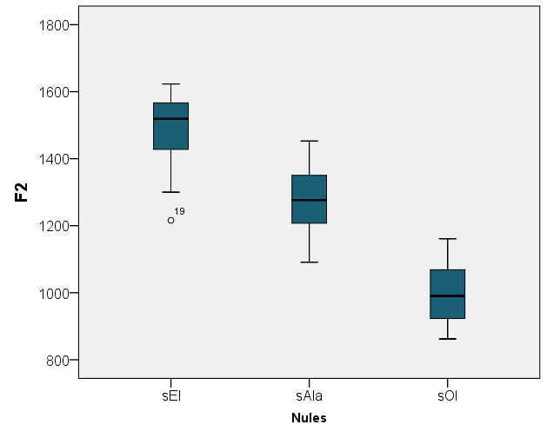
III.1. The starting point: neutral contexts

Slide 43
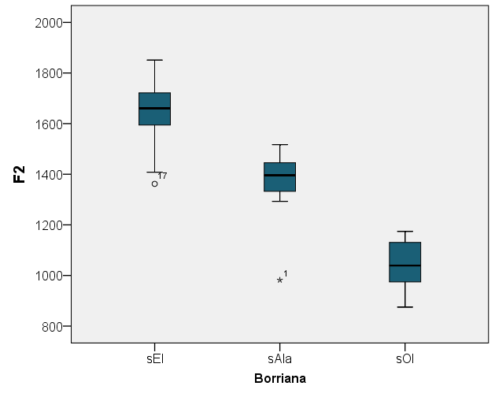
III.1. The starting point: neutral contexts

Slide 44
III.1. The starting point: neutral contexts
2. Lack of general assimilation or neutralization
    In Nules and Borriana the F2 values of unstressed /a/ in post-tonic position are not different from stressed /á/,…
  …neither in the context /á/+/a/:
        sala [sála] *[sálɔ], *[sálɛ]
  …nor in the context /ɛ́/+/a/:
        tela [tɛ́la] *[tɛ́lɛ], *[tɛ́lɔ]

Slide 45
III.1. The starting point: neutral contexts
2. Lack of general assimilation or neutralization
    Hence, there is neither general neutralization of final /a/ as [ɔ] (or [ɛ]), nor assimilation triggered by the stressed front vowel [ɛ́].
    Obviously, in both varieties the F2 value of the stressed [ɛ́] differs from the three low vowels of sala and tela:

Slide 46
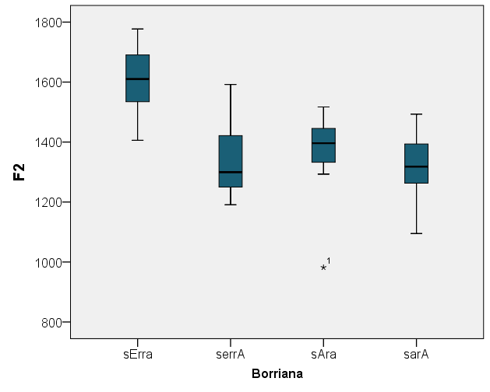
III.1. The starting point: neutral contexts

Slide 47
III.2. The preharmonic stage: Nules
1. General pattern
    In the environment /ɔ́/+/a/ (pistola) the F2 of the unstressed /a/ has an intermediate value between that of the stressed /ɔ́/ (pistola) and that of the unstressed /a/ in the context /á/+/a/ (sala), and is significantly different from the values of the last two vowels.

Slide 48
III.2. The preharmonic stage: Nules
1. General pattern
    The backing/rounding of /a/ in the context /ɔ́/+/a/ (pistola) is supposed to be caused by coarticulation stemming from the stressed vowel. (cf. Herrero 2010a)
    As a typical phonetic process, it should operate across morphological boundaries as well.

Slide 49
III.2. The preharmonic stage: Nules
1. General pattern
    Indeed, the levels of coarticulation across a clitic boundary (context dissol-la) & across a word boundary (context dissol la farina) are statistically equivalent to those found in the prototypically harmonic context (pistola).
    And in both cases the partially assimilated vowels appear to be different from the unstressed final low vowel in sala and the stressed round vowel in pistola.

Slide 50
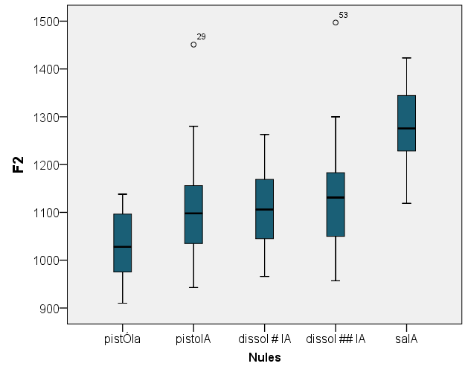
III.2. The preharmonic stage: Nules

Slide 51
III.2. The preharmonic stage: Nules
2. Perceptually asymmetrical contexts
    Word-final /a/ is protected from total assimilation by its relative prominence (on the status of final vowels, see Barnes 2006, Walker 2011).
    By comparison, post-tonic internal syllables are regarded as prosodically weaker. What happens in that position, i.e. in a less prominent site?

Slide 52
III.2. The preharmonic stage: Nules
2. Perceptually asymmetrical contexts
    Difficulties in describing the behavior of /a/ in this environment:
      Proparoxytones are not frequent in Romance languages.
      Post-tonic internal /a/ in traditional Catalan words were raised to [e]: orphănu > orfe (fem: òrfena), orgănu > orgue.
      Additionally, proparoxytones with internal /a/ tend to be learned words (apòstata ‘apostate’, pròstata ‘prostate’), usually taken directly from Spanish sources, without [−ATR] mid vowels.

Slide 53
III.2. The preharmonic stage: Nules
2. Perceptually asymmetrical contexts
    As a result, speaker’s intuitions for these words are uncertain.
    Alternative: Verbal forms ending in /a/ with penultimate stress followed by a syllabic clitic (for instance, the feminine clitic la):
      toca-la /tɔ́ka#la/ ‘touch it (fem)’
      assola-la /asɔ́la#la/ ‘devastate it (fem)’

Slide 54
III.2. The preharmonic stage: Nules
2. Perceptually asymmetrical contexts
    In these cases, the clitic forms a prosodic unit with the host (either a recursive phonological word or a clitic group):
      PWd (ClGr)
      PWd
      [[tɔ́k+a] #la]

Slide 55
III.2. The preharmonic stage: Nules
    2. Perceptually asymmetrical contexts
    In the context /tɔ́ka#la/, the intensity of the stressed vowel and the two post-tonic ones is not significantly different.
    But their length is distinctly different, with the length of the post-tonic internal vowel at the bottom; i.e. the internal vowel can be considered weaker.
      The shortening is especially pronounced in the sequence toca-la, the most common one.

Slide 56
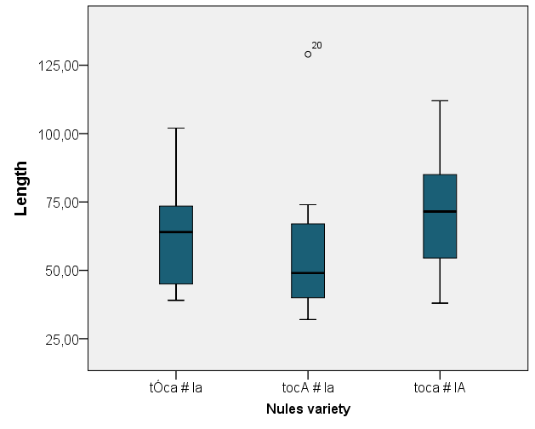
III.2. The preharmonic stage: Nules

Slide 57
III.2. The preharmonic stage: Nules
    2. Perceptually asymmetrical contexts
    Outcome: Post-tonic internal /a/ undergoes total assimilation with the stressed vowel /ɔ́/ in the verbal form.
    Vowel harmony does not continue to the following pronoun. The clitic vowel shows intermediate F2 values between the coarticulated /a/ in the context pistola and neutral [a] in the context sala. Hence, there is coarticulation with the preceding unstressed vowel, but less intense.

Slide 58
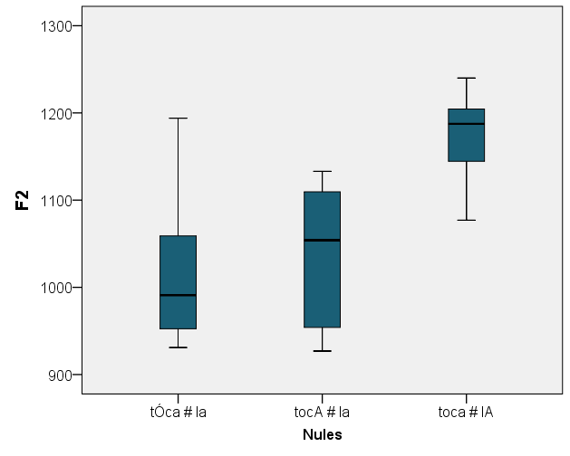
III.2. The preharmonic stage: Nules

Slide 59
III.2. The preharmonic stage: Nules
2. Perceptually asymmetrical contexts
    By contrast, although the same variation in vowel length exists, there are no similar assimilatory effects related to the front vowel /ɛ́/ in the parallel context /ɛ́/#/a/##/la/: serra-la ‘saw it (fem)’.

Slide 60
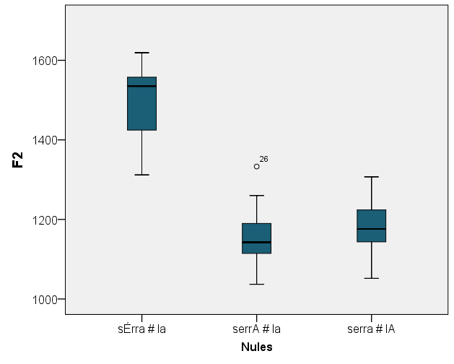
III.2. The preharmonic stage: Nules

Slide 61
III.3. The harmonic stage: Borriana
1. General pattern
    As expected, in this variety /a/ in the context /ɔ́/+/a/ (pistola) displays total assimilation to the stressed vowel: [pistɔ́lɔ].
    The process likewise affects the final vowel in the context /ɔ́/#/a/, with a clitic boundary (dissol-la).
      In a previous set of data, with subjects above 65 years-old, this context showed some variation between total and partial assimilation (Herrero & Jiménez 2011a,b).

Slide 62
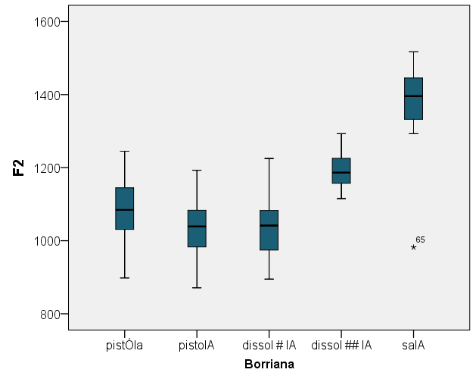
III.3. The harmonic stage: Borriana

Slide 63
III.3. The harmonic stage: Borriana
1. General pattern
    The assimilation, though, is sensitive to major morphological boundaries: across words (as in dissol la farina) the vowel of the article is not totally assimilated. Its realization is at an intermediate point between the harmonized /a/ in pistola and the neutral /a/ in the context sala.
    Therefore, there is coarticulation, as in Nules, but not vowel harmony.

Slide 64
III.3. The harmonic stage: Borriana

Slide 65
III.3. The harmonic stage: Borriana
2. Perceptually asymmetrical contexts
    As in Nules toca-la, round vowel harmony affects post-tonic internal vowels.
    The assimilation is again not recursive: the /a/ in the pronoun is only realized with slight changes in F2, like the /a/ belonging to a different word (context /ɔ́/##/a/, dissol la farina).

Slide 66
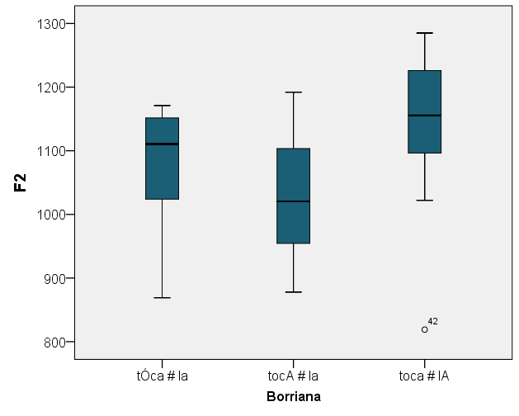
III.3. The harmonic stage: Borriana

Slide 67
III.3. The harmonic stage: Borriana
2. Perceptually asymmetrical contexts
    Replicating again the Nules pattern, mid-open front vowels do not trigger assimilation in the parallel context /ɛ́/#/a/##/la/: serra-la.

Slide 68
IV. Concluding remarks
1. Summary
Changes in F2 value | Nules | Borriana
/sál+a/ ‘room’ | X | X
/tɛ́l+a/ ‘cloth’ | No | No
[tɔ́kɔ] # /la/ ‘touch it (fem)’ | Coarticulation | Coarticulation
/disɔ́l ## la…/ ‘s/he dissolves the (f)…’ | Coarticulation | Coarticulation
/disɔ́l # la/ ‘dissolve it (fem)’ | Coarticulation | VH
/pistɔ́l+a/ ‘gun’ | Coarticulation | VH
/tɔ́ka # la/ ‘touch it (fem)’ | VH | VH

Slide 69
IV. Concluding remarks
2. Final remarks
    Generally speaking, differences in height among [−ATR] vowels do not seem to restrict their capability to trigger or experiment assimilation.
    In neutral contexts (rows 1 & 2), there is not general neutralization of final /a/ to [ɔ] in either variety.
    In the potentially harmonic context /ɛ́/+/a/ (row 2, tela) the [−back] feature is wholly realized in the stressed syllable, without coarticulation or vowel harmony to the final low vowel.

Slide 70
IV. Concluding remarks
2. Final remarks
    In both varieties, total assimilation from stressed [ɔ] is witnessed.
    In Nules variety, only the weakest of the post-tonic vowels, i.e. the post-tonic internal vowel, undergoes vowel harmony (row 7). This variety, thus, exhibits evidence of word-final faithfulness.
    In Borriana, low vowels adjacent to a round vowel and located in more prominent sites (word-final position and clitic-final position; rows 5 & 6) are realized with total assimilation as well.

Slide 71
IV. Concluding remarks
2. Final remarks
    Whereas Borriana vowel harmony is sensitive to major morphological boundaries (context /disɔ́l ## la…/; row 4), coarticulation operates in both varieties across major and minor morphological boundaries (Nules rows 3-6; Borriana, rows 3 & 4).
    The last vowel in the context /tɔ́ka/#/la/ (row 3), which could be a target for recursive vowel harmony, only undergoes coarticulation, i.e. partial assimilation.

Slide 72
IV. Concluding remarks
2. Final remarks
    Nules and Borriana partial assimilation acts as a typically phonetic process, whereas Borriana total assimilation displays the properties expected in phonological phenomena.

Slide 73
IV. Concluding remarks
2. Final remarks
    The whole picture is thus consistent with an interpretation in which Nules variety presents a first stage in the process of assimilation and Borriana variety displays a generalization of the extension to every strictly post-tonic vowel which is placed inside the clitic group (or the recursive phonological word).

Slide 74
V. References
Barnes, Jonathan (2006): Strength and Weakness at the Interface. Berlin / New York: Mouton de Gruyter.
Carrera, Josefina & Anna Maria Fernández (2005): Vocals mitjanes tòniques del català: estudi contrastiu interdialectal. Barcelona: Horsori.
Herrero, Ricard (2008): Les vocals tòniques de l’harmonia vocàlica del valencià: paràmetres des de la fonètica acústica. Master’s Degree Dissertation. València: Universitat de València.
Herrero, Ricard (2010a): «Anàlisi formàntica de la coarticulació V-a-V en valencià septentrional». Interlingüística, 20 (Actas del XXIV Encuentro Internacional de la Asociación de Jóvenes Lingüistas, Bellaterra 2009).
Herrero, Ricard (2010b): «Análisis instrumental de la reducción vocálica en valenciano». Interlingüística, 21 (Actas del XXV Encuentro Internacional de la Asociación de Jóvenes Lingüistas, Valladolid 2010), pág. 311-321.
Herrero, Ricard & Jesús Jiménez (2011a): «Coarticulació i harmonia vocàlica en valencià septentrional». In: Lloret, Maria-Rosa & Clàudia Pons (eds), Noves aproximacions a la fonologia i la morfologia del català. Volum d’homenatge a Max Wheeler. Col·lecció Symposia Philologica. Alacant: IIFV, p. 243-273.
Herrero, Ricard & Jesús Jiménez (2011b): «Vowel Harmony and Coarticulation in Northern Valencian». Poster presented at Phonetics and Phonology in Iberia (PaPI 2011). Tarragona.

Slide 75
V. References
Jiménez, Jesús (1998): «Valencian Vowel Harmony». Rivista di Linguistica, 10: 137-161.
Jiménez, Jesús (2001): «L’harmonia vocàlica en valencià». In: August Bover i Font; Maria-Rosa Lloret; Mercè Vidal-Tibitts (eds.) Actes del Novè Col·loqui d’Estudis Catalans a Nord-Amèrica. (Selected Proceedings.) Barcelona, 1998. Barcelona: Publicacions de l’Abadia de Montserrat, p. 217-244.
Jiménez, Jesús (2002): «Altres fenòmens vocàlics en el mot». In: Joan Solà; Maria-Rosa Lloret; Joan Mascaró; Manuel Pérez Saldanya (dir.) Gramàtica del català contemporani. Vol. 1. Barcelona: Empúries, p. 171-194.
Jiménez, Jesús; Lloret, Maria-Rosa (2011): «Harmonia vocàlica: paràmetres i variació». Estudis Romànics, XXXIII: 33-53.
Recasens, Daniel (1986): Estudis de fonètica experimental del català oriental central. Barcelona: Publicacions de l’Abadia de Montserrat.
Recasens, Daniel (1996): Fonètica descriptiva del català. 2nd ed. Barcelona: IEC.
Saborit, Josep (2009): Millorem la pronúncia. València: AVL.
Walker, Rachel (2005): «Weak Triggers in Vowel Harmony». Natural Language and Linguistic Theory, 23: 917-989. (Available at: http://roa.rutgers.edu/.)
Walker, Rachel (2011): Vowel Patterns in Language. Cambridge: Cambridge University Press.
Wheeler, Max (2005): The Phonology of Catalan. Oxford: Oxford University Press.

Slide 76
Thank you for your attention
76

Slide 77
Presentation soon available at: http://www.uv.es/foncat
Jesús Jiménez (jesus.jimenez@uv.es)
Ricard Herrero (ricard.herrero@ucv.es)
Research funded by the Spanish MICINN and the FEDER
(project FFI2010-22181-C03-02)
77

