Slide 1
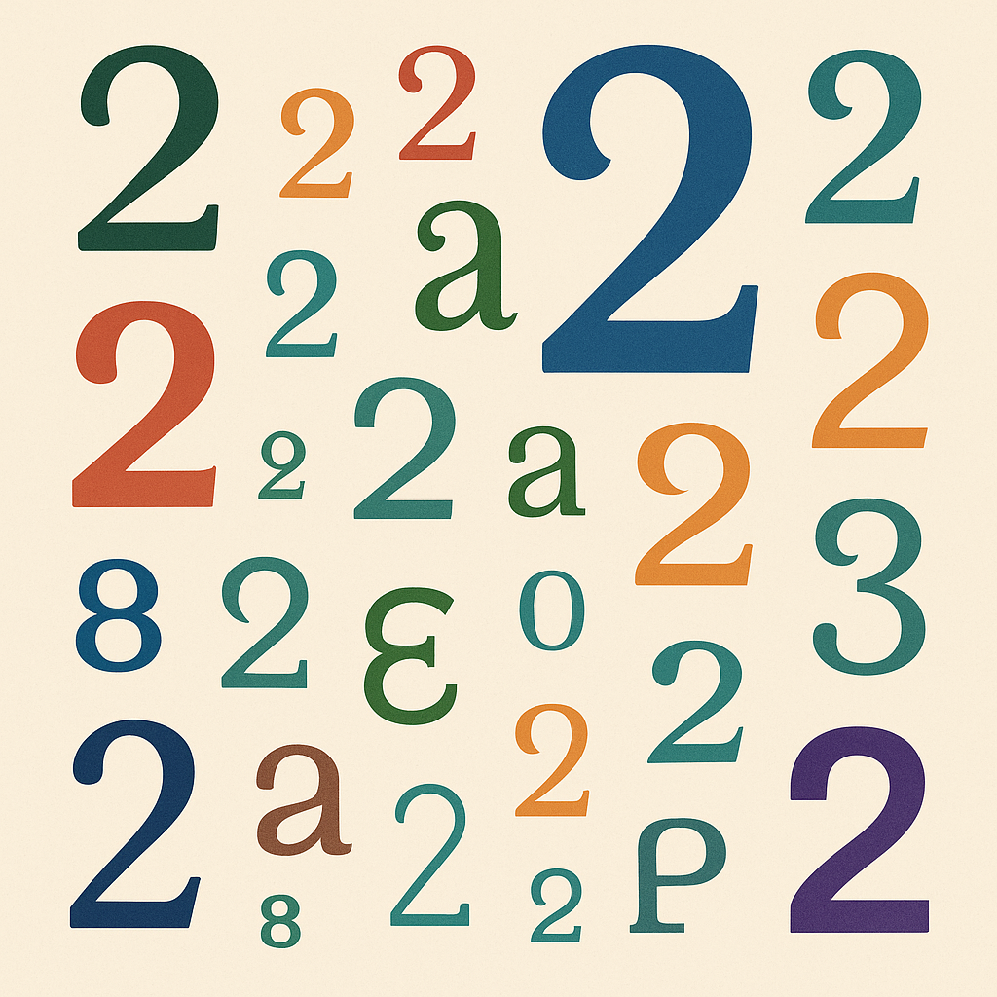
Are all number 2s the same?

Slide 2
Are all number 2s the same?
Place of Birth: 1 = ESP, 2 = EU (except Spain), 3 = Outside EU
Laura: 2
Valencian level: 1=Basic/None, 2=Intermediate, 3=Advanced
Laura: 2
Temperature in the room (in Celsius degrees)
Laura: 2
Number of siblings
Laura: 2
Time to solve a riddle (in seconds)
Laura: 2

