Slide 1

Welcome Session 29th January, 2021

Slide 2
Welcome Session
29th January, 2021
11:00 - 11:15 | Introduction: life in Valencia.
 | Universitat de Valencia. Campus & Facilities.
 | Esteban Sanchis Kilders.
 | Delegate of the Principal for Mobility
11:15-11:30 | Administrative Guide.
 | Sonsoles Oñate
 | Incoming Students Advisor.
11:30-12:00 | University Life.
 | Esteban Sanchis Kilders.
 | Delegate of the Principal for Mobility
12:00 - 12:30 | Questions & Answers.
 | Esteban Sanchis Kilders. Delegate of the Principal for Mobility.
 | Carlos Pomer Monferrer. Head of International Office.
 | Sonsoles Oñate. Incoming Students Advisor.

Slide 3
Witaj
Welcome
Bem-vindo
Willkommen
Bienvenue
velkommen
Dobrodošli
tervetuloa
Welkom
BIENVENIDOS
Καλώς ήρθες
Benvenuto
Добро пожаловать
Välkommen
Fiţi bineveniţi
Vítejte
karşılama
Benvinguts
Notes:
3

Slide 4
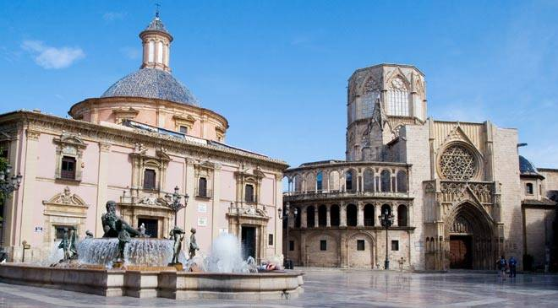
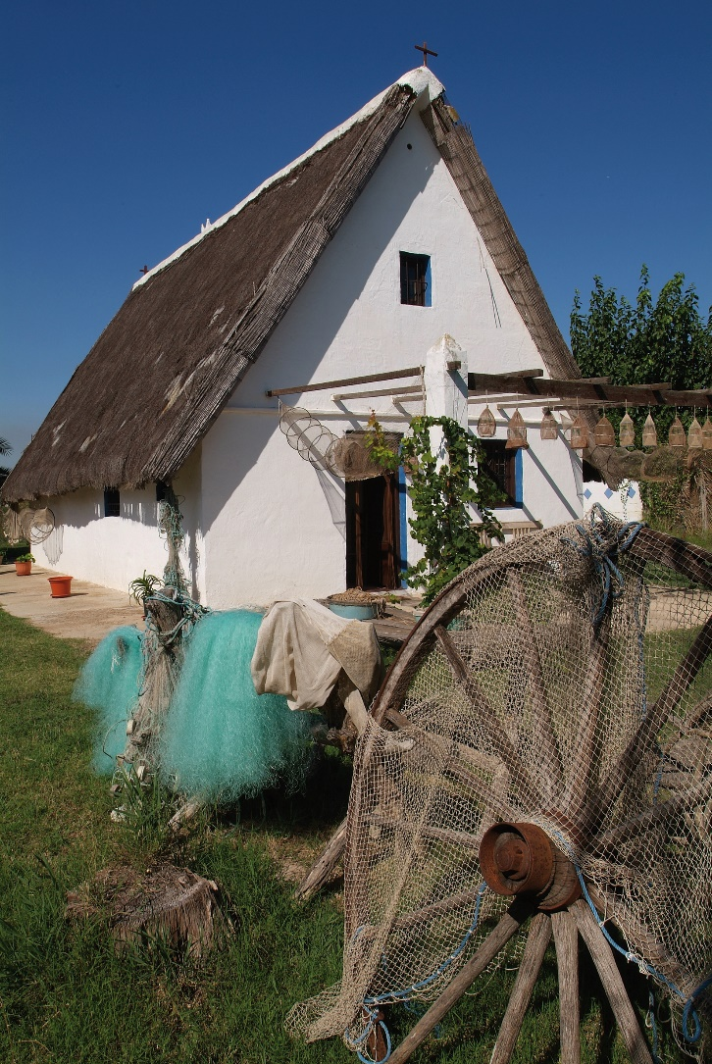
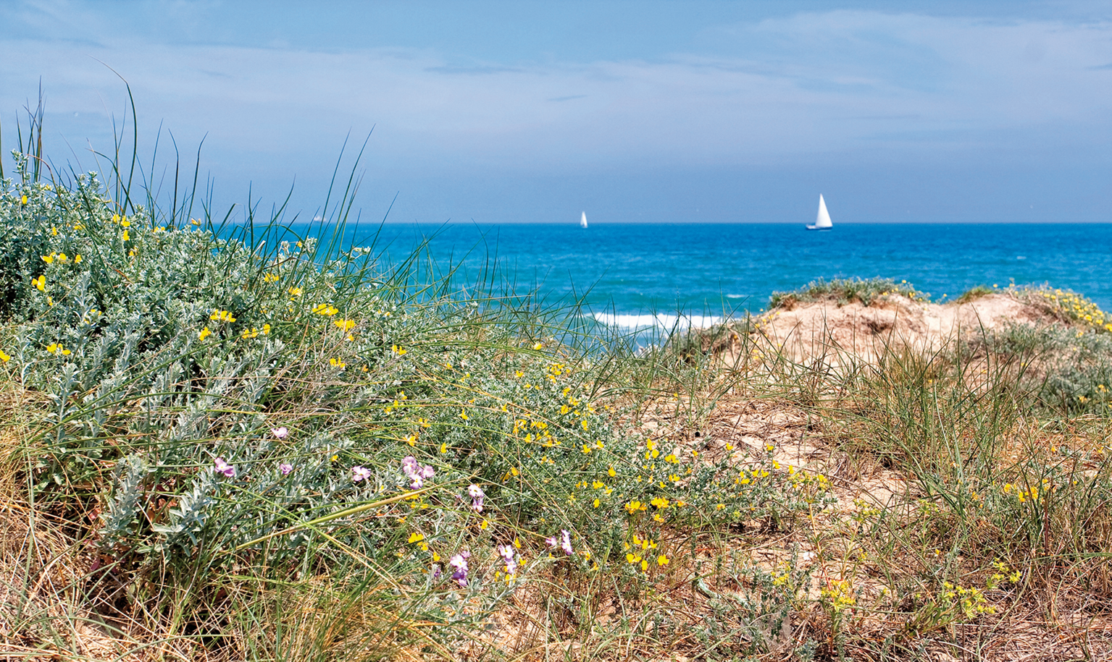
Life in Valencia
Campus de Blasco Ibáñez
Notes:
4

Slide 5
Valencia
Historical city full of monuments
Gastronomic city: Paella … + much more
City open to the sea: Beaches
City full of festivities: Fallas
Green city: Turia Garden
City of Arts and Sciences
see https://youtu.be/NAtuJ5zc__c
Notes:
5

Slide 6

Universitat de València
your university
Notes:
6

Slide 7
Figures
Founded in 1499, it is a modern European university, offering practically all branches of knowledge:
45 000 degree students
8 000 postgraduate students
The most internationalised Valencian University
+2 700 mobility students
    +3 500 foreign students
Notes:
7

Slide 8

UV, a global university
TEACHING
RESEARCH
KNOWLEDGE TRANSFER
CULTURAL AND SCIENTIFIC PRODUCTION
SOLIDARITY AND COOPERATION

Slide 9
Rankings
Erasmus Mobility
3rd university in Europe in receiving students, and the 4th European university in sending students abroad
Spanish Foundation for Science and Technology
UV is in the top 10
Shanghai - ARWU
4th Spanish university, in top 300 universities worldwide
1st of the Valencian Region
Notes:
9

Slide 10
UV Campuses
Notes:
10

Slide 11
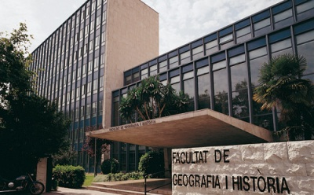
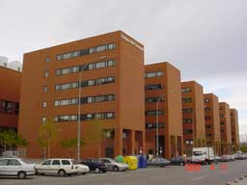
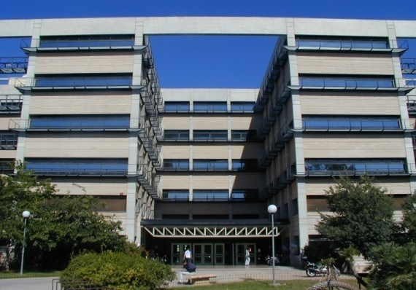
3 urban campuses
Blasco Ibáñez
Tarongers
Burjassot
Social sciences
Teacher training
Sciences
Engineering
Humanities
Education
Health science

Slide 12
Facilities
The buildings of the FACULTIES host the secretariat, the departments, the offices of Professors, classrooms, reprography service, canteens, computer rooms and student associations
Some Faculties and Schools not only teach in their main building, but also in classroom buildings (so-called “aularios”)
Notes:
12

Slide 13
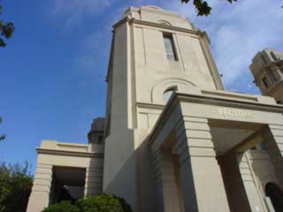
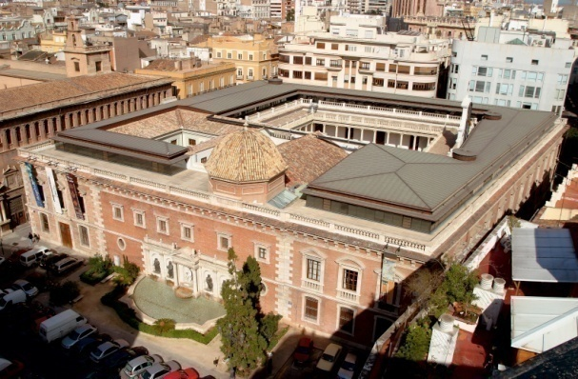
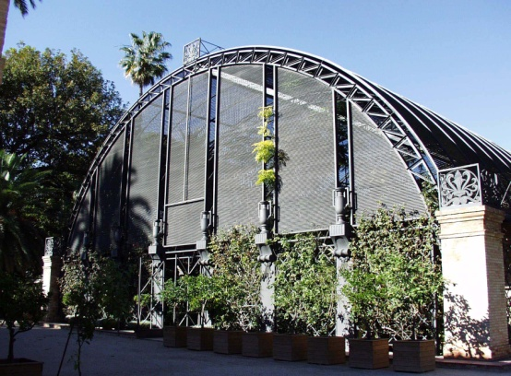
Other facilities
Rectorado
La Nau
Jardín Botánico
The UV Principal’s building and host of the central administrative services
UV’s historic site, currently a cultural centre and host of academic ceremonies
Botanical garden founded in 1567, located in the city centre.

Slide 14

Administrative
guide
Sonsoles Oñate
Incoming Students Advisor
Servicio de Relaciones Internacionales y Cooperación
Palacio de Cerveró
Plaza Cisneros, 4.
Valencia 46003
www.uv.es/relint
incoming@uv.es

Slide 15
INTRODUCTION
Welcome to Universitat de València!
We are here to help you:
IRS → International Relations Service. Central Office for the whole university.
IROs → International Relations Offices. Located at some faculties.
IR officer → person in the Secretaria of your faculty encharged of exchange students.
Buddy program → local student asigned to help you.
Academic coordinator → teacher responsable for exchange students in each degree.
Notes:
15

Slide 16

INTRODUCTION
Who to ask for help ?
Depending on your needs you will need advise from 5 different professional profiles:
IRS → International Relations Service. Central Office for the whole university. Contact: incoming@uv.es
IROs → International Relations Offices. Located at some faculties.
IR officer → person in the Secretaria of your faculty encharged of exchange students.
Notes:
16

Slide 17


Buddy program → local student assigned to help you. Contact: mentors@uv.es
Academic coordinator → teacher responsible for exchange students in each degree. More info: http://links.uv.es/incoming/coordinators
Notes:
17

Slide 18
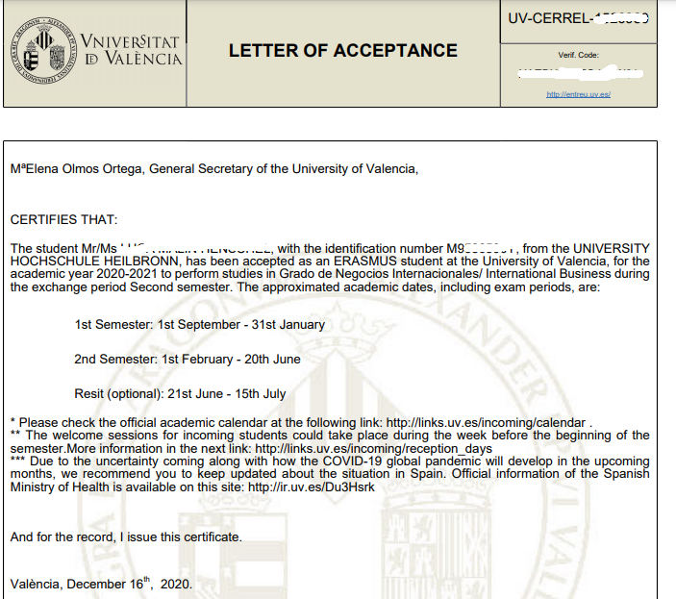
How to ask for help ?
Provide your personal UV ID Number.
  Example: M9123456X.
  You can find it in your Letter of Acceptance.
Use your UV email account (@alumni.uv.es) as soon as you get it.
Avoid to send emails to multiple recipients.
Notes:
18

Slide 19
CERTIFICATE OF ARRIVAL
FACULTY MEETING
LEARNING AGREEMENT - ACADEMIC COORDINATOR
ENROLMENT IN COURSES - FACULTY
ACADEMIC CALENDAR
CERTIFICATE OF ATTENDANCE & TRANSCRIPT OF RECORDS
Notes:
19

Slide 20
CERTIFICATE OF ARRIVAL
FACULTY MEETING
LEARNING AGREEMENT - ACADEMIC COORDINATOR
ENROLMENT IN COURSES - FACULTY
ACADEMIC CALENDAR
CERTIFICATE OF ATTENDANCE & TRANSCRIPT OF RECORDS

Slide 21
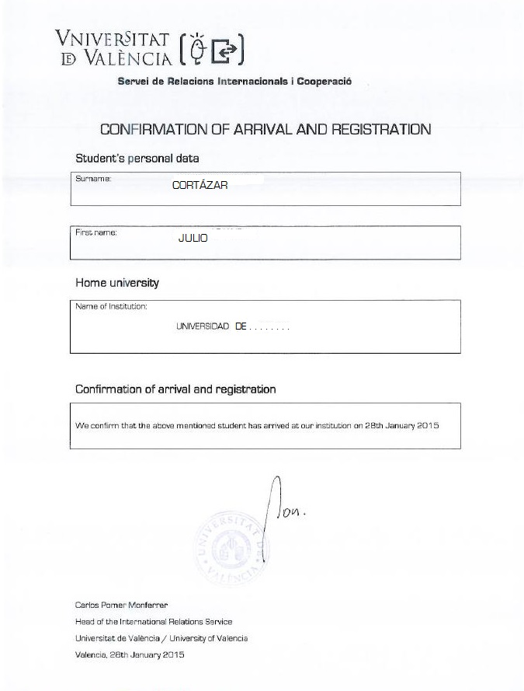
From Monday, 1st of February you will receive an email sent from entreu@uv.es with your Certificate of Arrival at Universitat de València.
It is an official document with a valid digital signature and a verification code.
In case you need any specific model of Certificate of Arrival to be signed, please, fill it in and send it to incodocs@uv.es

Slide 22
CERTIFICATE OF ARRIVAL
FACULTY MEETING
LEARNING AGREEMENT - ACADEMIC COORDINATOR
ENROLMENT IN COURSES - FACULTY
ACADEMIC CALENDAR
CERTIFICATE OF ATTENDANCE & TRANSCRIPT OF RECORDS

Slide 23
Friday, 29th January, 2021.
Faculty of Philology, Translation and Communication
Campus: Blasco Ibañez
Time: 13:00 pm.
Place: online
https://eu.bbcollab.com/guest/c38e2a6f329740a89fbb8c77ecabc8df
Monday, 1st February, 2021.
Faculty of Social Sciences
Campus: Tarongers
Time: 16:00 pm.
Place: “Sala de Actos” of the Faculty
Address: Avda. dels Tarongers, s/n.46021 Valencia

Slide 24

Faculties with past meetings (28th January, 2021):
Faculty of Economics
Faculty of Pharmacy
Faculty of Psychology and Speech Therapy
In case you have missed it, we recommend you to ask them for guidance:
Faculty of Economics: int-of.economia@uv.es
Faculty of Pharmacy: farmaerasmus@uv.es
Faculty of Psychology and Speech Therapy: interpsi@uv.es

Slide 25
CERTIFICATE OF ARRIVAL
FACULTY MEETING
LEARNING AGREEMENT - ACADEMIC COORDINATOR
ENROLMENT IN COURSES - FACULTY
ACADEMIC CALENDAR
CERTIFICATE OF ATTENDANCE & TRANSCRIPT OF RECORDS

Slide 26

Get your Learning Agreement signed by your Academic Coordinator.
In case you are not sure about who is your degree academic coordinator, you can always check it using the following link:
http://links.uv.es/incoming/coordinators
Notes:
26

Slide 27
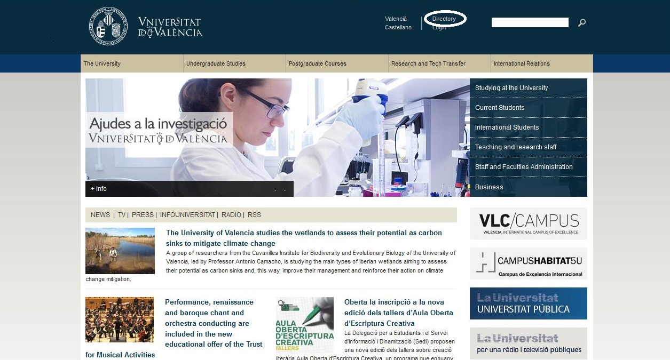
Find out first about your coordinator´s office hours: www.uv.es > Directory + Person finder
Notes:
Tutorial: lo cambiaría por “tutoring timetable” o “visit/office/tutoring hours” o “tutoring sessions”. Aunque “tutorial” también tiene el sentido de tutoría, se entiende más como “tutorial” también es español, es decir, una especie de guía (ej. Video tutorial). Puede llevar a confusión , no se entiende bien hasta que en la siguiente diapositiva se ve que te refieres al horario.
First: lo pondría al final de la frase: “Find out about your coordinator’s tutoring/visit hours first”

Slide 28
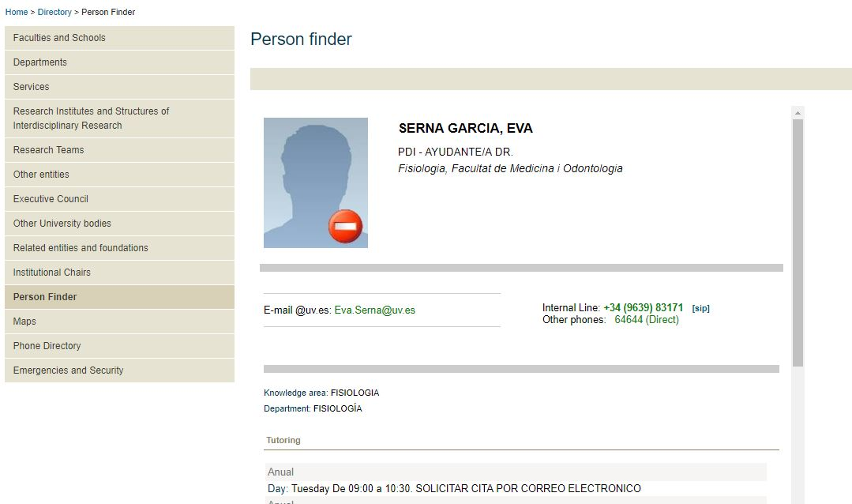

Slide 29
CERTIFICATE OF ARRIVAL
FACULTY MEETING
LEARNING AGREEMENT - ACADEMIC COORDINATOR
ENROLMENT IN COURSES - FACULTY
ACADEMIC CALENDAR
CERTIFICATE OF ATTENDANCE & TRANSCRIPT OF RECORDS

Slide 30
Once your coordinator has approved
your Learning Agreement
Go to the “Secretaría” of your faculty and enrol in the subjects approved
by your coordinator.
During this period of special health security, it might be necessary to make an appointment to attend the Secretaria / IRO of your faculty.
We recommend you to check it first.

Slide 31
Below you will find some IRO - faculty contacts:

Slide 32
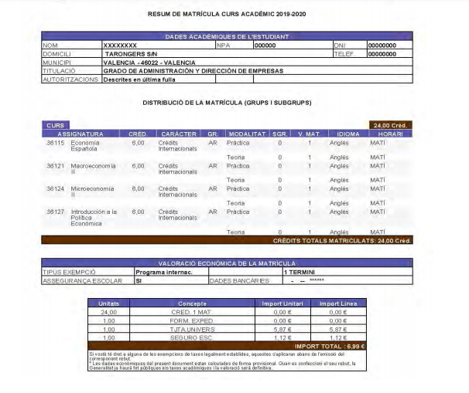

Slide 33
Most courses at the University of Valencia (UV) are assigned an ECTS value of 6 credits. In principle, students need to take up to 30 credits per semester.
We strongly advise exchange students to sign up for a minimum of 18 credits per semester when formulating their study programme at the UV.
Please note that Erasmus students have to select 50% of courses in the field of study that they have been nominated for.
In case they would also like to attend courses outside their nominated field of study, they could be on other degrees or faculties but:
  it will depend on the faculty rules and the course demand.
  the “Secretaría” of your faculty will apply for them and inform you.

Slide 34
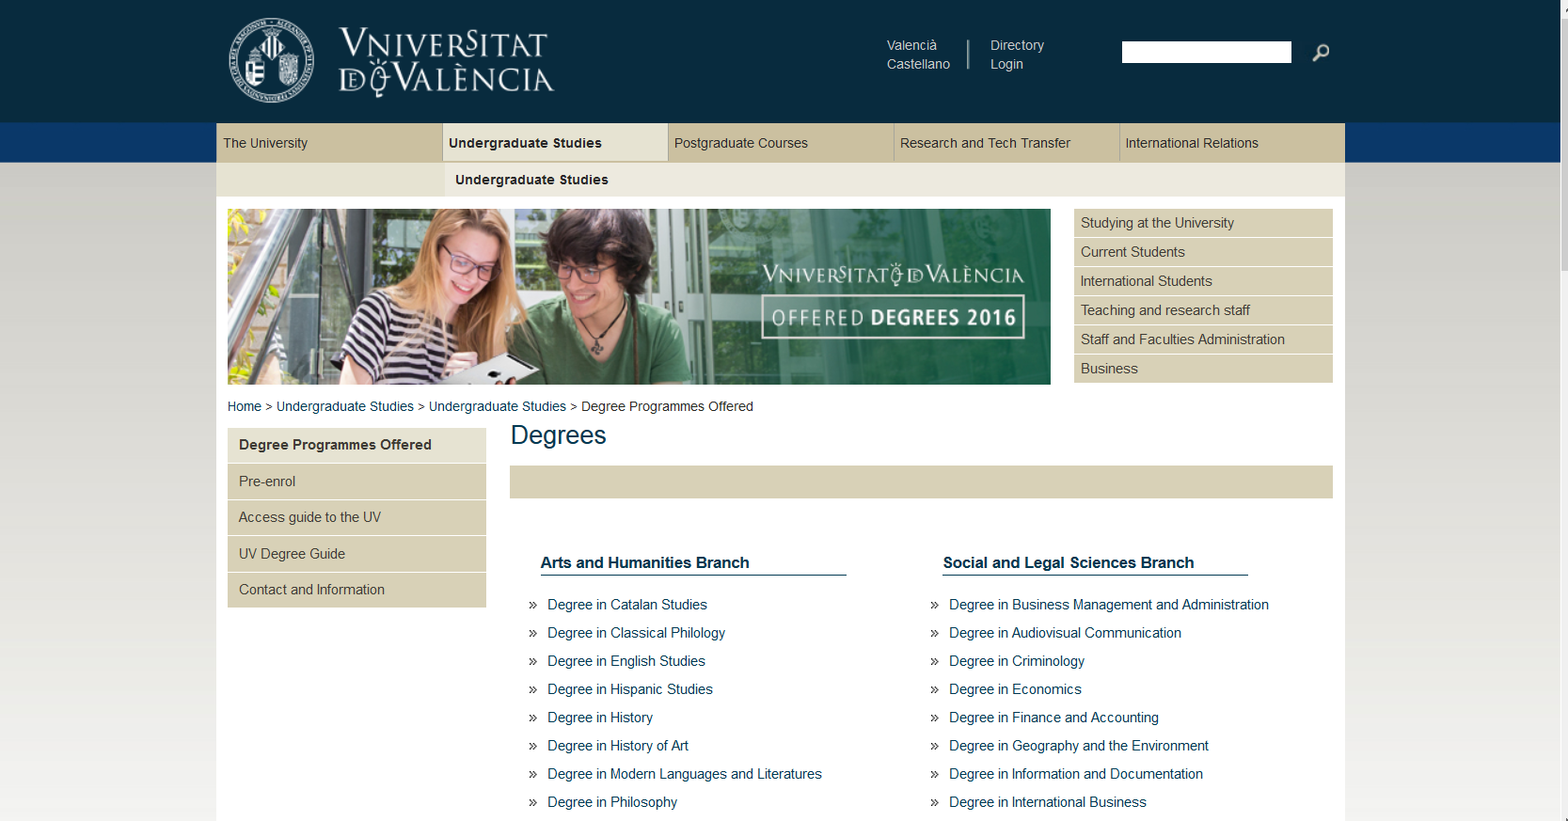
Look up your subjects at: http://links.uv.es/incoming/degrees

Slide 35
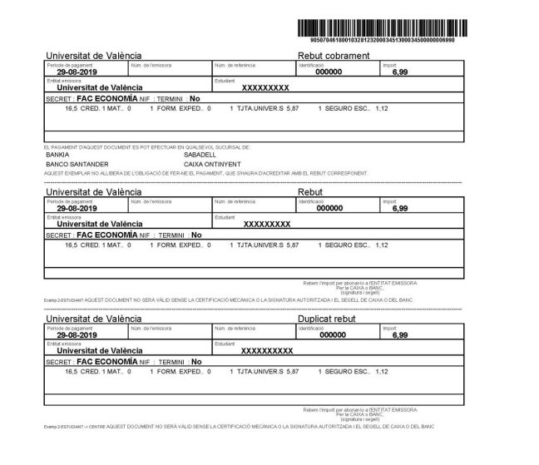
To complete your enrolment, you will have to pay a small fee of 6,99 € (for the student insurance and student card).

Slide 36
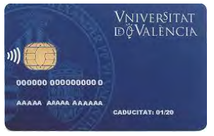



At the Faculty they will explain to you:
    how to get your student card. (Banco Santander. Campus office.)
    how to pay this small amount (online payment)

Slide 37
CERTIFICATE OF ARRIVAL
FACULTY MEETING
ACADEMIC COORDINATOR
ENROLMENT
ACADEMIC CALENDAR
CERTIFICATE OF ATTENDANCE & TRANSCRIPT OF RECORDS

Slide 38
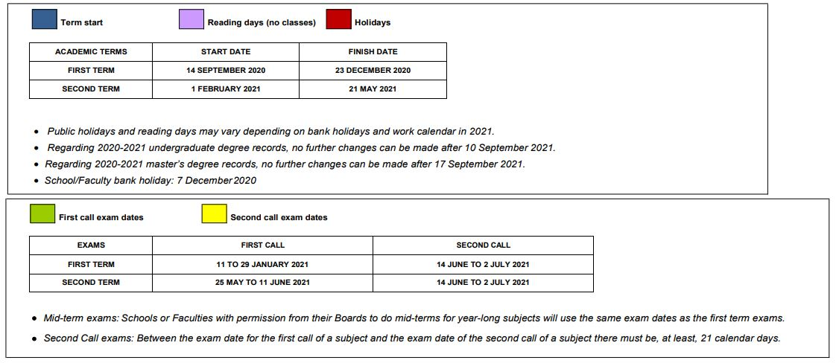
Academic Year structure:
http://links.uv.es/incoming/calendar
Notes:
38

Slide 39
  Second Term:
  From 1st February to 21st May
  Exams: 25th May - 11th June
In case you:
  can’t take a 1st-call exam
  fail a 1st-call exam
  2nd Call: 14th June – 2nd July
Notes:
39

Slide 40
CERTIFICATE OF ARRIVAL
FACULTY MEETING
ACADEMIC COORDINATOR
ENROLMENT
ACADEMIC CALENDAR
CERTIFICATE OF ATTENDANCE & TRANSCRIPT OF RECORDS

Slide 41
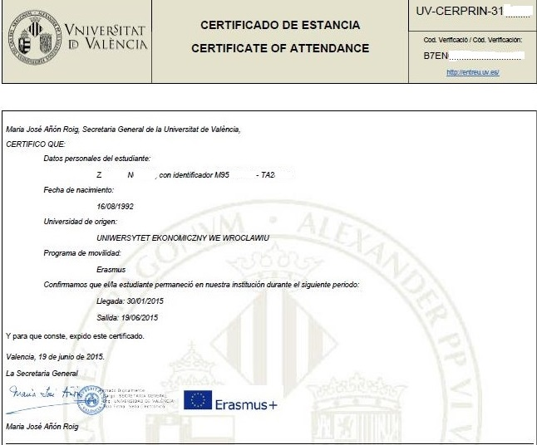
On the day of your last exam at UV you will have to apply online for your Certificate of Attendance.
We will send you an email with the link and instructions.
Note that the departure date that will appear on your certificate will be the same day you apply for it.
More info:
http://links.uv.es/8q9UC89

Slide 42
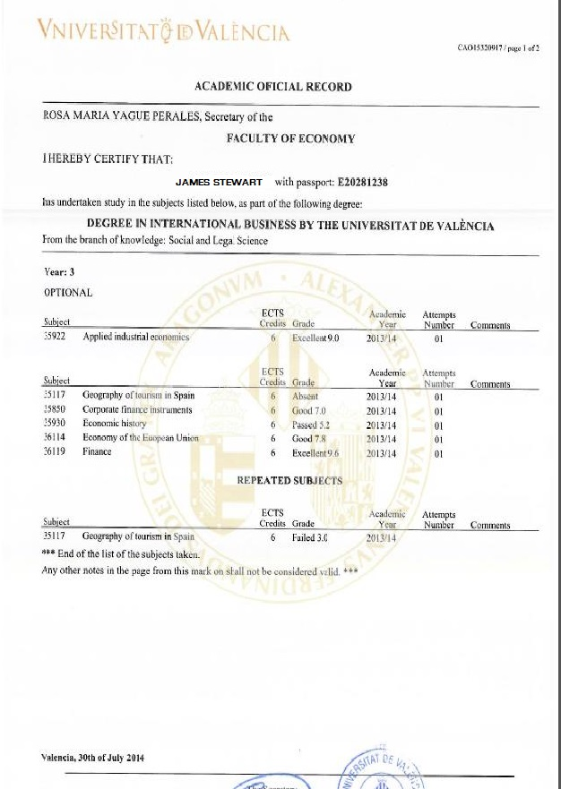
You will receive an email with the instructions to apply for your official transcript of records .
Please, do not request your transcript of records until at least 1 month after your last exam in order to be sure that all your marks have been properly processed and are included on it.
Additionally, it is also advisable to first check that you have all your marks ready in secvirtual.uv.es
Spanish courses at the Centre de Idiomas will never appear at the ToR. They will provide their own certificate.

Slide 43

Thank you!
www.uv.es/relint
incoming@uv.es
XatUV

Slide 44
University Life
Notes:
44

Slide 45

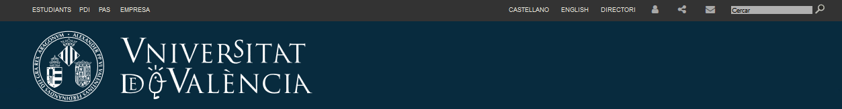
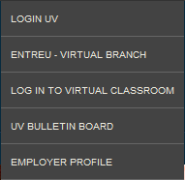
Be online
WIFI zones EDUROAM
You can also login with
username + password from
your home university
e-mail, Virtual Classroom, more…
Log in with the username + password of your UV e-mail account
Notes:
45

Slide 46
SOCIAL NETWORKS
facebook → www.facebook.com/universitatdevalencia
twitter → twitter.com/UV_EG
linkedin → www.linkedin.com/school/university-of-valencia
Multimedia Resources
Multimedia Corporate Server → http://mmedia.uv.es
Youtube channel → http://www.youtube.com/user/UniversitatValencia
UV Open CourseWare (OCW) courses → http://ocw.uv.es
Mobile apps: Android / Apple
Google Play / App Store → http://uvapp.uv.es/
Notes:
46

Slide 47
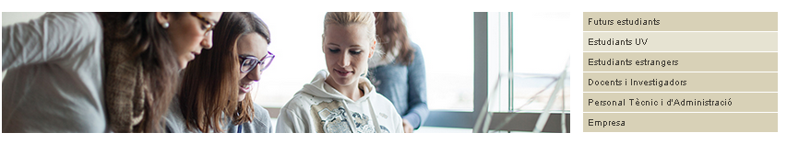
SEDI is the UV information and documentation centre
Information about studies, grants, accommodation cultural activities, job offers, etc.
Information
SEDI
http://www.uv.es/sedi
Notes:
47

Slide 48
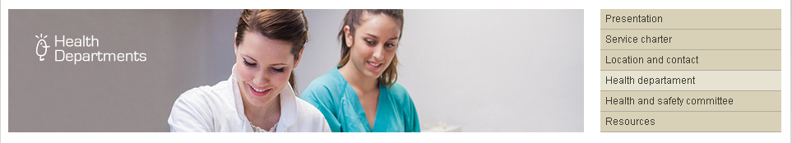
Health Assistance
Provides primary medical assistance (in all three campuses)
Office hours: Monday to Friday from 9:00 - 11:00 and 15:00 - 19:30
http://www.uv.es/dssqa
Notes:
48

Slide 49

  European residents having public social security health access in their home country are entitled to an European Health Insurance Card (EHIC)
  EHIC allows the same health care than a national
  You must have already got it in your home country
European Public Health System
http://ec.europa.eu/social/main.jsp?catId=559
Notes:
49

Slide 50
  Phone 012
  You must provide your address in Valencia and they will inform you about the closest public medical assistance centre near you
    Get family doctor attendance
    Prescriptions, medical analysis (blood, X-ray, etc.)
    Prescription for a specialist doctor
    In case of emergency, go to the nearest public hospital
Public Health System
Notes:
50

Slide 51
Private Healthcare
  Ask about the phone numbers, doctors and hospitals covered by your insurance
  Don’t wait until you are ill. Learn this information now.
  In case of emergency, go to the nearest hospital
Notes:
51

Slide 52

COVID-19
  Mask is compulsory everywhere, also when walking outside (not when making sport)
  Restrictions apply to public spaces (bars, restaurants, discos, etc)
  Maintain the social distancing
  In case of symptoms,
    call toll-free number 900 300 555
    Follow: https://www.mscbs.gob.es/en/profesionales/saludPublica/ccayes/alertasActual/nCov/ciudadania/docs/200327_Decalogo_como_actuar_COVID19_ingles.pdf
Notes:
52

Slide 53
COVID-19
  Regional regulations apply
    https://www.gva.es/en/inicio/presentacion
    Please check frequently, as they are updated regularly. In Spanish.
  From now till the 15th of February:
    its is forbidden to exit the Comunitat Valenciana
    Lock-down applies from 22:00 to 6:00
    People living in cities with a population larger than 50.000 cannot exit the city during the weekends
    No meetings of more than 2 people are allowed
Notes:
53

Slide 54
COVID-19
  More information can be found in
    Phone numbers: https://www.mscbs.gob.es/en/profesionales/saludPublica/ccayes/alertasActual/nCov/ciudadania/docs/200326_QueHacer_Telefonos_COVID19_ingles.pdf
    Quarantine: https://www.mscbs.gob.es/en/profesionales/saludPublica/ccayes/alertasActual/nCov/ciudadania/docs/200326_AislamientoDomiciliario_COVID19_ingles.pdf
Notes:
54

Slide 55
COVID-19
  University life
  ask your international coordinator for details on the different subjects
    Lectures can be on-line, blended (on-line + physical) or physical
    Wear mask
    Keep social distancing
    Follow the signs
Notes:
55

Slide 56
Language Centre: Spanish Courses
Spring Semester
Courses start: 16th February 2021
Registration: January /February 2021
secretaria@centreidiomes.es
Fees for Spanish courses (TBC)
65 € (Erasmus and international students only)
60 hours / 4 hours per week
Morning or afternoon courses
http://www.centreidiomes.es
Notes:
56

Slide 57
Aprender idiomas
Learn languages
Language Policy Service
  Offers Valencian language courses for free
  Language exchange (tandems)
  Self-study centres and conversation groups
  DELE official examination centre
http://www.uv.es/spl
Notes:
57

Slide 58
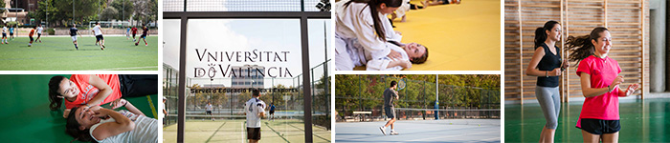
Sports
  Sport grounds
  Activities during the term
  Sports competitions
  Closure of facilities and suspension of activities until 31 January due to Covid
http://www.uv.es/sef -> self-enrolment
Notes:
58

Slide 59
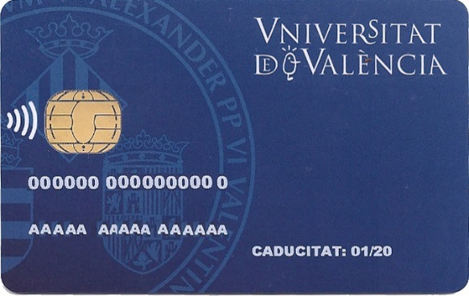
Libraries
  Open
    Student card needed
    Two sessions: morning and afternoon
  Electronic access also available
http://biblioteca.uv.es
Notes:
59

Slide 60
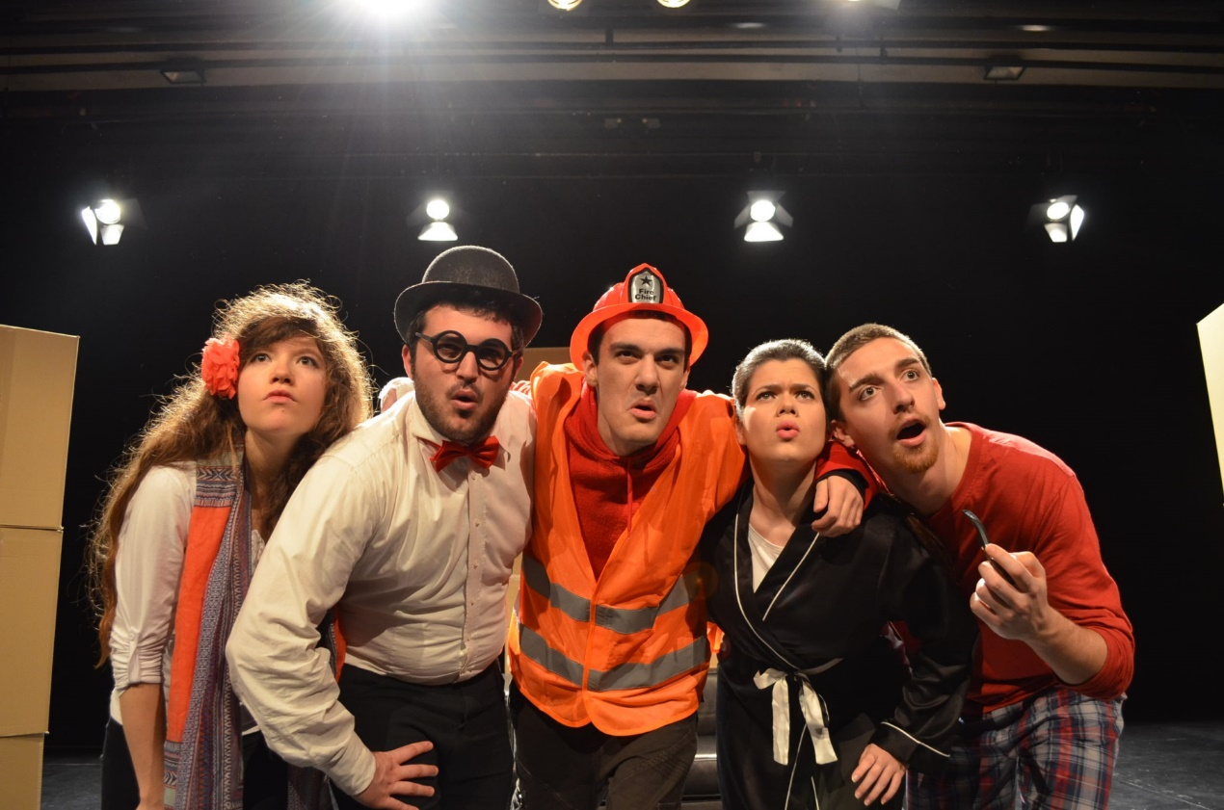
ESCENA ERASMUS
Theatre group of ERASMUS students
www.escenaerasmus.eu

Slide 61

Do you have a disability, learning difficulty or health condition that impacts on your studies?
Office:
  Avd. Blasco Ibañez 21
  (Faculty of Psychology)
  https://www.uv.es/uvdisability
  Phone: 96 39 83426
  E-mail: updestudiantes@uv.es

Slide 62

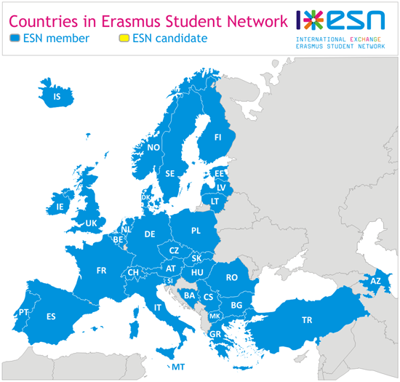
Who are we?
ESN is the biggest student association in Europe, we are present in 32 European countries, with more than 12.000 volunteers.
Our AIM is to help exchange students that come to our University.

Slide 63
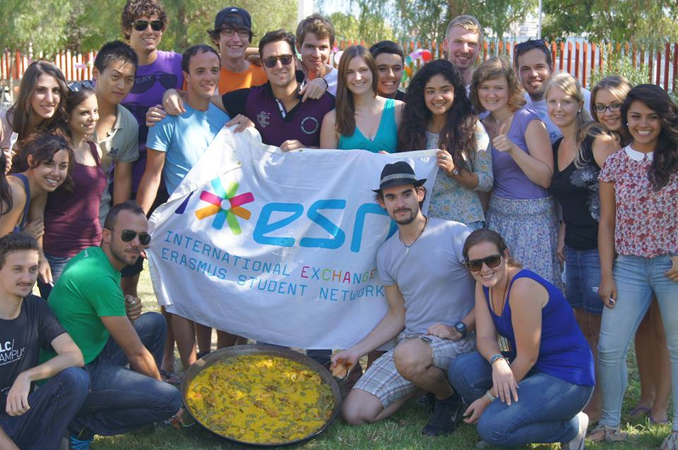
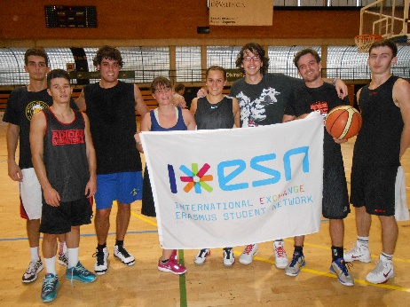

WHERE
CAN WE HELP YOU?
Academic advice.
Integration in the community
Cultural activities.
Sports teams and tournaments.
Trips.
Social projects
info@uv.esnvlc.es
www.esnuv.es

Slide 64
Accommodation
  UV Halls of Residence
    Colegio Mayor Rector Peset:
      www.uv.es/cmrpeset
      From 342 €/month
    Residencia Universitaria Damià Bonet:
      www.resa.es/esl/residencias/damia_bonet
      From 350 €/month
Notes:
64

Slide 65
Student flats
  Flats shared with other students are a big success
  Flat-hunting
      Specialised agencies: housinganywhere.com
      Internet, newspapers, ads…
      Noticeboards in faculties
Accommodation
Notes:
65

Slide 66
Meal times in Spain
    Breakfast: 8:00 – 9:00
    Lunch: 14:00 – 15:00
    Dinner: 21:00 – 22:00
UV canteens/cafeterias
  Located in in-campus
  Set meals from Monday to Friday: 6 to 8 €
  Good place to meet classmates and make friends
Where can I eat?
Notes:
66

Slide 67
Safety
Valencia is a safe city
Watch out for pickpockets!
Get in touch with the UV for any type of problem
24-hour free emergency phone:
112
Notes:
67

Slide 68
Banco Santander, next to Faculty of Psychology (Campus de Blasco Ibañez) and to the Faculty of Chemistry (Campus de Burjassot)
General payment using credit/debit cards
Many ATM all around
Banks
Notes:
68

Slide 69

www.uv.es/relint
relaciones.internacionales@uv.es
XatUV

