Slide 1
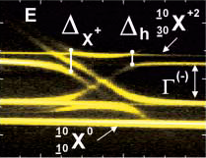



MICRO-PHOTOLUMINISCENCE FROM InAs/GaAS QUANTUM DOT MOLECULES GROWN BY DROPLET EPITAXY
G. Muñoz-Matutano¹, J. Canet-Ferrer¹, D. Fuster¹, J. Martínez-Pastor¹
P. Alonso-González², B. Alén², I. Fernández-Martínez², Y. González², F. Briones², L. González²
¹UMDO (unidad asociada al IMM-CSIC), Instituto de Ciencias de los Materiales, Universitat de València.
²IMM-CNM-CSIC: Instituto de Microelectrónica de Madrid.

Slide 2
MICRO-PHOTOLUMINISCENCE FROM InAs/GaAs QUANTUM DOT MOLECULES GROWN BY DROPLET EPITAXY
OUTLOOK:
1. Introduction: Quantum Dot Molecule.
2. Droplet Epitaxy Growth: optical features.
3. Sample and Experimental Set-Up.
4. Lateral QD molecule results.
i) Voltage Features.
ii) Molecular Coupling.
5. Vertical QD molecule preliminar results.
6. Conclusions.

Slide 3
1. INTRODUCTION: QD MOLECULES
VERTICAL MOLECULES
e⁻
h⁺
LATERAL MOLECULES
Growth Direction
Growth Direction
1. Electron states coupling (e⁻ Tunneling )
2. Hole states coupling (h⁺ Tunneling )
3. Excitonic state couplin ( Föster copling (virtual photon))

Slide 4
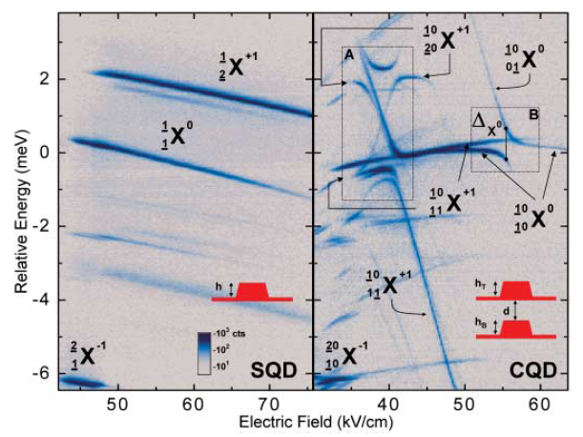
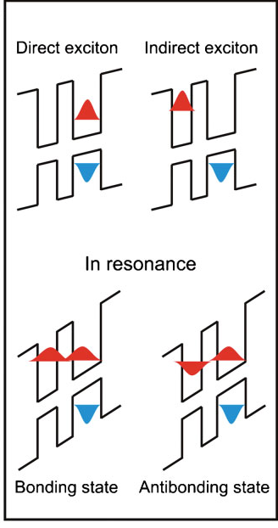
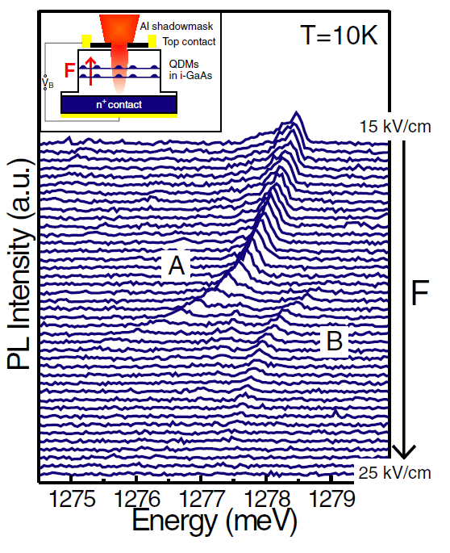
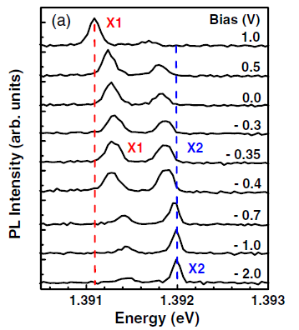
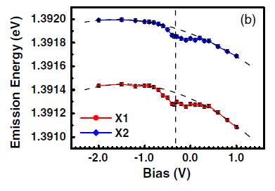
1. INTRODUCCIÓN: DEL QD AISLADO AL CRISTAL DE QDs
TUNNING QD STATES WITH ELECTRIC FIELD
LATERAL MOLECULES
VERTICAL MOLECULES
C.J. Beirne et al, PRL 96, 137401 (2006)
H.J. Krenner et al, PRL 94, 57402 (2005)
E.A. Stinaff et al, Science 311, 636 (2006)

Slide 5
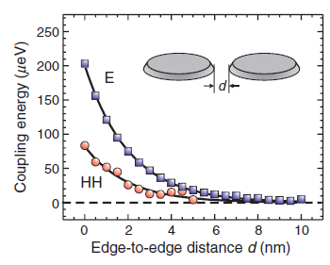
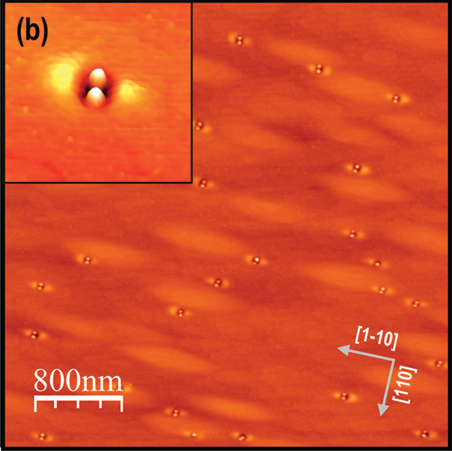
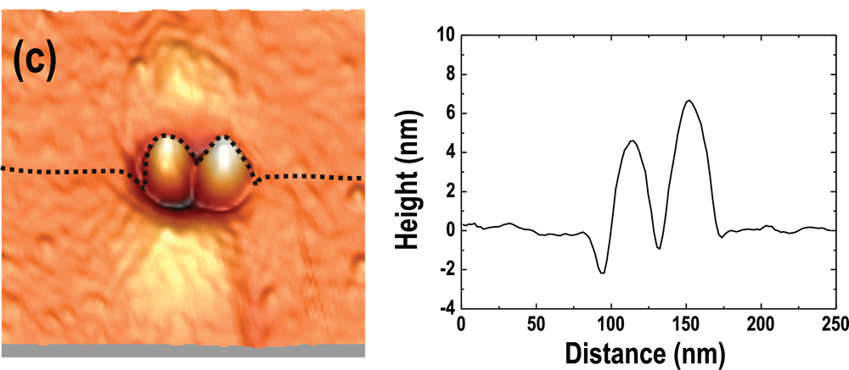
2. DROPLET EPITAXY GROWTH:
ADVANTAGES :
Localized nanostructures.
Low density samples.
Growth by QD pairs.
L.Wang et al, New Journal of Physics 10, 045010 (2008)
P. Alonso-González et al, Crystal Growth and Design 9, 2525 (2009)

Slide 6
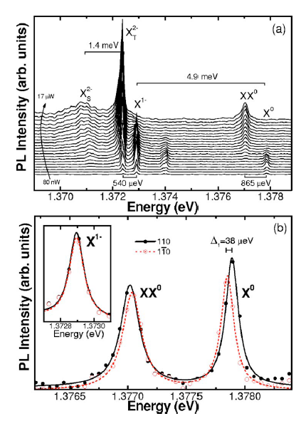
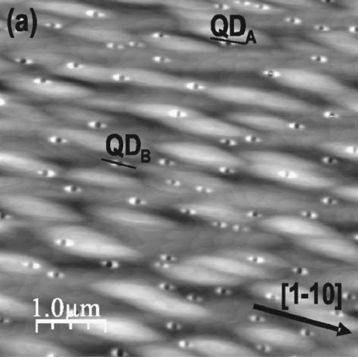
2. DROPLET EPITAXY GROWTH:
HIGH OPTICAL QUALITY
Density ≈ 2.5 x 10⁸ cm⁻²
Negative excitonic complex.
Arsenic Vacancies.
P. Alonso-González et al, APL 91, 163104 (2007)

Slide 7
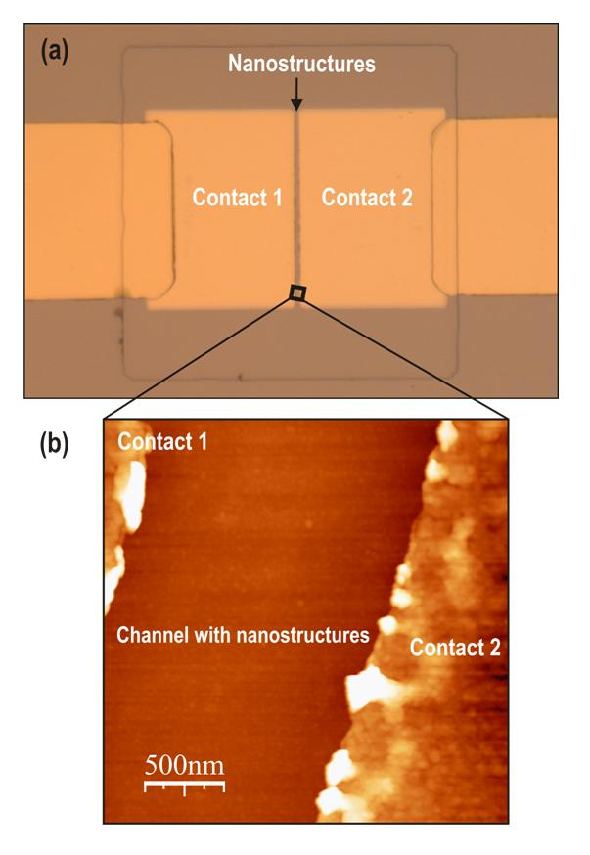
3. SAMPLE AND EXP. SET UP: Lateral Molecules.
E (110)
InAs Droplets Pairs.
Schottky Diode.
Field on 110
Au-Cr
InAs
GaAs
ΔV
110
1 - 1,5 µm
1-10

Slide 8
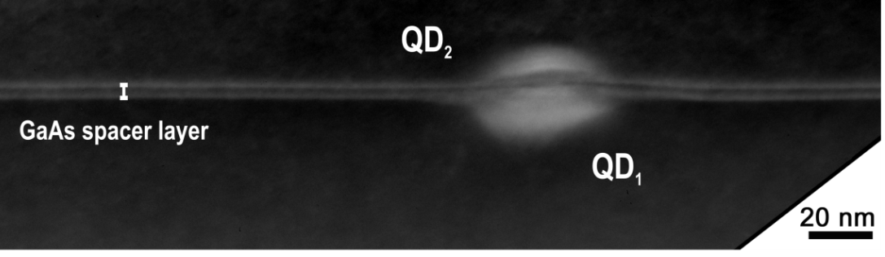
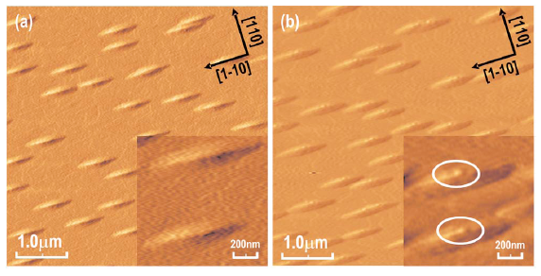
3. SAMPLE AND EXP. SET-UP: Vertical Molecules.
1.2 ML
1.4 ML
1.6 ML
First layer:
  QDs grown by Droplet Epitaxy
Second layer:
  4 nm of GaAs
Tercera capa:
  Self assembled QDs localized on first layer QDs.
P. Alonso-González et al, APL 93, 183106 (2008)

Slide 9
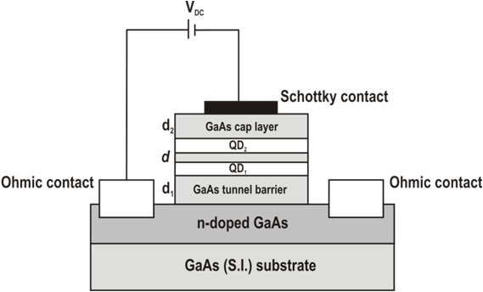
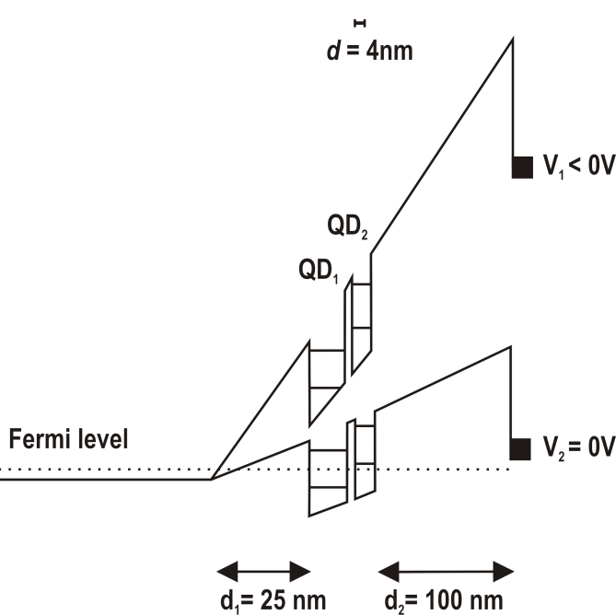
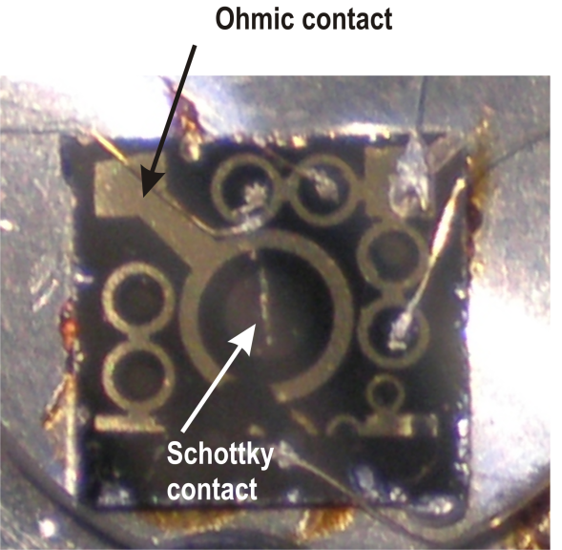
3. SAMPLE AND EXP: SET-UP: Vertical Molecules.

Slide 10
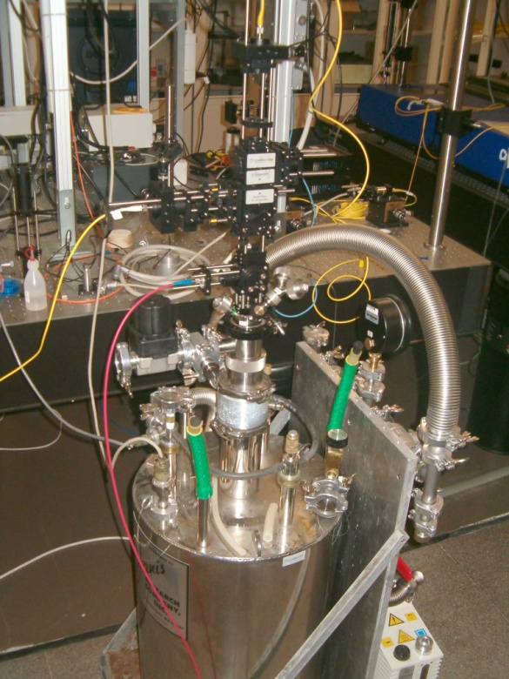
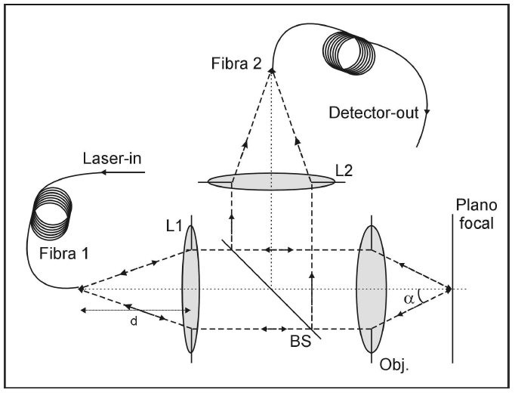
3. SAMPLE AND EXP. SET-UP: Confocal Microscope.
μPL Signal
Laser

Slide 11
LATERAL MOLECULE
RESULTS

Slide 12
4. RESULTS: Lateral Molecules
QDs DROPLET PAIRS: Voltage Features.
Type I: Isolated
Type II: Decoupled pair
Journal of Physics: Conference Serires 210, 012015 (2010)

Slide 13
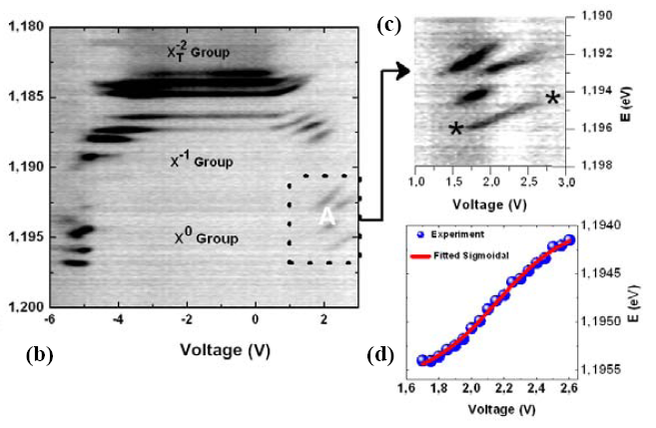
4. RESULTS: Lateral Molecules
QDs DROPLET PAIRS: Voltage Features.
Type III: Coupled pair
Journal of Physics: Conference Serires 210, 012015 (2010)

Slide 14
4. RESULTS: Lateral Molecules
QDs DROPLET PAIRS: Coupling (optical signatures)
V = 5.7 V

Slide 15
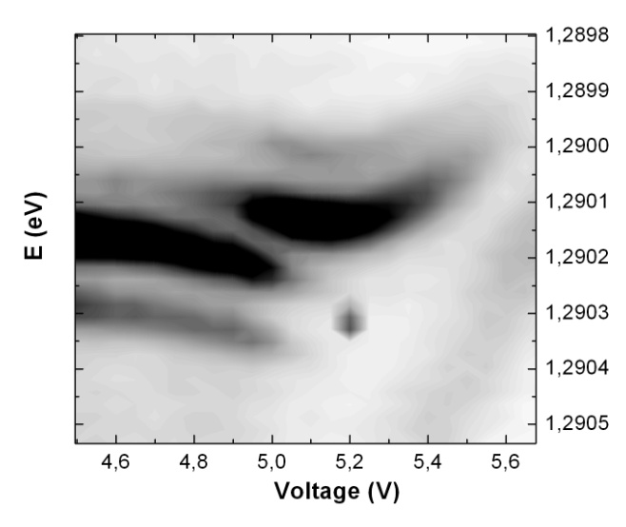
4. RESULTS: Lateral Molecules
QDs DROPLET PAIRS: Coupling
Positive Sweep
ZOOM 1
ZOOM 2
Identified some examples of anticrossing μPL evolution.

Slide 16
VERTICAL MOLECULE RESULTS

Slide 17

4. RESULTS: Vertical Molecules Preliminary Results
1.4 ML
Ensemble
QD Droplet (QD1) + SAQD (QD2)
μ-PL
μ-PL
μ-PL
QD-A
QD-B
QD-C

Slide 18
4. RESULTS: Vertical Molecules Preliminary results
E.A. Stinaff et al, Science 311, 636 (2006)
Anomalous stark shifts (Blue y Red Shifts)

Slide 19
MICRO-PHOTOLUMINISCENCE FROM InAs/GaAs QUANTUM DOT MOLECULES GROWN BY DROPLET EPITAXY
Conclusions:
Lateral Molecules:
  Different Voltage features.
  Optical anticrossings as signatures of molecular coupling.
2. Vertical Molecules:
  Optical evidences from two different QDs.
  Anomalous QCSE shifts.

